Slide 1
FE
Formation of the Earth
How did Earth’s geosphere form?
FE version August 2021

Slide 2
How to use these slides…
The following presentation was designed to support the implementation of the MBER-Biology curriculum—a student-centered sense-making classroom. It is NOT ready to show to students in its current form. You will notice there are two kinds of slides.
(1) Teacher Notes slides that provide information and notes for teacher, and are not meant to be shown to students. These slides are marked by a colored band in the header (as displayed above on this slide).
(2) Student slides designed to facilitate student sense-making as you move through the Learning Segments and are intended for use in the classroom during instruction. In the “Presenter Notes” field (under each slide) you will find useful information for each particular slide.
We have combined teacher slides and student slides so you can have almost everything you need in one place as you explore the flow of each triangle. You will need to either hide (see note below) or delete the Teacher Notes slides to use it as a presentation in your classroom.
This presentation is not meant to stand alone, however. Instead we hope you use it in conjunction with the website. As you step through the slides, reference the table on the triangle webpage. The Learning Segments and associated resources outlined in the PowerPoint directly correspond to the Learning Segments described in the table featured on the webpage. It may also help you to print out and have the student Doodle Sheet in front of you. Looking over the table as you preview the slides will help you stay oriented to the overall flow, track which resources go with the segment and access additional supports all while keeping in mind the high level goals of each learning segment and how the model is developed over the course of days.
We expect (and hope) you will modify this presentation keeping in mind the MBER philosophy. As a contributor you will be part of a community that helps improve the curriculum over time.
Thanks!
The MBER Team
Notes:
Not meant to show to students.

Slide 3
How to really use these slides… A note about coherence.
In our work with teachers, we have found that many feel overly “tied” to the PowerPoint presentations in their classrooms. We have designed these slide presentations as a resource not only for your students, but also for you as the teacher. The notes and presenter notes are there so that you can make coherent sense of the work in each model.
We feel strongly that it is your decision regarding what to actually show students. Treat each and every student slide as OPTIONAL. When we enact these lessons in professional development workshops, we sometimes completely shut off the PowerPoint. As long as you as the instructor know the moves of the lesson sequence, we hope that you will very much work with your students in the classroom—on whiteboards, poster paper, moving in and among groups—rather than feeling stuck at the front, lecturing from a screen. The goal in each triangle is to engage your students in making sense of the phenomenon at hand and to have that sensemaking process be purposeful and coherent. Sometimes reading from the PowerPoint slides can actually oppose that over-arching goal. Trust your teacher instincts!
It may be that on your first pass through the curricular year, you find the PowerPoint provides some needed structure for facilitation. We hope, however, that you will move away from the slides over time as you are comfortable. And as we have said, please make them your own. We have at times been constrained by less-than-ideal images or videos because of our commitment to keep the materials open source. You, however, can swap in whatever you like for your own classroom version! ☺
Many teachers have reworked the slides, re-sequenced learning segments (with attention to coherent knowledge-building of course), modified materials such as doodle sheets, or invented their own tools such as model trackers. We highly encourage you to do so as you become more familiar with the units in MBER. And we invite you to post ideas about what has worked well and what could work better to the Forums on the website.
Thank you again for all of the work you do on behalf of your students! We appreciate it and hope that some of what we provide supports you in your work! –The MBER Team
Notes:
Not meant to show to students.

Slide 4
Phenomenon-Question-Model
Phenomenon: The Earth is a unique planet, even among its neighbors in the inner solar system, having not only a rocky structure but also oceans, an atmosphere and life!
Question: How did Earth get all of the unique features that we described in our list? How did these various spheres (i.e. geosphere, biosphere, hydrosphere, atmosphere) of earth form?
→ But first, let’s explore, “How did the rocky Earth (the geosphere) initially come to be?”
Model for Formation of the Earth:
Earth formed when many small space rocks collided and came together.
When meteors (space rocks) combine, their masses add together.
Gravity increases when 1) the mass of an object increases and/or 2) when the distance between two objects decreases.
More gravitational attraction caused more collisions as proto-Earth gained mass.
As more and more nearby space rocks collided with the Earth, the number of nearby space rocks decreased.
Collisions of space rocks with planets and space rocks with space rocks convert kinetic energy into heat. Increases in the mass or velocity of the objects increases the heat generated during impact.
As proto-Earth was forming, there were so many collisions producing heat that the solid rocks melted into liquid.
The proto-Earth was a sphere of lava being constantly hit (and heated) by more space rocks.
As space rocks decreased in number, there were fewer collisions so the cold empty vacuum of space cooled proto-Earth down. The parts of Earth closest to the surface cooled down first, while the deepest center of earth remained molten rock.
Notes:
Not meant to show to students.

Slide 5
Symbols
We use these symbols to communicate to students the following actions:
Think
Write down
Share
Pair-Share
Work in research groups

Slide 6
LS 01: Learning Segment Overview
We first consider what makes the Earth unique. How is it different from other planets? Through a couple of activities, we develop a list of ways in which the Earth is similar to the other planets of the inner solar system and ways in which it is different.
80 minutes
Resources you will need:
FE Doodle Sheet
FE 01 Mercury Images, FE 01 Venus Images, FE 01 Moon Images, FE 01 Mars Images
FE 01 Mercury Vs Earth Data Table, FE 01 Venus Vs Earth Data Table, FE 01 Moon Vs Earth Data Table, FE 01 Mars Vs Earth Data Table
FE 01 Optional Supplement - Inner Solar System Reference Sheet
FE 01 Supplement Planets and Moons Images (a supplemental set of PowerPoint slides)
Notes:
Slide is not meant for students.
SOURCES:
Image, ”Planet Earth 87651”
URL: https://www.pexels.com/photo/planet-earth-87651/
Attribution: None required. [https://www.pexels.com/photo-license/]

Slide 7
LS 01: Phenomenon – Comparing Earth to Others
In this first Learning Segment we are interested in letting students make observations about similarities and differences between the Earth and other planets of the inner solar system. The activities and conversations are structured, but try to capture what your students are noticing and wondering about as much as possible. This will make it easier to draw out questions as we move forward.
There are a number of reading and dialog protocols you and your students might find useful, in addition to or instead of the language outlines on the student facing slides. These are available on our website. If your students are not used to working in groups, and because it is early in the year, you will want to spend some time reinforcing the norms you’ve set. As mentioned earlier, we’ve found that establishing some norms and a safe classroom culture early is key to foster student participation in the sensemaking classroom. Help to remind your students that all ideas are valued and that we are really trying to work together to figure out some big questions/concepts in science. That’s what the scientific community does—learns together and shares knowledge.
The work of this learning segment culminates in Doodle Box E where students are asked (in steps) to generate a Venn diagram of sorts that lists features that the Earth has in common with other planets of the inner solar system and features that are more likely unique. There is also space for students to list features they are less certain about. We next focus on the differences and start to unpack some of the items about which we are less certain. (See note about “Earth Science for Biologists” on a separate Teacher Slide.) Conversation about differences and then commonalities help us to eventually get to a Driving Question in the next segment.
Notes:
Slide is not meant for students.
SOURCES:
Image, ”Planet Earth 87651”
URL: https://www.pexels.com/photo/planet-earth-87651/
Attribution: None required. [https://www.pexels.com/photo-license/]

Slide 8
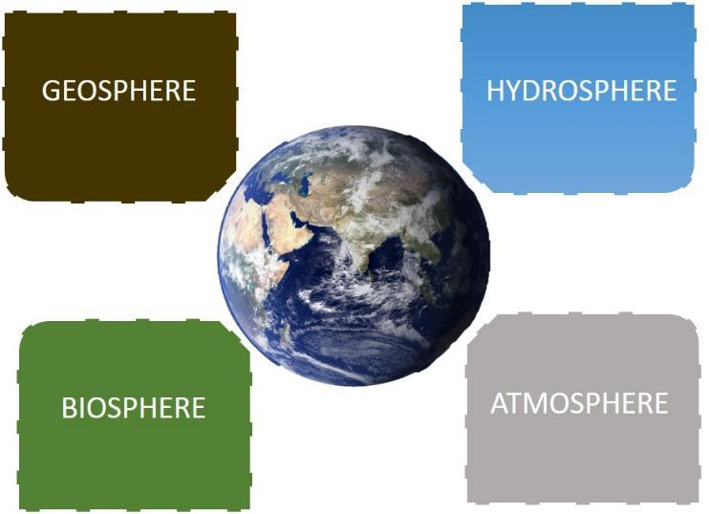
LS 01: Introducing the Four Spheres
The curricular materials will refer to four different “spheres” that can be used to describe the Earth. This is one way to visualize them, but you should create your own in the classroom. It would be helpful to have a poster of this available to students going forward, or to keep a version of it on your board for constant reference. You will be asking the students to sort their observations into these four categories very soon, and again and again as you move through this year.
There are a couple of points at which you can introduce this representation to students. We’ve outlined a clear point in this learning segment when we see that Earth is different in having water, an atmosphere and life. You can also wait to introduce it in the next learning segment as an emergent representation for organizing the questions students offer (leading up to development of the Driving Question).
Notes:
Slide is not meant for students.
SOURCES:
Image, ”Planet Earth 87651”
URL: https://www.pexels.com/photo/planet-earth-87651/
Attribution: None required. [https://www.pexels.com/photo-license/]

Slide 9
LS 01: Earth Science for Biologists
As you move through the earth science focused units in MBER-Living Earth, you may encounter some discussions where your own content knowledge as a biologist is challenged. In this learning segment, students may begin to ask some big questions. Is there evidence for past water on Venus or Mars? Why do some astrobiologists insist we should be looking for signs of past or even present lifeforms in our exploration of Mars? Do not feel that you need to be an immediate expert on any of these subjects. Your willingness to not know and try to find out can be a real opportunity to inspire your students to do the same—something that is critical to their own sensemaking process. Do be certain to prepare for these “moments of not knowing” in a manner that makes you feel relatively at ease. Throughout these curricular resources, we will try to point you (and your students) to outside resources that can help to bolster your earth science content knowledge.
One recommended resource that some of us on the curriculum design team who are less versed in earth science have found useful is The Story of Earth: The First 4.5 Billion Years, from Stardust to Living Planet by Robert Hazen. Despite the byline in the title (i.e. 4.5 billion years), it’s actually a rather quick read when tackled chapter by chapter. Even a single read-through of the book will help to boost your “big picture” content knowledge in the earth science aspects of this curriculum.
Grammatical note: The word “earth” should be capitalized when referring to the planet, especially when in direct comparison to other planets (just as we capitalize “Mars” or “Neptune”). However, when referred to as the planet we live on, or in that context, the capitalization is relaxed and often inconsistent. Therefore, you will see our planet referred to as both “Earth” and “earth” throughout the curriculum.
Notes:
Slide is not meant for students.
SOURCES:
Image, ”Planet Earth 87651”
URL: https://www.pexels.com/photo/planet-earth-87651/
Attribution: None required. [https://www.pexels.com/photo-license/]

Slide 10
Describing the Earth
Each person will get a new doodle sheet (Doodle Sheet: Earth).
For this first part, you will be writing in Box A of the doodle sheet.
I will show you 4 different pictures of the earth taken from space.
For each picture, please describe what you see. You can make a bulleted list, or use sentences, it is up to you.
I will give you about 1 minute to write out what you see, and then I will go to the next picture.
Each time, just keep adding notes in Box A.
The first picture shows all of the Earth, and the other three pictures are zoomed-in sections of the original picture.
Any questions? Are you ready?
Notes:
TEACHER NOTES:
Students start the unit by examining pictures of the Earth using this structured protocol. Modify as needed.
The end goal is for students to have a list of features unique to Earth by the end of this learning segment, but the immediate focus here is on noticing (noticing things like water, life, mountains, clouds, etc. Even if they just start with color, that would be a good discussion starting point).

Slide 11
Describe what you see—
Quietly write in Box A of the Doodle Sheet.
Notes:
TEACHER NOTES:
Tell students to begin with the obvious things (water, clouds, land, different colors) if they are struggling. This is a practice in observation and some kids may not know what to do. It might help to ask them, “What would you describe if someone couldn’t see the picture themselves?”
SOURCES:
Image, ”Planet Earth 87651”
URL: https://www.pexels.com/photo/planet-earth-87651/
Attribution: None required. [https://www.pexels.com/photo-license/]

Slide 12
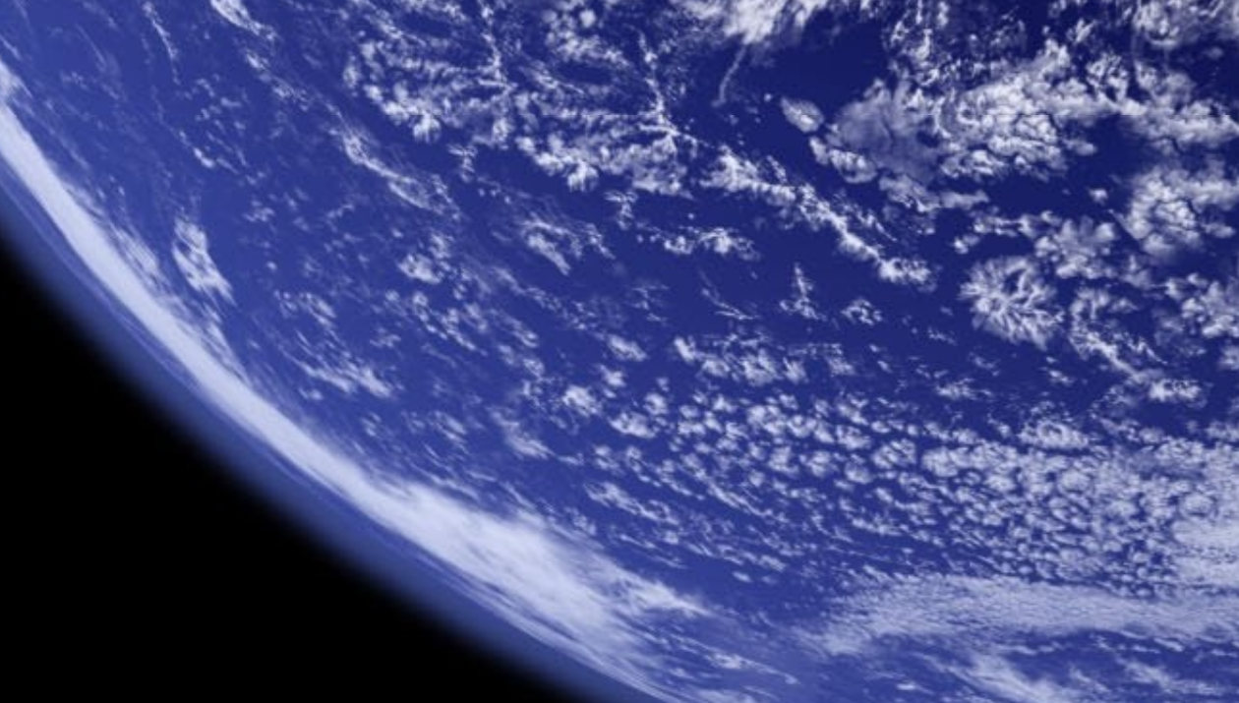
Earth: Describe what you see…
Notes:
TEACHER NOTES:
The focus here could be just how much water we have, and the global presence of clouds.
SOURCES:
Image, ”Planet Earth 87651”
URL: https://www.pexels.com/photo/planet-earth-87651/
Attribution: None required. [https://www.pexels.com/photo-license/]

Slide 13
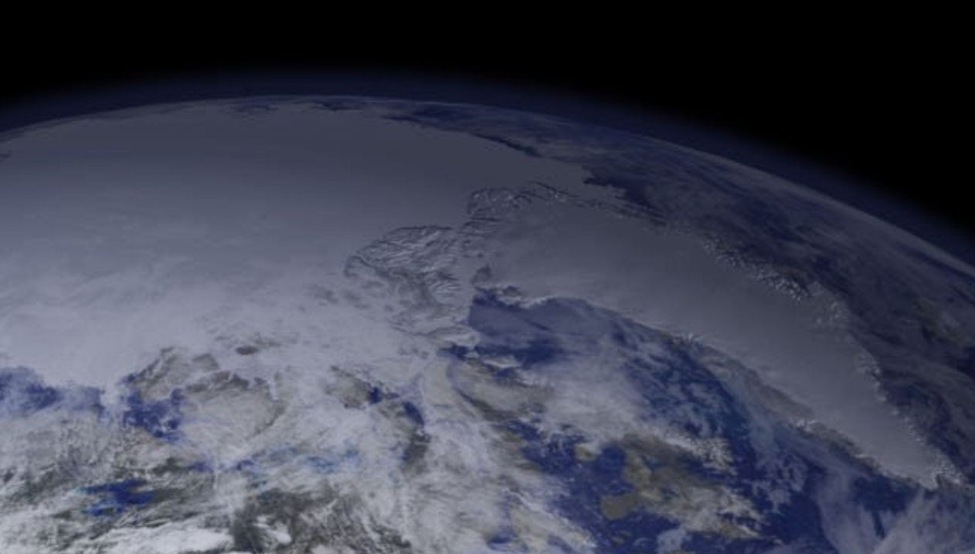
Earth: Describe what you see…
Notes:
TEACHER NOTES:
The focus here is, again, clouds and water, but also the presence of ice. (Greenland and the Arctic Ocean can be seen covered in ice.)
SOURCES:
Image, ”Planet Earth 87651”
URL: https://www.pexels.com/photo/planet-earth-87651/
Attribution: None required. [https://www.pexels.com/photo-license/]

Slide 14
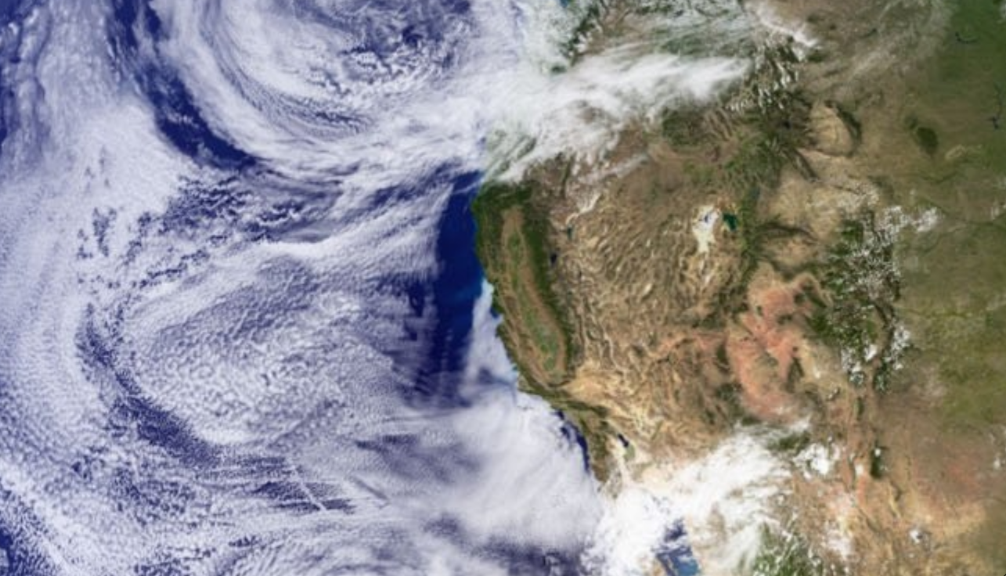
Earth: Describe what you see…
Notes:
TEACHER NOTES:
Now we finally need clouds and land interacting, and on the land, vegetation in addition to rock/dirt. (This is a closer image of the west coast of North America.)
SOURCES:
Image, ”Planet Earth 87651”
URL: https://www.pexels.com/photo/planet-earth-87651/
Attribution: None required. [https://www.pexels.com/photo-license/]

Slide 15
Earth—What did you notice?
Let’s share what we wrote in small workgroups.
Notes:
TEACHER NOTES:
As needed, remind the class of the norms you’ve all committed to, including the fact that we need to hear all ideas in order to come up with a good list. People notice different things during observation, so the more people we hear from, the better in science. The small group protocol follows on the next slide.

Slide 16
Group Talk—Discussion Protocol: Microphone
One person will share what they wrote in doodle Box A to the group. Everyone needs to listen respectfully.
Next, the same person will ask the group if anyone has any questions about what they just described.
The person should pause and make eye contact with each person in the group to make sure anyone with a question has a chance to ask it.
Then continue to the next person in the group, and repeat steps 1-3 until everyone has shared what they wrote.
As you are listening, think to yourself, “Did I see that same thing?”
If the other person described something that you didn’t see, and/or you are not sure what they are talking about, ask them to clarify when they ask if you have any questions.
Each group should be prepared to summarize what they agree they saw in the pictures to the class.
Notes:
TEACHER NOTES:
After every 1-2 minutes, the teacher should remind the class to switch to the next person. If students want to add to their Box A (with what others saw), tell they can do so once everyone has shared. Give students 2-3 minutes to discuss their summary and nominate a “reporter”. If your kids are fast, move things along. But be certain to reinforce class norms.

Slide 17
Share Out
Each group should share ONE thing they saw in the pictures.
I will try to capture what you share, so give me a moment to write it out before we go to the next group.
Try not to repeat what a previous group shared—pick something different.
We will go around a couple of times to get all the big things out.
Notes:
TEACHER NOTES:
As needed, help students to notice that earth: has liquid water oceans, has solid water ice caps, has land, has an atmosphere (with clouds), and (what is that green stuff?) living things. Also, this is probably the time to introduce the idea of spheres of earth which connect and interact (see previous Teacher Slides for one way to visualize):
*geosphere—the land, the continents, the sea floor beneath the oceans—essentially the rocks and minerals the compose the earth.
*atmosphere—the layer of gases surrounding the earth.
*hydrosphere—the water on earth’s surface: the oceans, lakes, ice, glaciers, etc.
*biosphere—all the living things on earth.
(Sometimes humans, their activity and products are separated from this biosphere. You might call it the anthrosphere. But it won’t likely come up in this activity.)
If bringing up the idea of the four spheres doesn’t seem to fit here, there will be another opportunity directly following students comparisons between Earth and other objects in the inner solar system.

Slide 18
Now that we have a good description of Earth’s features…
Notes:
TEACHER NOTES:
The next step is to recognize that Earth is unique in many ways when compared to the other planets in our solar system (and we’ll focus on the more similar inner or “terrestrial” solar system—Mercury, Venus, Mars… and our Moon).
Here is our bridge to looking at other bodies in the solar system. Students might already have a good sense of the other inner planets, but don’t assume anything. You could open the discussion with questions like, “OK, so we see that Earth has these four spheres (or some other language if you’ve yet to introduce the spheres), but are we the only ones with them? What do we know about other nearby planets?”. Students will probably be familiar with news about whether or not water has been on Mars, for example, or the search for life. It’s very easy for students to go down a rabbit hole if you bring up extraterrestrial life- if you have time, you can entertain those discussions because they do increase buy-in, but be wary of time- it could go on for a long time.

Slide 19
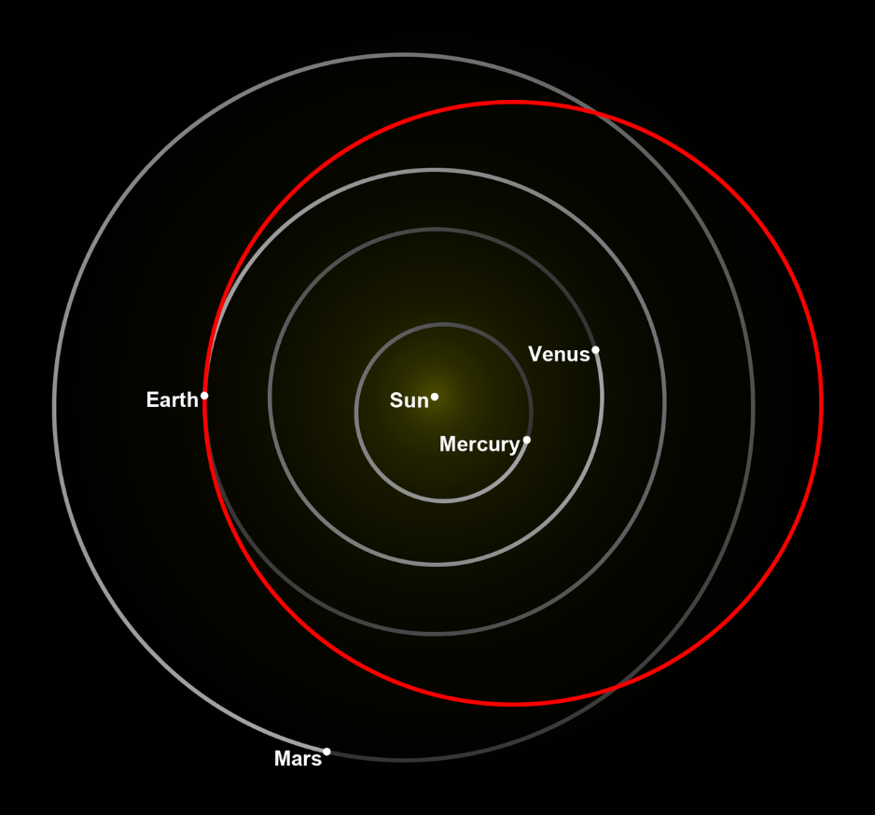
How does Earth compare with other nearby objects in the solar system?
Earth
Notes:
TEACHER NOTES:
Let the class know / remind them that we’re only going to talk about the inner planets because the others are gaseous, so they will be part of a later discussion. For now, we just focus on our nearest rocky neighbors, the Moon included. Most students will be familiar with this kind of depiction of the planetary orbits, but do check for understanding as you see the need.
If your students seem less familiar with the planets in general, you might choose to pause here for an introduction to the solar system. Feel free to use the supplementary slides provided in “FE 01 Supplemental Planets and Moons Images” to develop a mini-lecture. Do NOT let it go beyond 5 to 10 minutes. The goal here is not to rehash their prior learning about the solar system. It is simply to contrast the inner planets with the outer ones to focus our attention on the inner solar system for comparison and contrast with the Earth.
SOURCES:
Image modified from, “Orbital diagram of Elon Musk's Tesla Roadster and the terrestrial planets.” [Roadster orbit removed, planetary orbits colored.]
URL: https://commons.wikimedia.org/wiki/File:Tesla_Roadster_orbital_diagram.png
Attribution: nagualdesign [Public domain] via Wikimedia Commons (CC0)

Slide 20
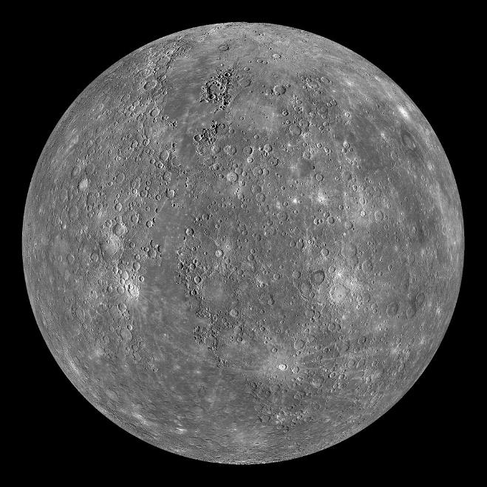
Earth
Some groups will compare:
Mercury
Notes:
TEACHER NOTES:
We’ve set this up so that you should have groups of four working on a single comparison (e.g. Earth vs. Mercury). In most classes, this means you’ll have two Earth vs. Mercury, two Earth vs. Venus, two Earth vs. the Moon, and two Earth vs. Mars groups (for a class of 32). Adjust the logistics according to your class needs and size.
SOURCES:
Image, ”Planet Earth 87651”
URL: https://www.pexels.com/photo/planet-earth-87651/
Attribution: None required. [https://www.pexels.com/photo-license/]
Image, “This image shows an orthographic projection of this global mosaic centered at 0°N, 0°E. The rayed crater Debussy can be seen towards the bottom of the globe and the peak-ring basin Rachmaninoff can be seen towards the eastern edge.”
URL: https://commons.wikimedia.org/wiki/File:Mercury_Globe-MESSENGER_mosaic_centered_at_0degN-0degE.jpg
Attribution: NASA/JHUAPL [Public domain]

Slide 21
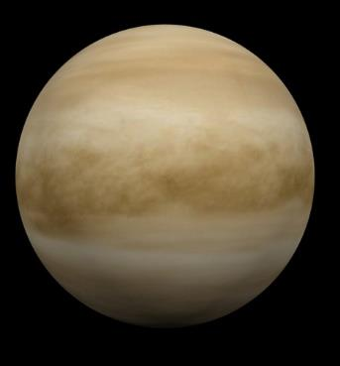
Earth
Other groups will compare:
Venus
Notes:
TEACHER NOTES:
We’ve set this up so that you should have groups of four working on a single comparison (e.g. Earth vs. Mercury). In most classes, this means you’ll have two Earth vs. Mercury, two Earth vs. Venus, two Earth vs. the Moon, and two Earth vs. Mars groups (for a class of 32). Adjust the logistics according to your class needs and size.
SOURCES:
Image, ”Planet Earth 87651”
URL: https://www.pexels.com/photo/planet-earth-87651/
Attribution: None required. [https://www.pexels.com/photo-license/]
Image modified from, “This diagram shows the approximate relative sizes of the terrestrial planets, from left to right: Mercury, Venus, Earth and Mars. Distances are not to scale.”
URL: https://commons.wikimedia.org/wiki/File:Terrestrial_planet_size_comparisons.jpg
Attribution: Wikipedia user Brian0918 [Public domain]

Slide 22
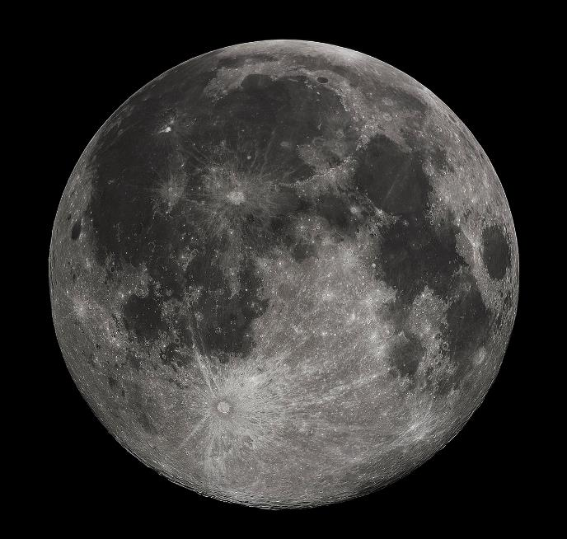
Earth
Other groups will compare:
Moon
Notes:
TEACHER NOTES:
We’ve set this up so that you should have groups of four working on a single comparison (e.g. Earth vs. Mercury). In most classes, this means you’ll have two Earth vs. Mercury, two Earth vs. Venus, two Earth vs. the Moon, and two Earth vs. Mars groups (for a class of 32). Adjust the logistics according to your class needs and size.
SOURCES:
Image, ”Planet Earth 87651”
URL: https://www.pexels.com/photo/planet-earth-87651/
Attribution: None required. [https://www.pexels.com/photo-license/]
Image, ”Full Moon photograph taken 10-22-2010 from Madison, Alabama, USA.”
URL: https://commons.wikimedia.org/wiki/File:FullMoon2010.jpg
Attribution: Gregory H. Revera [CC BY-SA (https://creativecommons.org/licenses/by-sa/3.0)]

Slide 23
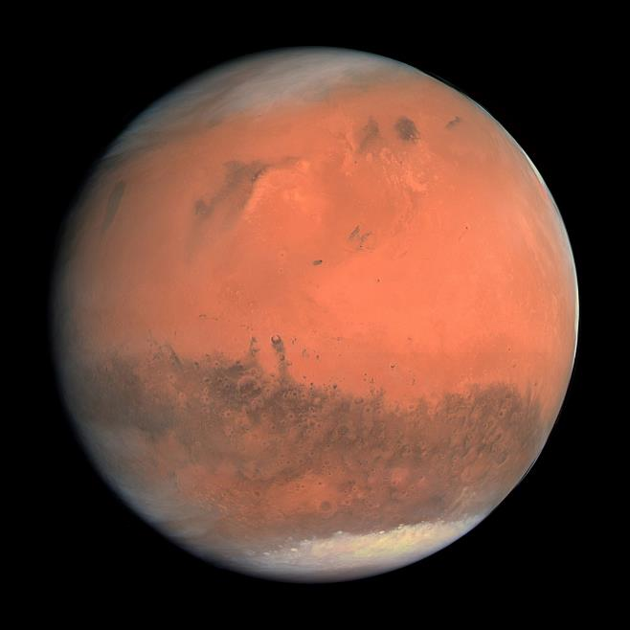
Earth
And finally a couple of groups will compare:
Mars
Notes:
TEACHER NOTES:
We’ve set this up so that you should have groups of four working on a single comparison (e.g. Earth vs. Mercury). In most classes, this means you’ll have two Earth vs. Mercury, two Earth vs. Venus, two Earth vs. the Moon, and two Earth vs. Mars groups (for a class of 32). Adjust the logistics according to your class needs and size.
SOURCES:
Image, ”Planet Earth 87651”
URL: https://www.pexels.com/photo/planet-earth-87651/
Attribution: None required. [https://www.pexels.com/photo-license/]
Image, “The true color image of Planet Mars, shot by Rosetta in February 2007”
URL: https://commons.wikimedia.org/wiki/File:OSIRIS_Mars_true_color.jpg
Attribution: ESA - European Space Agency &amp; Max-Planck Institute for Solar System Research for OSIRIS Team ESA/MPS/UPD/LAM/IAA/RSSD/INTA/UPM/DASP/IDA [CC BY-SA 3.0-IGO (https://creativecommons.org/licenses/by-sa/3.0-igo)]

Slide 24
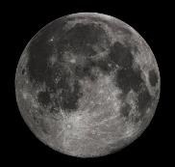
Keep in mind these objects are not all the same size as earth.
For example, earth’s diameter across the equator is 7926 miles.
The moon’s diameter is 2159 miles.
Notes:
TEACHER NOTES:
Images have been sized here to show relative size of the objects. This is an opportunity to attend to the NGSS Cross-Cutting Concept (CCC) about Scale (Scale, Proportion and Quantity).
SOURCES:
Image modified from, ”Planet Earth 87651”
URL: https://www.pexels.com/photo/planet-earth-87651/
Attribution: None required. [https://www.pexels.com/photo-license/]
Image modified from, ”Full Moon photograph taken 10-22-2010 from Madison, Alabama, USA.”
URL: https://commons.wikimedia.org/wiki/File:FullMoon2010.jpg
Attribution: Gregory H. Revera [CC BY-SA (https://creativecommons.org/licenses/by-sa/3.0)]

Slide 25
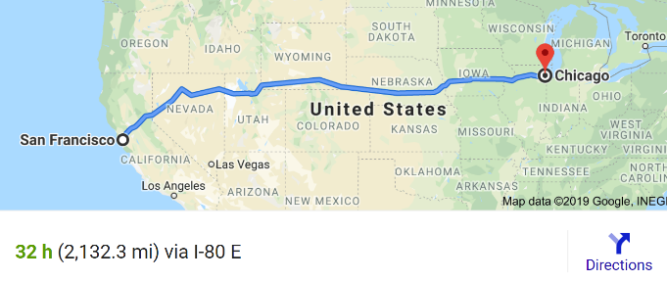
The moon’s diameter is 2159 miles.
That is about the driving distance (along earth’s curved surface) from San Francisco to Chicago.
https://en.wikipedia.org/wiki/File:FullMoon2010.jpg
Notes:
TEACHER NOTES:
Here we use a more relatable distance to help students understand the dimensions of the moon. This is a recurring issue that will need attention as we address both small-scale and large-scale phenomena. How can kids (and adults) wrap their brains around large distances, etc.? Scale, incidentally, is one of the NGSS Cross Cutting Concepts. Note: Mercury is also significantly smaller than Earth (~ 38% the size of us), Mars is about 50% our size, but Venus is nearly identical in size.
SOURCES:
Image, ”Full Moon photograph taken 10-22-2010 from Madison, Alabama, USA.”
URL: https://commons.wikimedia.org/wiki/File:FullMoon2010.jpg
Attribution: Gregory H. Revera [CC BY-SA (https://creativecommons.org/licenses/by-sa/3.0)]

Slide 26
Comparing Pictures of the Inner Planets & Moon
First, record the planet/moon you were assigned in doodle sheet Box B. Then…
Compare the pictures of earth and the planet/moon you were assigned. Fill in the table in doodle sheet Box C.
→ Make sure to leave some room at the bottom of the box—try to stay in the top half of the box if possible: we will be adding more to it later.
Notes:
TEACHER NOTES:
Handout the various pics of the comparison planets/The Moon (e.g. FE 01 Venus Images). One color handout per pair is best rather than per table so that students can take a close look at the images. (You can preserve color copies in sheet protectors as a class set.) Students will need a few minutes to individually take notes, not similarities and differences between the images they are seeing and what they know the surface of the Earth to look like. Wander so that you can assess the necessary timing. This is a chance to push kids to make observations and ask some questions, but if the energy is slowing, move things along.
Next their group will be given data on their focal planet in order to supplement the comparison with Earth.

Slide 27
Comparing Data on the Inner Planets & Moon
You will be given a data table comparing Earth to a planet or moon.
Each of you will be responsible for a understanding and explaining part of the data table.
There are 14 rows, so…
Notes:
TEACHER NOTES:
Students working in groups will be given a rather dense data table that compares various measurements/characterizations between Earth and their focal planet/The Moon.
Hand out the comparison sheets (e.g. FE 01 Venus Vs Earth Data Table)—one per student, but refrain from handing out the summary table of all planets. Groups should still be working only on characterizing their focal planet and comparing it to the Earth. (Soon we will mix groups so that cross-planetary data can be shared.)

Slide 28
Comparing Data on the Inner Planets & Moon
Working in Groups:
If you are in a group of 3 people:
The youngest person at the table is responsible for rows 1-4.
The 2nd youngest person is responsible for rows 5-9.
The oldest person is responsible for rows 10-14.
If you are in a group of 4 people:
The youngest person at the table is responsible for rows 1-3
Th 2nd youngest person is responsible for rows 4-6
The 3rd youngest person is responsible for rows 7-10.
The oldest person is responsible for rows 11-14.
Take a moment to mark YOUR rows.
You have one minute to figure this out, then wait for instructions.
Notes:
TEACHER NOTES:
This is one way to divide the work. Feel free to use your own method.
Reviewing the different rows could help bolster conversations, especially if your students don’t seem familiar with planets in general. Clarifying vocabulary and terms will help facilitate conversations in a few minutes.

Slide 29
Comparing Data on the Inner Planets & Moon
TASK: Quietly read the rows you were assigned.
Then write a summary of those rows (your data) in Doodle box D.
Be prepared to share your summary.
You have about 4 minutes!
Working in Groups:
If you are in a group of 3 people:
The youngest person at the table is responsible for rows 1-4.
The 2nd youngest person is responsible for rows 5-9.
The oldest person is responsible for rows 10-14.
If you are in a group of 4 people:
The youngest person at the table is responsible for rows 1-3
Th 2nd youngest person is responsible for rows 4-6
The 3rd youngest person is responsible for rows 7-10.
The oldest person is responsible for rows 11-14.
Take a moment to mark YOUR rows.
You have one minute to figure this out, then wait for instructions.
Notes:
TEACHER NOTES:
Reviewing the different rows could help bolster conversations, especially if your students don’t seem familiar with planets in general. Clarifying vocabulary and terms will help facilitate conversations in a few minutes.
Have students work to summarize their rows of data in Doodle D. Use a reading protocol if your students need more scaffolding here.

Slide 30
Comparing Data on the Inner Planets & Moon
Share your summary of the rows you were assigned with your group:
Start with the youngest person (first row) and work down the data table.
Each person will have about 1 minute to share their summary.
Any questions?
GO!
Notes:
TEACHER NOTES:
Consider giving students a structured dialog protocol here. You may choose to keep reinforcing one that you and the students are practicing. Or you might want to switch it up. See the MBER Essentials on the website for ideas (e.g. Talking Sticks).

Slide 31
Comparing Data on the Inner Planets & Moon
You now have a lot more information, so…
Go back to Doodle Box C, and add more items in each column. Work as a group and help each other.
You have about 5 minutes.
Important: each person should be prepared to share your group’s answers to doodle Box C. Each of you will be going to a new/different group soon. You will be the expert on the planet or moon you were assigned.
Notes:
TEACHER NOTES:
Students may have difficulty summarizing their ideas here. Let them work and wander the room to assess how they are doing with the data. The point of these readings and of the summarization activity is not to have students memorize all of the facts. Rather, we’d like them to practice organizing some complex information in a way that they’ll be able to present to other students comfortably in a small group environment. For students who are struggling or who may be nervous, help reassure them that they only need to share a few key ideas with their classmates. Have them focus on what they think might be unique about the planet they compared with the Earth.

Slide 32
Mix it up!
We’re going to form new, mixed groups for sharing.
You will be placed in a new group of 3-5 people.
Each group should have a representative for:
Mercury vs. Earth
Venus vs. Earth
Moon vs. Earth
Mars vs. Earth
Notes:
TEACHER NOTES:
You want mixed groups to share information about their planet in a structured way. Facilitate formation of the groups in any manner you see fit. You could also substitute a gallery walk here if you feel the constant movement will help your class. Be sure, however, to structure the protocol and to have students take notes on their Doodle Sheet, otherwise it will be too easy for the transfer of information to become passive.

Slide 33
In the new mixed groups…
Each person will share their list from Doodle Box C.
Share Out in the order from the sun:
Mercury vs. Earth
Venus vs. Earth
Moon vs. Earth
Mars vs. Earth
If there are 2 people with the same planet/moon,
they should each share about half of what they captured in Doodle Box C.
We have about 4 minutes for this, so each person will have about 1 minute to talk.
Notes:
TEACHER NOTES:
Again choose a dialog protocol here as you see fit. Keep things moving and active for your students.

Slide 34
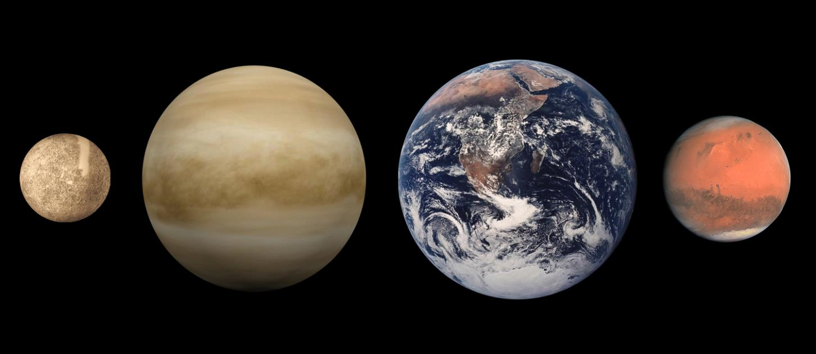
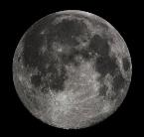
Discuss with your new group—then write your answer in Doodle Box E: When you compare the Earth to the moon and other nearby planets, what makes Earth unique? In other words, what characteristics are only found on Earth? (4 minutes)
Mercury
Venus
Earth
Mars
Note:
The diameters/sizes are to scale.
The distances between the objects is NOT to scale.
Moon
If there are characteristics you aren’t sure are unique, place them in the center box in Doodle E. We’ll talk about it in a few minutes.
Notes:
TEACHER NOTES:
Wander the room as your students work in groups on Doodle Box E, a Venn diagram of characteristics of the Earth and other inner planets. You may have to review how to use a Venn diagram- they can be a little confusing!
There may be a number of characteristics they are convinced are unique to the Earth and others where they are less sure. You’ll want to anticipate some of what might be shared out in a minute so a fairly thorough assessment of the room is recommended here.
Note: This is the only image where Mercury is depicted as brown rather than gray. It may be colorized to distinguish it from The Moon, but as noted on the Mercury images shown earlier in class, Mercury is actually a gray color.
SOURCES:
Image, “This diagram shows the approximate relative sizes of the terrestrial planets, from left to right: Mercury, Venus, Earth and Mars. Distances are not to scale.”
URL: https://commons.wikimedia.org/wiki/File:Terrestrial_planet_size_comparisons.jpg
Attribution: Wikipedia user Brian0918 [Public domain]

Slide 35
What makes Earth unique?
Share out ONE unique characteristic of earth per group.
(These are the ideas that you’ve described in the left portion of Doodle Box E.)
Mercury
Venus
Earth
Mars
Note:
The diameters/sizes are to scale.
The distances between the objects is NOT to scale.
Moon
Notes:
TEACHER NOTES:
You’ll use this discussion and/or the next three slides in conjunction to introduce your representation of the “spheres” (if you haven’t already introduced it).
Allow each group to share one characteristic in turn. Your list might be relatively short. Based on what students were writing in the “both” column in Box E, you might have them start to share ideas they are less certain about in a second list. Get as many ideas out here as you can. Students have been working hard to make these observations and comparisons over the class period.
The multiple spheres…
As students share, some words such as “atmosphere” may arise for the first time in front of the whole class. Pause to check in with students to see if they are all familiar with the vocabulary being used by their peers.
Introducing the “Spheres” Representation:
When you’ve finished writing these lists (and especially after you have reviewed the next three slides on “Big Differences”) it might be a good time to introduce your representation of the “spheres”: hydrosphere, atmosphere, biosphere, and geosphere (which is a commonality instead of a Big Difference and can wait to be introduced in the next learning segment). As you introduce the representation, let students know that you’ll be referring back to it throughout the year. We feel the easiest way to “organically” introduce the spheres vocabulary is to use the next three slides that cover the “Big Differences” to generate them—hydrosphere, atmosphere, biosphere. The geosphere can either be offered by you to complete the representation, or it can be recognized in the next learning segment when discussing commonalities/similarities.
Once you’ve introduced the spheres, you can work with your students to map your lists of characteristics and your questions about unique features of earth onto the representation.
SOURCES:
Image, “This diagram shows the approximate relative sizes of the terrestrial planets, from left to right: Mercury, Venus, Earth and Mars. Distances are not to scale.”
URL: https://commons.wikimedia.org/wiki/File:Terrestrial_planet_size_comparisons.jpg
Attribution: Wikipedia user Brian0918 [Public domain]

Slide 36
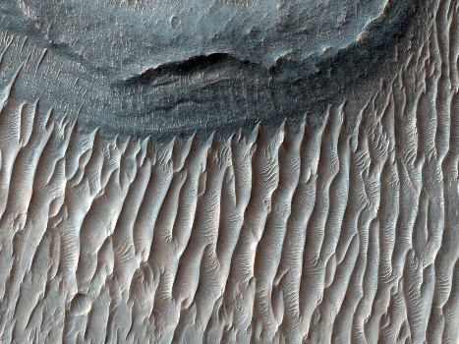
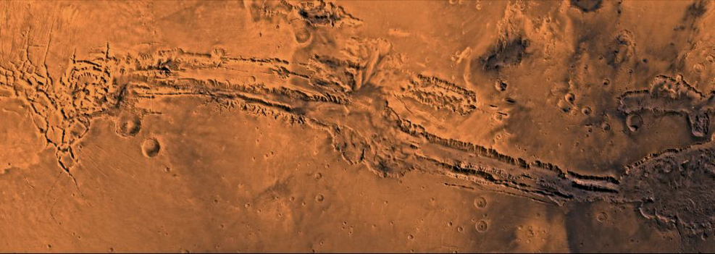
Big Differences…
Add your thoughts to Doodle Box F.
Water covers a lot of the Earth.
Could there be water elsewhere?
Do you think there was once water on any other planets? Discuss with your group (3 minutes).
Notes:
TEACHER NOTES:
This slide engages students in thinking about Earth’s unique hydrosphere. You could ask students what they think these images show and how that might indicate water. Both are images of Mars (see source info below and follow links for more information). Though some student might see the ripples in the image on the left as evidence of water, they are actually dunes that have been created through wind action rather than water. It is rather, the canyons pictured in each image that are pretty good evidence for liquid water on Mars at one point in its history. Currently the only surface water we see is in Mars’s polar icecaps. Show students your image an image of Mars to remind them of this fact ask for student’s who studied Mars earlier to offer their ideas about water on Mars. (Hopefully they say “Mars has ice!”)
The goal of the next series of conversations is to really delineate the things that make the Earth both unique and not unique. It is much easier for the students to see the differences (Earth has water and life, most obviously) than the commonalities. Eventually, though (in the next learning segment), we’ll want to recognize commonalities so that we can develop a driving question for this unit.
These slides are designed to engage students in looking at evidence that they likely haven’t seen before. We have put some discussion questions on the slide that you can have groups discuss, but you might have to hand-feed them some of these data if they don’t have any prior knowledge about other planets. For example, you might need to have these two images up on the screen while they’re discussing if they seem to be at a dead end. For example, the image on the right is clearly a canyon. If students aren’t making that connection, the question “What would Earth look like if we drained all of the water out of it?” might be an interesting thread to follow. Similarly, ripples are something we *generally* see in water, though students might make the connection to sand dunes and would then need some re-direction.
Once the class has had a discussion, have them record some of the important ideas and questions you’ve generated together on the doodle sheet in Box F.
There are also MANY images of water features on Mars that could be used to bolster the evidence to show them if needed.
SOURCES:
Image, “The Red Planet is home to Valles Marineris, the solar system's largest canyon. Within this canyon lies Ius Chasma. This image, which spans the floor of its southern trench, was taken by the Mars Reconnaissance Orbiter. The canyon is well-known for its fine stratigraphic layers modified by wind and water.”
URL: https://commons.wikimedia.org/wiki/File:Ius_Chasma,_Valles_Marineris,_Mars.jpg
Attribution: NASA/JPL-Caltech/Univ. of Arizona [Public domain]
Image, “Valles Marineris is a vast canyon system that runs along the Martian equator. At 4,500 km long, 200 km wide and 11 km deep, the Valles Marineris rift system is ten times longer, seven times wider and seven times deeper than the Grand Canyon of Arizona, making it the largest known crevice in the solar system.”
URL: https://commons.wikimedia.org/wiki/File:VallesMarinerisHuge.jpg
Attribution: Courtesy NASA/JPL-Caltech [Attribution]

Slide 37
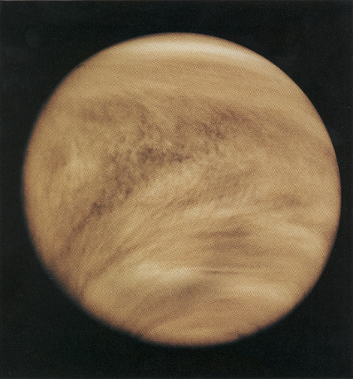
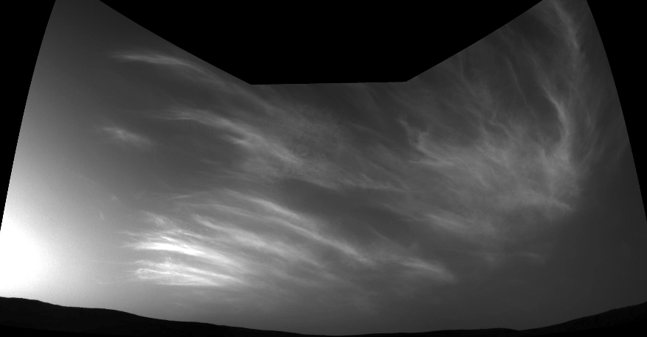
Big Differences…
Add your thoughts to Doodle Box F.
Earth is covered in clouds.
Could there be water elsewhere?
Do other planets have clouds? Are they like our clouds? Discuss with your group (3 minutes).
Notes:
TEACHER NOTES:
This slide engages students in thinking about Earth’s unique atmosphere. Both Venus (shown here on the left) and Mars (image on the right taken from the surface) have clouds, The atmospheres of Venus, Earth and Mars, however, are very different. So, what makes our atmosphere unique? Or what do we think?
Have students revisit their doodle sheet to consider some of the similarities and differences as needed in order to offer their own ideas and questions about Earth’s atmosphere.
Image on the left is colorized ultraviolet image of Venus’s atmosphere (which is mostly CO₂ and N₂) as picked up by the Pioneer orbiter in 1979.
Image on the right is from the Curiosity rover on Mars, 2019. The clouds in this image are very likely similar to cirrus clouds on Earth, mostly composed of water-ice crystals!
Students don’t need to explore the composition of Venusian clouds necessarily (as there are lots of model ideas they might need—including the role of carbon dioxide in creating a greenhouse effect). So, don’t feel the need to lecture on the composition and history of the Venusian atmosphere. The focal phenomenon here is that Venus has clouds… and this implies an atmosphere. It might also imply water to your students if they connect clouds to oceans and the water cycle.
We still don’t understand some aspects of Venusian clouds, including why the ultraviolet images produce the features seen in the image above. Robert Hazen’s book (mentioned in the teacher slides at the beginning of this learning segment) has a nice description of the Venusian atmosphere and its likely origin in the very first chapter (p. 24 in the section titled, “Rocky Worlds”). The description is short, but you can find more extensive information at the Wikipedia Article for the Atmosphere of Venus: https://en.wikipedia.org/wiki/Atmosphere_of_Venus.
Here’s an excerpt:
“The atmosphere of Venus is the layer of gases surrounding Venus. It is composed primarily of carbon dioxide and is much denser and hotter than that of Earth. The temperature at the surface is 740 K (467 °C, 872 °F), and the pressure is 93 bar (9.3 MPa), roughly the pressure found 900 m (3,000 ft) underwater on Earth. The Venusian atmosphere supports opaque clouds made of sulfuric acid, making optical Earth-based and orbital observation of the surface impossible. Information about the topography has been obtained exclusively by radar imaging. Aside from carbon dioxide, the other main component is nitrogen. Other chemical compounds are present only in trace amounts.
Martian clouds are better studied at this point, though somewhat complex.
Check the Atmosphere of Mars Wikipedia page:
NASA’s page (from which the photo was copied) describes the above image as follows:
“NASA's Curiosity Mars rover imaged these drifting clouds on May 17, 2019, the 2,410th Martian day, or sol, of the mission, using its black-and-white Navigation Cameras (Navcams).
These are likely water-ice clouds about 19 miles (31 kilometers) above the surface. They are also ‘noctilucent’ clouds, meaning they are so high that they are still illuminated by the Sun, even when it's night at Mars' surface. Scientists can watch when light leaves the clouds and use this information to infer their altitude.”
SOURCES:
Image, ” Ultraviolet image of Venus' clouds as seen by the Pioneer Venus Orbiter (February 26, 1979). The immense C- or Y-shaped features which are visible only in these wavelengths are individually short lived, but reform often enough to be considered a permanent feature of Venus' clouds. The mechanism by which Venus' clouds absorb ultraviolet is not well understood.”
URL: https://commons.wikimedia.org/wiki/File:Venuspioneeruv.jpg
Attribution: NASA [Public domain]
Image, “Curiosity's Three-Frame Mosaic of Clouds”
URL: https://www.jpl.nasa.gov/spaceimages/details.php?id=PIA23243
Attribution: NASA/JPL [Public domain]

Slide 38
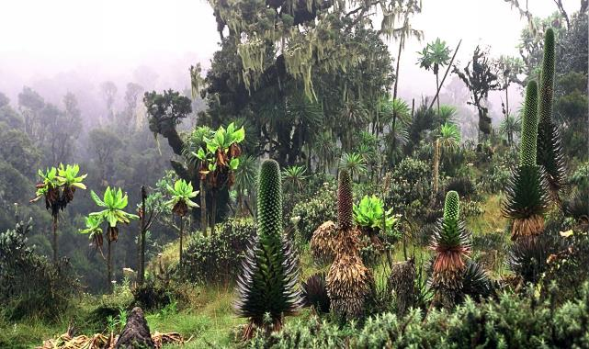
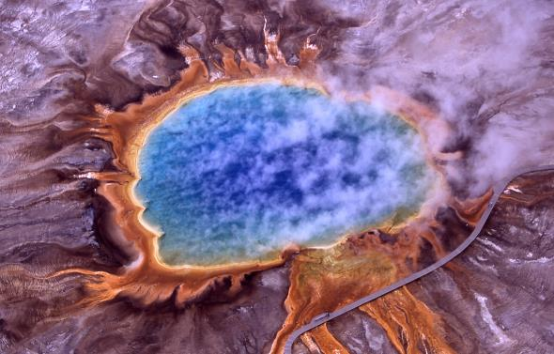
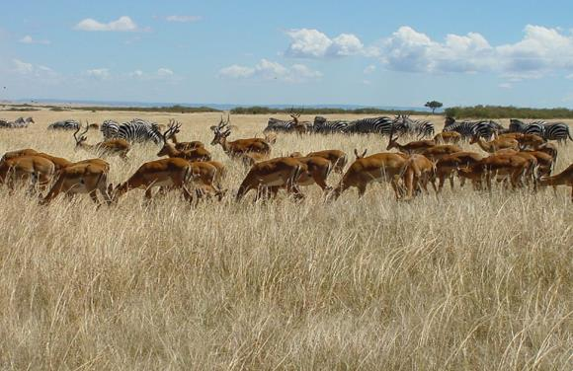
Big Differences…
Add your thoughts to Doodle Box F.
Life!
What do we know about life on other planets?
Do other planets have life? Of any kind?
Discuss with your group (3 minutes).
Notes:
TEACHER NOTES:
This slide engages students in thinking about Earth’s unique biosphere.
Wrap up your introduction of at least three of the sphere’s with this slide and consider mapping student observations/ideas and questions onto your budding representation. We’ll next be moving on to considering questions we have.
We are less certain about the possible existence of living organisms on other planets and in our solar system these days, but there is no direct evidence that life exists elsewhere now or has in the past. This, however, is a great way to generate conversation about what we know and don’t know. Don’t feel the need to be an expert and be willing to place student questions about life elsewhere in the solar system in the Parking Lot.
The middle image on the slide does in fact represent life. Your students may be surprised, so look over the description in these presenter notes below in order to familiarize yourself with how the hot pools in Yellowstone are teeming with life.
SOURCES:
Image, “Plants in the Bujuku Valley, Rwenzori Mountains National Park, in the Ruwenzori Mountains at about 3,700 metres (12,100 ft) altitude, SW Uganda. Center rear - a high Erica tree hung with lichen; left side - short "trees" with bright green leaves are Dendrosenecio adnivalis; and also Lobelia in front of straw flowers.”
URL: https://commons.wikimedia.org/wiki/File:Ruwenpflanzen.jpg
Attribution: Manuel Werner [CC BY-SA (https://creativecommons.org/licenses/by-sa/2.5)]
Image, “Herds of zebra and impala gathering on Masai Mara plain”
URL: https://commons.wikimedia.org/wiki/File:Herds_Maasai_Mara.JPG
Attribution: Roomtorun [CC BY-SA (https://creativecommons.org/licenses/by-sa/2.5)]
Image, “Aerial view of Grand Prismatic Spring; Hot Springs, Midway & Lower Geyser Basin, Yellowstone National Park. The spring is approximately 250 by 300 feet (75 by 91 m) in size. This photo shows steam rising from hot and sterile deep azure blue water (owing to the light absorbing overtone of an OH stretch which is shifted to 698 nm by hydrogen bonding) in the center surrounded by huge mats of brilliant orange algae, bacteria and archaea. The color of which is due to the ratio of chlorophyll to carotenoid molecules produced by the organisms. During summertime the chlorophyll content of the organisms is low and thus the mats appear orange, red, or yellow. However during the winter, the mats are usually dark green, because sunlight is more scarce and the microbes produce more chlorophyll to compensate, thereby masking the carotenoid colors.”
URL: https://commons.wikimedia.org/wiki/File:Grand_prismatic_spring.jpg
Attribution: Jim Peaco, National Park Service [Public domain]

Slide 39
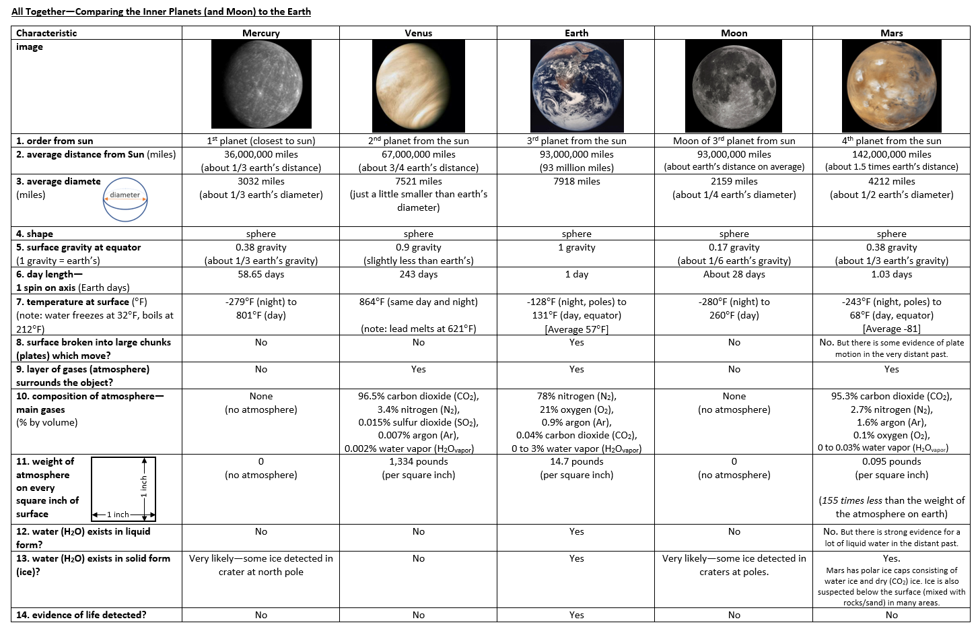
You will get a new handout for reference.
Notes:
TEACHER NOTES:
Optional slide. Optional resource.
Hand out the resource “FE 01 Optional Supplement - Inner Solar System Reference Sheet”.
Students may use this later. If you’re resource rich, it would be worth laminating these so that students can make notes on them later, but that’s not necessary by any means.
SOURCES:
Image, courtesy of MBER-Bio, represents photos already credited elsewhere in these materials.

Slide 40
LS 01: Learning Segment Summary
What we’ve figured out…
We’ve identified some ways in which the Earth is unique, and some ways in which it resembles neighboring planets. This sets us up to generate questions and to leverage our ideas about commonalities to develop a Driving Question.
LS 01 Teacher Reflection:
What I think worked well…
What I would change…
Notes:
Slide is not meant for students.

Slide 41
LS 02: Learning Segment Overview
We compile the questions we have. Instead of settling immediately on a broad Driving Question about the formation of the Earth, we engage in a short discussion about the commonalities among the inner planets (including Earth). We then decide to begin our exploration of an overall question about the formation of Earth by first focusing on the geosphere. How did Earth’s rocky structure (the “geosphere”) form?
30-55 minutes
Resources you will need:
FE Doodle Sheet
Cards or papers for collecting student (group) questions.
Notes:
Slide is not meant for students.

Slide 42
LS 02: Driving Question – How did our unique Earth form?
In this segment, we begin by asking students to compile a series of questions they are wondering about. Some of the questions are likely to seem more productive than others, but we’ll help the class move in the direction of a logical first step. Questions that are fact-based (just need research attention) or that are beyond the scope of the unit should be posted to the Parking Lot for now. (See the website for a description of the Parking Lot and how to use it in your classroom.) As this unit is about formation of the Earth, we’d like to land on a driving question something like, “How did the earth form?” Basically, the first part of the model we build addresses the geosphere, so we’d like to steer the class in this direction first.
We’ll get to the focused driving question through a discussion about two features we can see that Earth has in common with all other planets of the inner solar system and with the Moon: (1) a rocky composition and (2) craters. Through the discussions, we prime students to recognize that a question leading us to explore the formation of the geosphere is a logical place to start. You may in fact choose to formally generate TWO driving questions. This is a perfectly good approach. Just be certain your students follow the logic, and as much as possible, that it is their logic driving the decision making (or at least check for buy-in).
Possible Initial Driving Question(s): How did earth get all of the unique features that we described in our list? Where did all of these features of earth come from? How did these various spheres (i.e. geosphere, biosphere, hydrosphere, atmosphere) of earth form?
Possible Focused Driving Question: How did the rocky Earth (the geosphere) come to be?

Slide 43
Questions— What are you wondering about?
What are you now wondering about? What questions do you have about our lists and the things we’ve noticed?
In Doodle Box G, quietly write a few of your questions (at least two).
(We’ll share them in groups in a minute.)
Notes:
TEACHER NOTES:
Start this slide by saying something like:
“We have looked at a lot of data, and we created a list of earth’s features, including what makes earth unique compared to other nearby planets.”
Recall that ultimately we are trying to get the class to a big question, “How did the Earth form?” with a focus in this unit on the formation of the geosphere. Though this question may already emerge from your students at this point, we do not expect that and have designed the coming slides focusing on commonalities and ensuing conversation to help move us coherently together in the direction of that bigger question.
You will find, however, that MBER regularly asks you as the teacher to make a rather crafted move from student questions to a coherent class Driving Question. The more you can partner with your students in making that move, the better. Invite your students to work together to see the pattern in the questions or the one fundamental question we as a class could ask in order to generally answer most of the questions that class is wondering about.

Slide 44
Questions— What are you wondering about?
Go around and discuss the questions in your group. Through consensus select your group’s top 3 questions.
Write your group’s top 3 questions on the three blank papers you are given (one question per paper—don’t write on the back). Rank them in order from 1-3. Make sure your names are on the back of each paper.
Bring them to me when you are ready to post them—I will try to categorize your questions.
Notes:
TEACHER NOTES:
You might choose to structure the group time with a dialog protocol such as talking sticks. (See the MBER website for more information on dialog protocols.)
If you have a representation of the spheres in your classroom, you might suggest that students use it as an organizing tool for their questions. You will have a chance to organize them once students hand them in of course.
Compiling the questions for yourself and your students may take some time. Think ahead about how you want to collect them, summarize them and organize them. You may want to recruit a couple of skilled students.

Slide 45
Questions— What are you wondering about?
Let’s look over our board of questions…
We have lots of questions!
Where might we start?
Notes:
TEACHER NOTES:
Before clicking through the animation on this slide, take a few minutes to summarize the questions students have posted on the board, taking care to not omit any particular questions or categories of questions.
Some of the questions are likely to seem more productive than others, but the next move you will make (on this slide) is to help the class move in the direction of a logical first step. As this unit is about formation of the Earth, we’d like to land on a driving question something like, “How did the earth form?” a couple of slides from now. Basically, the first part of the model we build addresses the geosphere, so we’d like to steer the class in this direction first.
Students may decide on their own that exploring the formation of Earth’s geosphere (and that of the other inner planets for that matter) is the logical first step as you need a ball of rocks before you add an atmosphere, hydrosphere, and ultimately life. You can certainly leverage your class representation of the spheres to work together to this logical point. However, if that direction does not emerge, the next couple of slides help to focus the conversation on the geosphere through the recognition of some commonalities among the planets—they are all made up of rocks and they (maybe) all have craters.

Slide 46
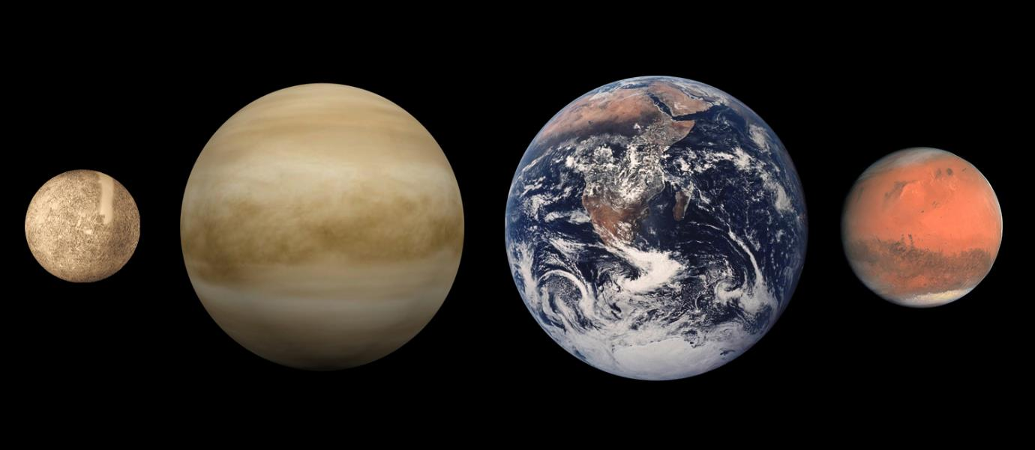
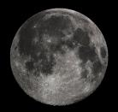
NOW, when you compare the earth to the moon and other nearby planets, what do they all have in common?
In other words, what characteristics do we see across all of the major bodies in the inner solar system? (4 minutes)
Mercury
Venus
Earth
Mars
Mercury
Venus
Earth
Mars
Note:
The diameters/sizes are to scale.
The distances between the objects is NOT to scale.
Moon
Discuss with your group—then write in Doodle Box H.
Notes:
TEACHER NOTES:
We’ve been thinking about differences among all of these planets, but let’s start to think a little more about what they have in common in order to help us think about a good driving question in a moment.
Hopefully, after discussions from the previous two slides, students are now starting to realize that the inner planets have more in common that they realized before. We want the students to see that Earth shares a lot with its neighbors, because we will soon transition into a discussion of the formation of the Earth and all the inner planets, so we want to draw some of these similarities out of the students in anticipation of that. Take a look at the two slides after this and try to draw those similarities out of the students BEFORE showing them the next slides. If they’re struggling, give them some big hints (i.e. “What would happen if you landed on Mercury? The moon? Mars?” or “What surface features do we see on ALL the inner bodies?”).
Though the biosphere still technically remains a sphere unique to Earth, you are encouraged to engage students in discussions about whether or not life could exist on other planets (start with “what does life need to exist?”). That discussion is totally optional, though- the discussion of the biosphere and what allows life to happen will be fully explored in the Biology sections of the year, and it can often be a time sink (students LOVE the alien discussion, but now might be the right time).
SOURCES:
Image, “This diagram shows the approximate relative sizes of the terrestrial planets, from left to right: Mercury, Venus, Earth and Mars. Distances are not to scale.”
URL: https://commons.wikimedia.org/wiki/File:Terrestrial_planet_size_comparisons.jpg
Attribution: wikipedia user Brian0918 [Public domain]

Slide 47
Big Similarities…
Composed of rocky “stuff”.
Is it all the same “stuff”?
Would walking on Venus or Mercury or the Moon feel like walking on Earth?
Discuss with your group (3 minutes).
Notes:
TEACHER NOTES:
This is where you can introduce the term geosphere, and its place on your spheres representation if you haven’t done so already.
Have students go back over their group’s list of similarities and differences and compare notes on the various planets, with these questions up on the board. Have a whole class discussion to confirm that in fact yes, they have similar “stuff” and walking on the land parts of any planet would feel similar.
Note: students might get distracted by thinking about gravity and how that would affect the hike- black box that for a while. Tell them that we will be talking about gravity soon, but right now, just imagine the gravity is the same on all bodies. You can also place questions about the composition of the outer planets, the “gas giants” in the Parking Lot and decide later how you might address those. They are not a focus of this unit (or any part of the curriculum), but some ideas can be answered with supplementary materials provided with the Formation of the Earth unit.

Slide 48
Big Similarities…
Craters: at least the Moon, Mars and Mercury have craters we can easily see.
Does Venus have craters?
What about the Earth?
On Earth, where would the craters be if we had them?
Discuss with your group (3 minutes).
Notes:
TEACHER NOTES:
Similar to the last slide, have students compare notes and discuss. You could even revisit the images of Mercury/Venus/Mars/Moon from slides 11-14.
Leave the question open as to whether or not Earth has craters. Use this as a transition to the next phenomenon, Meteor Crater in Arizona.
Later you can have a whole class discussion confirming that yes, we see craters on all planets, even Earth.

Slide 49
Big Similarities…
Other similarities…
What else do we see these planets and our moon have in common?
Notes:
TEACHER NOTES:
Optional slide. Just don’t forget to address any other commonalities that arise in the course of conversation. You’ll leverage the two listed on the previous slides no matter what. The heavy lifting here is getting them to focus in on the geosphere commonalities- that’s where we want to spend some time, so it’s important they see the similarities in the rocky stuff amongst all the inner planets.

Slide 50
Try to Identify the Driving Question
Do these commonalities help us to decide on a logical place to start?
Let’s work together to develop at least a first Driving Question that we can use to decide next steps.
Notes:
TEACHER NOTES:
Start this slide by saying something like:
“We have looked at a lot of data, and we created a list of earth’s features, including what makes earth unique compared to other nearby planets and moons AND what all these planetary bodies have in common.”
After getting some student questions, it’s OK to remind the class (as needed) to focus on the Earth. That’s really what we are most interested in. This should get the class to the bigger question about how the spheres formed (on Earth).
Possible Initial Driving Question: How did earth get all of the unique features that we described in our list? Where did all of these features of earth come from?
How did these various spheres (i.e. geosphere, biosphere, hydrosphere, atmosphere) of earth form?
Possible Focused Driving Question: How did the rocky Earth (the geosphere) initially come to be? It is OK to have both questions, but we need this question (one focused on the geosphere).
More on having one or more Driving Questions here:
It’s OK to have two questions. For example, “How did our unique Earth form?” and then more specifically, “How did the Earth’s (and other planets’) geosphere form?” Even if the assertion of the second, more specific question does not emerge directly from your students, they should at least understand why we might on the more specific question of geosphere and be willing to “buy into” exploring that sub-question first.
We hope through the previous slides exploring commonalities that this is a class decision about what logically makes sense as a starting point, but if it doesn’t emerge in that way, be sure to help make the point here that we’re going to “build Earth” by starting with the most basic component(s) it shares with the other planets of the inner solar system. We’ll then figure out how to add an atmosphere, the oceans and life after we’ve got this first model fleshed-out.

Slide 51
Our Driving Question
[insert class driving question here or refer to it on the board]
Please record our Driving Question in Box I.
Let’s start to think about this question by going back to thinking about commonalities, in particular, craters.
So, it is true that there are at least some craters on the Earth’s surface. We’re going to start by learning more about one in the United States, in Arizona in particular.
Notes:
TEACHER NOTES:
Have your students record the Driving Question for the unit on their doodle sheet.
Then help create a coherent transition to the next learning segment where we’ll take a look at the phenomenon of an impact crater in Arizona (creatively known as “Meteor Crater” but more correctly, “Barringer Crater”). The easiest way to do this is to remind students that all of the inner planets had craters, so a first step would be to look at that common land feature among the planets since we *think* all of them may have formed in a similar manner.

Slide 52
LS 02: Learning Segment Summary
What we’ve figured out…
We have both a broad Driving Question that asks how the Earth came to be as it appears to day, and a more immediate Driving Question that will carry us through this unit. How did the rocky Earth (the geosphere) form?
LS 02 Teacher Reflection:
What I think worked well…
What I would change…
Notes:
Slide is not meant for students.

Slide 53
LS 03: Learning Segment Overview
We begin to develop some model ideas about the formation of the Earth by exploring the specific phenomenon of a crater in Arizona.
55 to 110 minutes
Resources you will need:
FE Doodle Sheet
FE Teacher Guide – Building the Model (Read this now so that you know how to build the model later.)
FE 01 Supplement Planets and Moons Images (a supplemental set of PowerPoint slides)
Check out the Supplemental Resources at the end of this FE PowerPoint.
Read the Earth Science Guide “About Meteors” on the website.
Notes:
Slide is not meant for students.

Slide 54
LS 03: Phenomenon – Barringer Crater
Meteor impacts on the Earth give us a route into exploring the accretion model for planet-building. The idea, for which scientists are still gaining evidence, is that the smaller rocks that made up the solar disk of gas and dust at the beginning of our solar system’s history collided and “stuck” together. Eventually gravity increased the probability of these impacts resulting in an increase of mass of planetary bodies and a reduction in the amount of loose space rocks and gases. We will, in fact, spend the next few learning segments coming to even initial ideas around this model.
Here we build some understanding about impacts and their likelihood given the current composition of the solar system. There are still space rocks out there and impacts (though rare) still occur. These conversations give us a glimpse into our solar system’s past when such impacts were more common, but again, we won’t address that until later in the unit.
In exploring Barringer Crater, your students will first be asked to consider what processes might have led to its formation. It may be that they insist it was a meteor impact fairly quickly. If this is the case, you can move through these slides a bit faster. You do need to establish some ideas with your students that provide evidence for this most likely explanation (that a meteor caused the impact).
Students may also have other questions, including ones about the likelihood of a catastrophic impact in their lifetime and may even express anxiety about the possibility. Decide ahead of time how you will prepare to address this question and others drawing on, in part, the supplemental materials provided at the end of this PowerPoint.
Notes:
Slide is not meant for students.

Slide 55
Navigation
How to track we learn across learning segments and days:
In the next learning segments, students will have more opportunities to wonder about what actually happens during a meteor impact.
Tracking Ideas: What have we learned? and What are we wondering?
In this learning segment and the few that follow, we’ll be focused on understanding impacts and what happens with matter and energy during an impact. Not until we come to Learning Segment 8 will we leverage these ideas in order to start building our model that addresses the Driving Question (i.e. How did Earth’s geosphere form?).
In the meantime, however, we do need a way to track the class’s ideas. We recommend that as you move through these lessons, you create public artifacts (separate from the notes your students may be taking on their doodle sheets and in their science notebooks) that lists both what we are wondering about and what we have learned. In this learning segment, you will work with students to raise some questions in response to examining the Barringer Crater in Arizona. You will also want to track some established ideas. These may not necessarily appear in the model we build in Learning Segment 8, but they are important to track as we’ll use them in building the model. See the next slide for sample representations. We’ll suggest additions to each in the coming learning segments as well.
Notes:
Slide is not meant for students.

Slide 56
Navigation
Tracking Ideas: What are we wondering? and What have we learned?
What are we wondering? (Sample. Just track your kids’ questions here. )
What happens to space rocks in impact craters?
What happens to the ground and to plants and animals when an impact occurs?
Are there other craters on Earth? What do they look like?
How likely would it be for a large meteor to hit the Earth now?
Feel free to use sticky notes to track student questions for these learning segments, similar to the Parking Lot.
What we have learned: (Sample. Your list might look different.)
There are lots of space rocks floating around the solar system.
Sometimes they enter our atmosphere and are visible as “shooting stars”.
We see evidence that they have hit both Earth and other planets in the past.
Our atmosphere breaks up most space rocks that are headed toward Earth. The last impact we know of was 200 years ago in the desert of the Arabian Peninsula.
<Supplement> Older impact craters change with time and are often disguised by water, erosion (from wind and water) and by plants and ecosystems growing over them.
Minerals near impact craters sometimes show evidence of heat and pressure from the impact, even when the space rock itself is not found.
Notes:
Not meant to show to students.

Slide 57
LS 03: Teacher Supplement – Taking Notes
Teachers have differing commitments to students learning how to take notes productively. In MBER, we’ve generally pushed any important student recordings onto the Doodle Sheet. We see this sheet not only as a public record of student accountability, but also a way for students to track their own thinking and learning as the unit progresses.
Therefore, when we don’t ask students to actively record information, we are leaving it to you (the teacher) to decide how you might want you students to track the information.
In this learning segment, students will be given a lot of information through questions and discussions, but also through a certain amount of lecture. Our suggestion is that you help students track key pieces of information publically, relieving them of any detailed note-taking outside the Doodle. Our hope is that individuals feel ownership of the information as you track it on the “What we’ve learned…” and “What we’re wondering…” posters highlighted in the navigation slides in this PowerPoint. However, you know you students population and its needs best. Please review the information in this learning segment, track its connection to the eventual model building (Learning Segment 08: Rewind the Clock), and then make decisions about how you would like your students to track the information.
You will encounter a similar “density of information” in Learning Segment 07 when students try to make sense of what is happening with energy during impacts.
To be clear, we are not against note-taking. We have tried to highlight for you where it is best to take up using the Doodle Sheet and leave the rest to your best judgement.
Notes:
Slide is not meant for students.

Slide 58
LS 03: Teacher Supplement - Earth Science for Biologists
As mentioned earlier, we will continually recommend resources for biology teachers who may not feel so confident in their earth science content knowledge.
Here are some ideas you may want to review before engaging your students in Learning Segment 3:
Space rock impacts on Earth occur regularly and add mass to our planet over time even in modern times. (Earth still gains about 80 million lbs of rock/metal from space each year, mostly from dust and some from meteors.) Most space rocks smaller than a football field will break apart in Earth’s atmosphere. Traveling at tens of thousands of miles per hour, the object disintegrates as pressure exceeds the strength of the object, resulting a bright flare. Typically less than 5 percent of the original object will ever make it down to the ground. These meteorites, pieces of meteors that are found, typically range between the size of a pebble and a fist. Every once in a while, a larger object enters Earth’s atmosphere. Mineral components of meteorites and other rocks observed at impact sites give us a lot of information about the composition of celestial objects and also the formation of earth through impacts and reconstitution of minerals through various geological processes.
A number of geological processes affect the appearance of craters over time. Your students should know about some of these or know enough to make some inferences about erosion, watershed pooling, and succession (i.e. growth of the biosphere over the impact site over time).
Be sure to read the Earth Science Guides on the website for more complete background information. These guides may be particularly germane during enactment of earth science units, but they will more generally inform you instruction using the Living Earth curricular resources.
Notes:
Slide is not meant for students.

Slide 59
Video of phenomenon in Arizona
Notes:
TEACHER NOTES:
Tell your students that we’re going to begin our exploration of an answer to the Driving Question by focusing a little more on one particular commonality that the (geosphere’s of the) inner planets have in common—craters.
Show the video of the crater in Arizona or explore it in another manner (series of pics, for example). Really any video showing the impact crater can work, but BE SURE TO MUTE the video so that you don’t give away any information that could steal your students’ “aha” moments! You should be ready to give students some information about the size of the crater and its discovery, but not about the cause. That’s what we’ll be exploring.
In fact, it may be wise to REFRAIN FROM REFERRING TO THIS CRATER AS “METEOR CRATER”, one of its official names. (It’s also known as Barringer Crater.) The “hole in the ground in Arizona” is a perfectly fine way to refer to this until your students have decided that this is a crater from a “space rock” or meteor.
SOURCE:
Video, ”Arizona's Jaw-Dropping Mile-Long Meteor Crater” can found at: https://www.youtube.com/watch?v=odGrgsLkfUQ

Slide 60
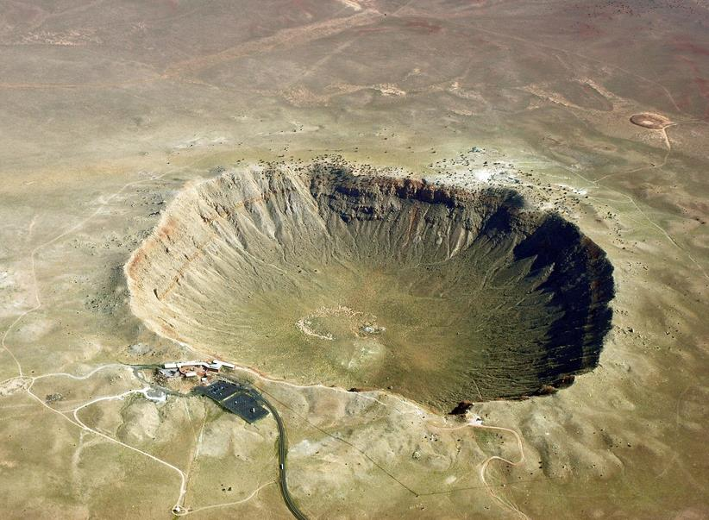
So, what might have caused this hole to form?
Notes:
TEACHER NOTES:
Quick transition slide to next slide.
SOURCES:
Image, “Meteor Crater Aerial View 2010”
URL: https://commons.wikimedia.org/wiki/File:Meteorcrater.jpg
Attribution: Shane.torgerson [CC BY (https://creativecommons.org/licenses/by/3.0)]

Slide 61
What might have caused this feature in the land?
Discuss answers to this question with your group. Work to come up with multiple ideas.
Record your group’s ideas in Doodle Box J.
Be prepared to share your group’s ideas.
Notes:
TEACHER NOTES:
Have students work in groups to discuss the question. Ask them to brainstorm (**but see notes below) a couple of ideas and then ask each group to share out one idea.
It’s best if you can have a large image of the crater in front of them (a color handout, and if you can laminate it, even better- one per group) so that they can make observations in order to “notice” and “wonder” (if you can laminate, provide them with dry erase markers . However, if you can’t manage that, it might be sufficient to return to the previous slide or create a new one where the image fills the entire field of view.
Then have a quick whole class discussion. If all of the class’s ideas are already on the board, either ask the next group to choose the one they feel is most likely and continue around the room, or end the class discussion before hearing from all groups in order to move things along quickly.
Since they’ve already seen craters in the previous exploration, they might get to the “answer” quickly, but encourage students to explore multiple ideas. Volcanic craters can look similar, so that’s one possibility, and of course, nuclear bombs can leave similar “scars”. Let them be creative- the more we have to work with, the richer the discussion will be.
**Important note, be responsive to your class: Your students may very quickly decide this is an impact crater with little else to say. If the brainstorming alternatives seems strained, ditch it. Instead probe a bit with your students about what evidence they might look for to convince them it’s an impact crater. And what could have made a crater this size? How large would it have to be, etc.? Ask them what makes them think it’s not a volcanic crater (the most likely alternative kids would come up with) and maybe have someone look up an image of a dormant volcano caldera. Always be willing to take the discussion in a slightly different direction and then move on. You don’t always need to be well prepared to be responsive. “I don’t know but let’s see if we can find out together.” is always a valid response. You can always tell students that you’ll do some research and they can too and you’ll take it up next class period. (For example, even after deciding this is a crater, you can come back the next day and look at images of dormant volcano craters to convince yourself and the class that this looks different. You could even spend 5 minutes talking about volcanic craters as a separate topic if your students seem interested.)
Sample student ideas:
A. a rock from space hitting the earth (an impact)
B. volcanism/a volcano
C. a human-made explosion
D. a sink hole (caused by a collapse of an aquifer or a massive release of gases)
E. human mining of minerals
F. old lake
Based on historical records, we can eliminate initial models C and E.
For B and D, we need to provide students with data to investigate, such as pictures and diagrams of volcanic craters and sink holes. Students compare the features of volcanic craters and sink holes with the Arizona phenomena. Hopefully students will notice that a) the bottom of volcanic craters is higher in elevation than the surrounding land, and b) sink holes do not have raised rims surrounding them. This will allow us to eliminate initial models B and D.
For F, we would similarly provide some examples of dry lakes today (such as Owens Lake or Deep Springs Valley Lake). Lakes have a different shape by the time they dry out, with much shallower sides and much more eroded edges.
We are left with Model A to investigate.
SOURCES:
Image, “Meteor Crater Aerial View 2010”
URL: https://commons.wikimedia.org/wiki/File:Meteorcrater.jpg
Attribution: Shane.torgerson [CC BY (https://creativecommons.org/licenses/by/3.0)]

Slide 62
More Information on the Phenomenon
This land feature came to the attention of scientists in the late 1800s as settlers moved into the West.
Scientists first thought the land feature was volcanic—that it was a circular crater formed as lava breaks through from below.
However, research in 1905 led a scientist (Barringer) to conclude that the phenomenon was caused by the impact of a meteorite (rock) from space.
Other scientists disagreed with his findings, and the origin of the Arizona phenomenon remained unsettled for decades.
Notes:
TEACHER NOTES:
Start to unpack with a bit more information and move toward the current explanation. Be sure, however, to thoughtfully evaluate alternatives. See notes below for guidance.
Note: we do not intend for students to be recording these facts, but you may have your own commitments to note-taking. (Our design commitment is to keep some record of individual thinking, the class’s ideas, and eventually a model.)
In considering this list of sample student ideas:
A. a rock from space hitting the earth (an impact)
B. volcanism/a volcano
C. a human-made explosion
D. A sink hole (caused by a collapse of an aquifer OR a massive release of gases)
E. Human mining of minerals
F. Old lake
… we can work with students to hone in on the most likely explanations.
Based on historical records, we can eliminate initial ideas C and E above.
For B and D, we need to provide students with data to investigate, such as pictures and diagrams of volcanic craters and sink holes. Students compare the features of volcanic craters and sink holes with the Arizona phenomena. Hopefully students will notice that a) the bottom of volcanic craters is higher in elevation than the surrounding land, and b) sink holes do not have raised rims surrounding them. This will allow us to eliminate initial models B and D. For F, we would similarly provide some examples of dry lakes today (such as Owens Lake or Deep Springs Valley Lake). Lakes have a different shape by the time they dry out, with much shallower sides and much more eroded edges. We are left with Model A to investigate.

Slide 63
Could this phenomenon in Arizona have been caused by a space rock hitting the Earth?
We need to consider evidence which might support or refute Barringer’s claim.
In thinking about evidence…
What might we like to know?
(I’ll record some of our class questions as you share out.)
Notes:
TEACHER NOTES:
This is a key move that we’ll use to motivate our exploration of impact craters. We’ll be focusing on this phenomenon for the next few days through a series of conversations, labs and simulations. We’ll then come back to our Driving Question about how (the geosphere of) the Earth formed.
Remind students that they generated a whole series of possible explanations for the hole. What would convince them that it was a space rock that did this?
Have them pair share or go back into groups quickly as needed. Be sure to document student ideas as outlined in the teacher notes at the beginning of this learning segment. This learning segment provides a chance to help your students think about what (in general) constitutes evidence.
There are lots of questions students could generate at this point. We’ve created some supplemental materials to explore them. The slides are located at the end of this PowerPoint. It’s perfectly fine to not show them to students, but you should explore them yourself in order to bolster your Earth science content knowledge.
Record student questions on post its or simply right them on a public artifact. Give it the title, “What are we wondering about?”
You’ll pair this artifact with a “What we’ve learned…” record as you move through this learning segment. If you have a commitment to students taking notes, you might consider having them track these two lists of questions/ideas in their notebooks.
The remainder of this learning segment focuses solely on exploring a few ideas that were historically key to supporting Barringer’s hypothesis that the crater was indeed formed by a space rock.
These are ideas are:
Are there rocks in space that could potentially hit the earth? Yes, there are .
Can we see evidence that space rocks have hit other planets and moons of the solar system? Yes, we do.
Do we have any recent evidence of space rocks hitting Earth? We think so. We at least see regular direct evidence that they enter our atmosphere.
However, we expect there are some very likely student-driven questions that will also arise.
These are:
Did anyone find a space rock in the hole?
Is there evidence of other craters on Earth?
What do these other craters on Earth look like?
What are the chances we’ll get hit again? (What are the chances it will happen in the near future?)
If your students don’t ask these questions or if they ask others, don’t worry. But again, if they do, we’ve provided some supplemental materials as a starting point for answering these questions. Check out the slides at the end of this PowerPoint. Some questions you may alternatively choose to have your students (or a subset of students) research directly.

Slide 64
Science and Skepticism
Scientists were very skeptical of Barringer’s idea that a space rock was the most reasonable explanation. No one in recorded history had a reliable source actually witnessed a space rock hitting the surface of the Earth.
So, as skeptical scientists ourselves, there are a few other ideas/questions it would probably be helpful to review in order to establish whether a space rock hitting Earth is at least a likely event… likely enough to be the explanation for this crater and maybe others we’ve noticed in pictures of other planets.
Notes:
TEACHER NOTES:
You don’t need to show this. You need to say this.
In the coming slides you’ll guide students through a series of questions… and answers. Try to keep things moving quickly.
You might want to encourage your students to take some notes as you move through these slides, especially if you’ll think they will need them in order to fill out Doodle Box K, about 10 slides from now. You can have them start recording some notes in Doodle K, which we’ve made rather large for this purpose. Your decision to have students take notes will depend on the amount of time that passes while covering these ideas and the particular considerations of your student population.
At the end of this subset of slides, we’ll pause to record the ideas on the “What we’ve learned…” poster.
Ideally, the questions we’re going to address would be ones that students would have, but you may not want to take the time to have students push in this direction. It may not be a priority at this point.
One helpful way to frame these next few conversations with students is that it is not enough to simple say this is the most likely explanation because the others are unlikely, we also want to consider any evidence or models that might support this idea. So, is it likely that this was caused by a space rock? What would you want to know?
We’ll explore the following series of questions…
Q: are there rocks in space that could potentially hit the earth?
P: view NASA simulation of tracked space objects.
Answer: yes, there are lots of rocks in space that could potential hit the earth. (And NASA is trying to find all of them and map their orbits so we would have some advanced notice.)
Q: can we see evidence of space rocks having hit other planets and moons?
P: view pics of the moon and other planets/moons. Most are covered with visible craters.
Answer: yes, there is evidence that space rocks hit other planets and moons.
Q: do we have any recent evidence of space rocks are hitting the earth?
P: View pics/videos of meteors/shooting stars entering the atmosphere. (For example, YouTube dash cam videos, etc.)
Answer: yes, just look on the internet!

Slide 65
Could this phenomenon in Arizona have been caused by a space rock hitting the Earth?
One thing we might need to know is:
1. Are there even rocks in space that could potentially hit the Earth?
Let’s watch a NASA simulation which maps the positions of known “near-Earth objects” (NEOs).
Notes:
TEACHER NOTES:
This is the first idea to problematize for kids. (We are not asking them to generate this question or the next two.)
You’ll cue up, a YouTube video, “All Known Asteroids in the Solar System (1998-2018)” (https://www.youtube.com/watch?v=vfvo-Ujb_qk) from the NASA Jet Propulsion Laboratory. You should fast forward to 0:23 in the clip (we have increased the number of satellites tracking images, so our “picture” of how much is out there has gotten much better, and denser, since 1998; if you show the whole clip, students might draw the obvious (but false) conclusion that the # of things flying around space has increased dramatically in the last 20 years).
NOTE: One thing that is misleading about the NASA simulation is that the space rocks are not shown to scale. (You’ll notice the dots representing the space rocks are similar in size to the planets.) In reality, the space rocks are much smaller than the inner planets—so there is actually a lot more empty space than you see in the images.
We’re exploring the following series of questions… (quickly, please)
Q: are there rocks in space that could potentially hit the earth?
P: view NASA simulation of tracked space objects.
Answer: yes, there are lots of rocks in space that could potential hit the earth. (And NASA is trying to find all of them and map their orbits so we would have some advanced notice.)
Q: can we see evidence of space rocks having hit other planets and moons?
P: view pics of the moon and other planets/moons. Most are covered with visible craters.
Answer: yes, there is evidence that space rocks hit other planets and moons.
Q: do we have any recent evidence of space rocks are hitting the earth?
P: View pics/videos of meteors/shooting stars entering the atmosphere. (For example, YouTube dash cam videos, etc.)
Answer: yes, just look on the internet!
SOURCES:
Video, “All Known Asteroids in the Solar System (1998-2018)”
URL: https://www.youtube.com/watch?v=vfvo-Ujb_qk
Attribution: NASA Jet Propulsion Laboratory (YouTube Channel)

Slide 66
Are there rocks in space that could potentially hit the Earth?
… there are now over 20,000 known NEOs and the discovery rate averages about 30 per week.
Notes:
TEACHER NOTES:
Be sure you’ve helped to clear up any misunderstandings of the video (see presenter notes on the last slides), and conclude the presentation with this fact about the continued discovery rate. Pause as you see fit to let students generate more questions for the “What are we wondering about?” tracker.
We’re still exploring the following series of questions… (quickly, please)
Q: are there rocks in space that could potentially hit the earth?
P: view NASA simulation of tracked space objects.
Answer: yes, there are lots of rocks in space that could potential hit the earth. (And NASA is trying to find all of them and map their orbits so we would have some advanced notice.)
Q: can we see evidence of space rocks having hit other planets and moons?
P: view pics of the moon and other planets/moons. Most are covered with visible craters.
Answer: yes, there is evidence that space rocks hit other planets and moons.
Q: do we have any recent evidence of space rocks are hitting the earth?
P: View pics/videos of meteors/shooting stars entering the atmosphere. (For example, YouTube dash cam videos, etc.)
Answer: yes, just look on the internet!
SOURCES:
Video, “The animation depicts a mapping of the positions of known near-Earth objects (NEOs) at points in time over the past 20 years, and finishes with a map of all known asteroids as of January 2018. Asteroid search teams supported by NASA's NEO Observations Program have found over 95 percent of near-Earth asteroids currently known. There are now over 18,000 known NEOs and the discovery rate averages about 40 per week.”
URL: https://www.jpl.nasa.gov/news/news.php?feature=7194
Attribution: NASA/JPL-Caltech

Slide 67
“Two Asteroids Safely Fly by Earth”
NASA news article dated September 12, 2019:
Two relatively medium-sized asteroids will fly safely past Earth overnight Sept. 13-14, 2019. NASA is tracking the objects, but orbit calculations ruled out any chance that the objects could pose a threat to our planet.
“These asteroids have been well observed—one since 2000 and the other since 2010—and their orbits are very well known,” said Lindley Johnson, planetary defense officer and program executive for the Planetary Defense Coordination Office at NASA Headquarters in Washington, DC.
One of the asteroids is estimated to be 400-850 feet in size, and the other is estimated to be 950-2,100 feet in size.
“Both of these asteroids are passing at about 14 lunar distances from the Earth, or about 3.5 million miles away, but small asteroids pass by Earth this close all the time.”
Notes:
TEACHER NOTES:
More evidence to address our question about space rocks… Yes, they come close to Earth, but close in not a direct hit. Have students read this aloud if you have strong readers who will not mind lending their voice to the classroom. Otherwise, read it aloud yourself.
Students will likely ask about the likelihood of apocalyptic impacts here… or in a few slides after seeing footage of a recent meteor that actually made it to Earth’s surface after streaking across the sky in Russia (2013).
If this comes up, put the question in the parking lot… And then commit to a time to take the question up as a class. Maybe help students to generate a question like, “How big would a meteor have to be in order to cause a major extinction of life on our planet?” You’ll be able to address some of this question directly in a couple of days when students explore impacts using an on-line simulator, but you may choose to devote some additional time and resources to answering this question.
(If you don’t have the ability to give your students access to the simulator, consider running it as a demo. Alternatively, you could talk about this more concretely with them at the end of this unit after exploring the matter and energy considerations of impacts), or—even more richly—the end of the next unit once we’ve established some ideas about the atmosphere.)
We’re exploring the following series of questions… (quickly, please)
Q: are there rocks in space that could potentially hit the earth?
P: view NASA simulation of tracked space objects.
Answer: yes, there are lots of rocks in space that could potential hit the earth. (And NASA is trying to find all of them and map their orbits so we would have some advanced notice.)
Q: can we see evidence of space rocks having hit other planets and moons?
P: view pics of the moon and other planets/moons. Most are covered with visible craters.
Answer: yes, there is evidence that space rocks hit other planets and moons.
Q: do we have any recent evidence of space rocks are hitting the earth?
P: View pics/videos of meteors/shooting stars entering the atmosphere. (For example, YouTube dash cam videos, etc.)
Answer: yes, just look on the internet!
SOURCES:
Nasa Article, “Two Asteroids Safely Fly By Earth”
https://www.nasa.gov/feature/two-asteroids-to-safely-fly-by-earth

Slide 68
Our question: Could this phenomenon in Arizona have been caused by a space rock hitting the Earth?
Next let’s consider:
2. Do we see evidence that space rocks have hit other planets and moons of the solar system?
Notes:
TEACHER NOTES:
Have the supplemental resource, “Planetary Images” ready or splice it into this PowerPoint.
Your students should recall that we’ve seen images of craters on other planets. IF you feel they have this idea, move on and forget the supplemental materials. Otherwise, you are welcome to have them look over images once again, including images of planets and moons from parts of the solar system we have yet to focus on—the outer planets. Images can be found in the supplemental resource: FE Supplemental Resource—Planetary Images.
One productive way to use the resource is to create black and white or color images in sheet protectors (from the slides) to your students so they can take a closer look and then report back as a class. Be aware that you should anticipate additional (perhaps tangential) questions depending on which images you choose to provide to the class. Remember that you are not responsible for teaching students about the entire solar system in the scope of this unit or even this course: we’re just trying to generate/evaluate a model for the formation of the Earth. Many student questions will beyond the scope of this course.
We’re exploring the following series of questions… (quickly, please)
Q: are there rocks in space that could potentially hit the earth?
P: view NASA simulation of tracked space objects.
Answer: yes, there are lots of rocks in space that could potential hit the earth. And NASA is trying to find all of them and map their orbits so we would have some advanced notice.
Q: can we see evidence of space rocks having hit other planets and moons?
P: view pics of the moon and other planets/moons. Most are covered with visible craters.
Answer: yes, there is evidence that space rocks hit other planets and moons.
Q: do we have any recent evidence of space rocks are hitting the earth?
P: View pics/videos of meteors/shooting stars entering the atmosphere. (For example, YouTube dash cam videos, etc.)
Answer: yes, just look on the internet!
We already have some evidence based on our previous discussion, but now we will look at a deeper data set to confirm this hypothesis…

Slide 69
Could this phenomenon in Arizona have been caused by a space rock hitting the Earth?
What about the Earth?
3. Do we have any other evidence of space rocks hitting Earth?
Notes:
TEACHER NOTES:
The slides that follow may inspire you to bring in some of the supplemental materials provided at the end of this PowerPoint. Please be certain to review those materials prior to engaging in this conversation.
Our most direct route, as outlined here, is to show students that lots of space rocks fly toward the Earth. They, of course, generally burn up in our atmosphere instead of hitting the ground. That’s even true for the 2013 near impact in Russia that we highlight here (which caused damage on the ground but NO IMPACT CRATER). You should familiarize yourself with the supplemental materials and decide which ideas/slides you and your students might like to explore or where your students questions might need to be better addressed.
We’re exploring the following series of questions… (quickly, please)
Q: are there rocks in space that could potentially hit the earth?
P: view NASA simulation of tracked space objects.
Answer: yes, there are lots of rocks in space that could potential hit the earth. And NASA is trying to find all of them and map their orbits so we would have some advanced notice.
Q: can we see evidence of space rocks having hit other planets and moons?
P: view pics of the moon and other planets/moons. Most are covered with visible craters.
Answer: yes, there is evidence that space rocks hit other planets and moons.
Q: do we have any recent evidence of space rocks are hitting the earth?
P: View pics/videos of meteors/shooting stars entering the atmosphere. (For example, YouTube dash cam videos, etc.)
Answer: yes, just look on the internet!

Slide 70
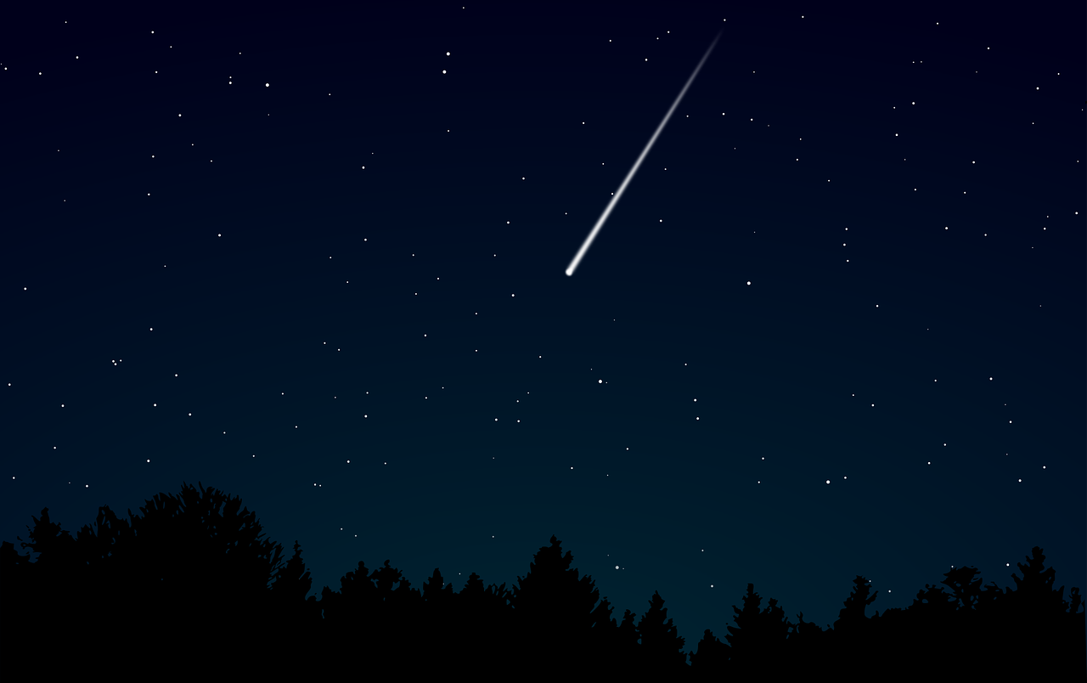
Have you ever seen a “shooting star” in the sky?
These are space rocks (meteors) hitting the earth’s atmosphere.
Most are very small, the size of sand, or a pebble.
Several visible meteors per hour can usually be seen on any given night.
But more can be seen during a “meteor shower”.
Notes:
TEACHER NOTES:
Decide whether you will have students share out the answer to the question above. You can feel free to insert as much information about and footage of meteor showers as you think will engage your students. Move on quickly as appropriate.
We’re exploring the following series of questions… (quickly, please)
Q: are there rocks in space that could potentially hit the earth?
P: view NASA simulation of tracked space objects.
Answer: yes, there are lots of rocks in space that could potential hit the earth. And NASA is trying to find all of them and map their orbits so we would have some advanced notice.
Q: can we see evidence of space rocks having hit other planets and moons?
P: view pics of the moon and other planets/moons. Most are covered with visible craters.
Answer: yes, there is evidence that space rocks hit other planets and moons.
Q: do we have any recent evidence of space rocks are hitting the earth?
P: View pics/videos of meteors/shooting stars entering the atmosphere. (For example, YouTube dash cam videos, etc.)
Answer: yes, just look on the internet!
SOURCES:
Image, “Dark Darkness Meteor”
URL: https://www.needpix.com/photo/853185/dark-darkness-meteor-night-shooting-star-sky-star-woods-free-vector-graphics
Attribution: Public domain. No attribution needed. (Needpix, original source Pixabay.)

Slide 71
Video of Annual Perseid Meteor Shower
Notes:
TEACHER NOTES:
There are lots of different video resources on YouTube showing the Perseids. You likely want to be careful to mute video to avoid unnecessary or problematic commentary. The NBC News video. “The Perseid Meteor Shower Puts On The Best Light Show Of The Year” (https://www.youtube.com/watch?v=WZlJFtlkRNY) has quite a bit of footage of the sky. Preview before showing to your students. Edit for length and interest.
We’re still exploring the following series of questions… (quickly, please)
Q: are there rocks in space that could potentially hit the earth?
P: view NASA simulation of tracked space objects.
Answer: yes, there are lots of rocks in space that could potential hit the earth. And NASA is trying to find all of them and map their orbits so we would have some advanced notice.
Q: can we see evidence of space rocks having hit other planets and moons?
P: view pics of the moon and other planets/moons. Most are covered with visible craters.
Answer: yes, there is evidence that space rocks hit other planets and moons.
Q: do we have any recent evidence of space rocks are hitting the earth?
P: View pics/videos of meteors/shooting stars entering the atmosphere. (For example, YouTube dash cam videos, etc.)
Answer: yes, just look on the internet!
SOURCES:
Video (NBC News YouTube Channel), “The Perseid Meteor Shower Puts On The Best Light Show Of The Year”
URL: https://www.youtube.com/watch?v=WZlJFtlkRNY

Slide 72
A couple of times a year, larger meteors hit the atmosphere.
This is video of a meteor in Russia from 2013.
Notes:
TEACHER NOTES:
Cue the YouTube video from CNN “Videos capture exploding meteor in sky” (https://www.youtube.com/watch?v=Y7Rx2PZ7C0c).
Students will likely have questions about the impact. There was none in this case.
Most space rocks smaller than a football field will break apart in Earth’s atmosphere. Traveling at tens of thousands of miles per hour, the object disintegrates as pressure exceeds the strength of the object, resulting a bright flare. Typically less than 5 percent of the original object will ever make it down to the ground. These meteorites, pieces of meteors that are found, typically range between the size of a pebble and a fist. (See the supplemental slides at the end of this PowerPoint for more detailed information on this meteorite.)
There are lots of different video resources on YouTube showing meteors in the sky. You likely want to be careful to mute video to avoid unnecessary or problematic commentary. The CNN video attached here is interesting and has quite a bit of footage of the sky. Preview before showing to your students.
Again, students will likely ask about the likelihood of apocalyptic impacts here if they haven’t already.
If this comes up, put the question in the parking lot… Maybe help students to generate a question like, “How big would a meteor have to be in order to cause a major extinction of life on our planet?” You’ll be able to address some of this question directly in a couple of days when students explore impacts using an on-line simulator.
(If you don’t have the ability to give your students access to the simulator, consider running it as a demo. Alternatively, you could talk about this more concretely with them at the end of this unit after exploring the matter and energy considerations of impacts), or—even more richly—the end of the next unit once we’ve established some ideas about the atmosphere.)
We’re still exploring the following series of questions… (quickly, please)
Q: are there rocks in space that could potentially hit the earth?
P: view NASA simulation of tracked space objects.
Answer: yes, there are lots of rocks in space that could potential hit the earth. And NASA is trying to find all of them and map their orbits so we would have some advanced notice.
Q: can we see evidence of space rocks having hit other planets and moons?
P: view pics of the moon and other planets/moons. Most are covered with visible craters.
Answer: yes, there is evidence that space rocks hit other planets and moons.
Q: do we have any recent evidence of space rocks are hitting the earth?
P: View pics/videos of meteors/shooting stars entering the atmosphere. (For example, YouTube dash cam videos, etc.)
Answer: yes, just look on the internet!
SOURCES:
Video (CNN), “Videos capture exploding meteor in sky”
URL: https://www.youtube.com/watch?v=Y7Rx2PZ7C0c
Video (The Telegraph), “Five most dramatic asteroids caught on camera”
URL: https://www.youtube.com/watch?v=Vx90UZGHxwo

Slide 73
Let’s quickly record what we’ve learned…
Notes:
TEACHER NOTES:
Transition slide.

Slide 74
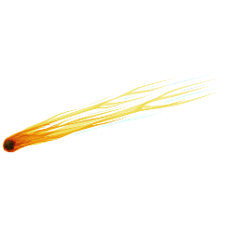
Our question: Could this phenomenon in Arizona have been caused by a space rock hitting the Earth?
Are there rocks in space that could potentially hit the earth?
Can we see evidence that space rocks have hit other planets and moons of the solar system?
Do we have any recent evidence of space rocks hitting Earth?
Record your ideas in Doodle Box K.
In your answer, say why you think so—what is your evidence?
Notes:
TEACHER NOTES:
We’ve now finished exploring these questions and want students to link the ideas to evidence for meteor impacts on Earth.
The last question will likely be the trickiest. We haven’t provided direct evidence of direct hits. (You can explore this using the supplemental materials at the end of this PowerPoint.) We can reason, though, that impacts on Earth today are as likely as impacts on other planets.
Your students may need to look back through notes (as suggested a number of slides ago), depending on when and how you’ve covered the above ideas. This is a chance to have the class discuss an important scientific principle, “What constitutes evidence?”

Slide 75
Our question: Could this phenomenon in Arizona have been caused by a space rock hitting the Earth?
Are there rocks in space that could potentially hit the earth?
Can we see evidence that space rocks have hit other planets and moons of the solar system?
Do we have any recent evidence of space rocks hitting Earth?
What did you write about?
(I’ll record some of our class ideas.)
Notes:
TEACHER NOTES:
Add to your idea tracker.
If it’s getting messy, you can always decide how to clean it up outside of class time. Consider involving your students in the clean-up process, especially if you plan to do more than re-write ideas for tidiness: if you edit the actual ideas on the tracker, your students will get the idea that you are the knowledge authority and that their voice is secondary. (The best way to change or eliminate ideas is to do so with your students!)

Slide 76
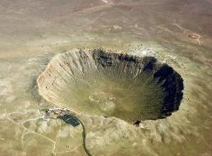
Back to that hole in the ground…
More evidence it was in fact an impact event:
In 1960 a scientist (Eugene Shoemaker) discovered the rare minerals coesite and stishovite in the crater.
These minerals are forms of silica found only where quartz-bearing rocks have been severely shocked by extremely high temperatures and pressures.
These minerals cannot be created by volcanic action; the only known mechanisms of creating them is naturally through meteorite impacts, or artificially through nuclear explosions.
Notes:
TEACHER NOTES:
After this slide, check in to see what explanations besides the meteor seem possible if necessary. This is the time to establish the likelihood that it was caused by a space rock. Acknowledge that without this extra mineralogy data, the volcanic explanation makes sense in many ways. Some sources cite the presence of a “lava dome” (even if dormant) in the center of the crater as evidence of volcanic origin, but there are plenty of impact craters with some kind of dome in the center.

Slide 77
But wait…
Did anyone find a space rock in the hole?
Well, no, not exactly. Barringer even drilled down in the hole, convinced he’d find a large space rock.
However, in the rocks people collected from in and around the crater since its discovery, people have noticed a number of oddities.
Notes:
TEACHER NOTES:
This issue of whether or not we find space rocks is a bit complex. But here we’re using it mainly as a way to transition into the next learning segment where we wonder about what happens with matter at an impact site. In order to do so, we have to briefly address some of the thinking about what happened to the matter at the Barringer Crater site. At this and many impact locations, we find both native metamorphosed rocks (rocks on the ground transformed by the immense heat and pressure caused by the impact) AND chunks of extraterrestrial matter, i.e. pieces of the space rock. Many samples of each were found at Barringer crater. We see both types of rock at most impact craters.
However, we also find chunks of space rock at sites where there is NO impact crater. For example, the near-impact in Russia (2013) reviewed in the curriculum did NOT generate a crater. Thankfully, it broke up in the atmosphere, the pieces falling to the ground with very reduced momentum. (You can see a map of where the fragments landed in some later slides.)
In Barringer’s case, he was convinced there should be a large rock in the hole. And since there was evidence that an ancient lake had once occupied the hole, he figured that drilling through the deposited sediment at the bottom of the crater should eventually lead to a sizable space rock. It didn’t. However, there is no way of knowing if native Americans removed some of the debris prior to settlement by Spaniards and other Europeans in the 16th century and beyond.

Slide 78
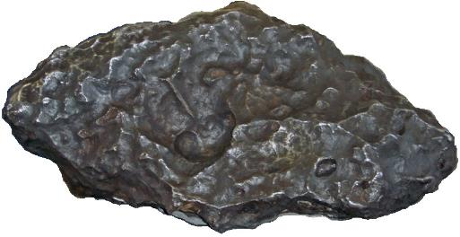
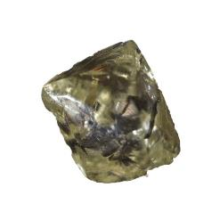
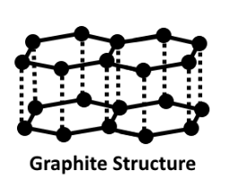
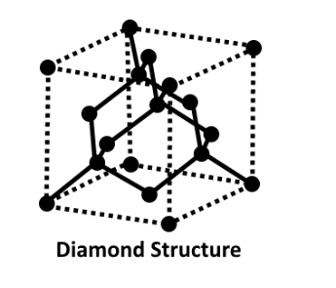
Question: Did anyone find a space rock in the hole?
First, there are a lot of tiny, tiny metal spherical rocks in the area. There were also some larger (but not huge) and very heavy rocks made of nickel-iron metal found on the plains surrounding the hole. Many of these also include some graphite, a form of carbon.
In some of the rocks around the rim of the crater, there are diamonds. Diamonds are another form of carbon where tremendous heat and pressure has squished the atoms together into a particular configuration.
Largest discovered nickel-iron rock in the area of the crater—about the size of two human brains.
A rough diamond
(not cut or polished yet).
Heat and Pressure
Notes:
TEACHER NOTES:
This slide is just information for the students. You don’t need to check for understanding. If they don’t have questions, move on. We do intentionally seed the idea of tremendous heat and pressure here. We’ll spend more time thinking about what happens with matter in the next couple of learning segments and then energy (heat) in the following two before we return to our Driving Question a bit later.
SOURCES:
Image modified from, “Allotropes Of Carbon. Graphite and Diamond.”
URL: https://commons.wikimedia.org/wiki/File:Allotropes_Of_Carbon.png
Attribution: Diepizza / CC BY-SA (https://creativecommons.org/licenses/by-sa/4.0)
Image modified from, “Diamond, a cubic carbon crystal, is the hardest known mineral.”
URL: https://commons.wikimedia.org/wiki/File:Rough_diamond_-_hardest_known_mineral.jpg
Attribution: Unknown author / Public domain
Image modified from, “[Holsinger Meteorite] The largest fragment discovered from the meteorite that formed Meteor Crater, exhibited at the tourist center in Meteor Crater, Flagstaff, Arizona.”
URL: https://commons.wikimedia.org/wiki/File:Meteor_Crater_08_2010_151.JPG
Attribution: Mariordo Mario Roberto Duran Ortiz / CC BY-SA (https://creativecommons.org/licenses/by-sa/3.0)

Slide 79
If there was a meteor, (and there is a giant hole in the ground), why wouldn’t we find at least a pretty big rock?
(And would we usually expect to find a rock at an impact site?)
→ This is a great question!
What actually happens during an impact?
Let’s explore a bit further by doing a lab.
Notes:
TEACHER NOTES:
Though we’ve made a conscious decision to not focus too heavily on the “Where’s the rock?” question in our most direct path through the exploration of Barringer Crater in this learning segment, we do need to leverage that question a bit in order to motivate the lab coming next. It is likely a question your students have already asked at some point. It may be in the Parking Lot, so be sure to honor this as a student question if appropriate.
Questions about what happens during a meteor impact provide a transition into the lab. In the lab we’ll track the matter first. In a later lab, we’ll bring in the idea of what happens with energy during an impact.

Slide 80
LS 03: Learning Segment Summary
What we’ve figured out…
We’ve explored the crater in Arizona and have developed a pretty solid evidence-based argument for how a meteor impact could explain its origin. But we’re still wondering what really happens during an impact and decide to first consider what happens to the all of the “stuff” (the matter)—the space rock and the ground.
LS 03 Teacher Reflection:
What I think worked well…
What I would change…
Notes:
Slide is not meant for students.

Slide 81
LS 04: Learning Segment Overview
We explore what happens to matter during an impact by engaging in a lab and tracking the mass of the system both before and after a simulated event.
55 minutes
Resources you will need:
FE Doodle Sheet
FE 04 Dropping Objects Lab
FE 04 Dropping Objects Lab Teacher Guide
FE 04 Dropping Objects Lab – Sample Student Video
Read the Earth Science Guide “About Accretion” on the website.
Notes:
Slide is not meant for students.

Slide 82
LS 04: Preparing for the Lab
The last learning segment launched us into an investigation. “What happens during and impact?” In particular, we are wondering what happens to the “stuff”, the matter on impact. We handle this in the lab by having students track the mass of the system before and after dropping a flour ball into a pile of flour (an impact simulation). Be sure to read the teacher guide in preparation for this lab. Just as important as preparing the materials for your students and being ready to orient them to the procedure is your preparation in framing the lab. Though we are not having students actually design the investigation here, we would like them to buy-in to the idea that this investigation is a logical next step in our exploration.
The big idea that comes out of this lab is that mass is conserved during the simulation. This leads us to ask: is mass conserved during an actual impact? We start by asking students how they feel the simulation was “realistic” and how it was not. We then move into a Four Corners conversation about what happens with matter—and to some extent energy—during a real impact. This question will drive us forward into the next two activities.
In preparation for the post-lab conversation and the Four Corners activity, you’ll want to be ready to probe students about what they think words like “vaporize” mean or what they mean by such words. Students should have the law of conservation of matter from middle school science, but if they don’t seem to be offering ideas like “matter can’t just disappear!”, you will want to problematize this for them. Can matter disappear? Can it be “converted” or “transformed” into energy? Well, yes, it can (E=mc2), but is that what is happening to the matter in this case? When and where does that kind of transformation happen? Be ready for these side conversations as necessary.
Notes:
Slide is not meant for students.

Slide 83
Navigation
What have we learned over the past couple of days?
Tracking Ideas: What are we wondering? and What have we learned?
Again, these are sample questions and ideas you might develop in the course of this learning segment. Please see the document Teacher Guide – Building the Model for more information on tracking ideas in Learning Segments 03-07.
What are we wondering?
What really happens to matter during an impact?
What happens with energy and heat?
What we have learned:
Mass is conserved during a simulated impact.
Matter is conserved in the universe, so the matter in a real impact has to go somewhere.
In special circumstances, matter can be converted to energy (E=mc²), but that’s not what is happening during an impact. (We are pretty sure.)
Notes:
Not meant to show to students.

Slide 84
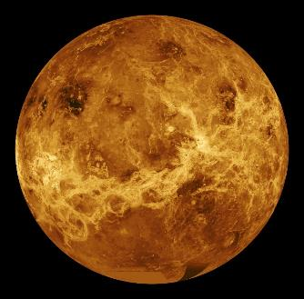
Teacher Notes: Using Warm-ups
Consider furthering students’ connections / exploration of the inner solar system or other phenomena through warm-up questions (used at the start of a class period, often to remind students about the ideas discussed during the previous class). Thoughtfully used, warm-ups can reinforce or seed ideas that may become important later. For example,
Don’t feel the need to get to a complete answer, warm-ups are just ways to get students ready for conversation.
Other ideas about how to use them: Warm ups can also be an important way to formatively assess students’ current understanding or as a way to reinforce or even challenge/evaluate model ideas that exist in the classroom.
They can also be used to help students navigate sensemaking across days in a unit. That is, what did we explore or what did we figure out about this yesterday? Where are we going next in addressing our Driving Question?
Warm-Up Question (Sample):
Why do you think we see fewer craters on Venus than on the Moon?
Considering this question leads to ideas about the role of the atmosphere in either masking impact craters (here uncovered using radar) or attenuating the number of impacts (as occurs due to Earth’s atmosphere).
Notes:
Not meant to show to students.

Slide 85
Let’s Try It!
Once you get the Dropping Objects Lab handout,
quietly read the instructions.
Also read each row of the data table.
We need to complete the lab and all of the questions today.
In your groups, figure out your roles:
space rock specialist
impact videographer
measurement specialist
team leader (groups of 4 only)
Start with step 1. When you get to step 2, follow the instructions to check out your materials.
You will get two space rocks to test.
Make sure to read the note at the bottom of the page!
Notes:
TEACHER NOTES:
Lab instructions for students. Be sure that you’ve reviewed the lab and have handed students appropriate materials. The Teacher Guide provides you with instructions and a supplies list.

Slide 86
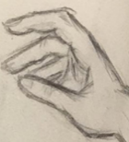
You will get a cup of flour.
The flour represents the surface of a planet/moon.
4
3
2
1
Scale (g)
Scale (g)
Scale (g)
Find and record the starting mass of your “planet” or “moon”.
Separately, find and record the mass of space rock #1.
Record your dropping height in cm.
While your impact videographer is recording (in slow motion if available), drop the space rock.
Find the mass of the system after impact.
Describe what happened in the data table.
Then test space rock #2 (repeat).
Answer the lab questions on the back.
Notes:
TEACHER NOTES:
Go over these instructions with your students.
SOURCES:
All images generated by MBER-LE Team.

Slide 87
What did we learn?
What did we learn about meteor impacts from doing this lab?
Notes:
TEACHER NOTES:
Just get conclusions from the lab here out to the whole class. In a minute, we’re going to think more deeply about how realistic it was, but not yet.
In the course of the lab, the class should have entertained a couple of ideas: (1) the basic rule about conservation of matter, and (2) that matter/mass is conserved in an impact such as the one we’re considering.
It’s OK, however, if students are uncomfortable with translating the lab results to the impact crater in Arizona. It may still seem to them that the speed and energy of impact of a REAL meteor might produce different results in terms of conservation of mass. They might have a question here—if mass was conserved in the Arizona impact, where did it all go?
Earth still gains about 80 million lbs of rock/metal from space each year, mostly from dust & some meteors.
It’s good to have the students acknowledge that there are some obvious differences between what you’ve simulated here and an actual impact. Primarily, the size of the objects. However, since the most important thing that they’re getting out of this lab is that accretion (the process of things smashing together and sticking) is a consequence of such impacts, you can use this discussion as a way to hone in on that topic.
SOURCES:
Statistics on annual mass added to Earth pulled from Ward and Brownlee 2004, “The Life and Death of Planet Earth”.
Ward, P. D., & Brownlee, D. (2004). The life and death of planet Earth: how the new science of astrobiology charts the ultimate fate of our world. Macmillan.

Slide 88
LS 04: Learning Segment Summary
What we’ve figured out…
We see that mass is conserved in our lab simulation, but we wonder if this is what really happens in a high speed impact.
LS 04 Teacher Reflection:
What I think worked well…
What I would change…
Notes:
Slide is not meant for students.

Slide 89
LS 05: Learning Segment Overview
We consider how realistic the lab might have been when compared to what actually happened at Barringer Crater or other impact sites. We engage in a Four Corners activity, debating our ideas about what might actually happen during an impact.
20-30 minutes
Resources you will need:
FE Doodle Sheet
FE 05 Four Corners – Mass and Impacts (optional: you can just project the activity)
Notes:
Slide is not meant for students.

Slide 90
LS 05: Preparing for the Discussion
We just completed the impacts lab and drew-out the main conclusions, so here we pause to ask students how they feel the simulation was “realistic” and how it was not. Work to get a decent list here that includes the size of the objects involved, their speeds, and the materials used. This will help to motivate further exploration of impacts using an online simulator in the next learning segment.
The “flour ball impacts” lab importantly seeds the concept of “accretion” (growth when things come together in bits) in the classroom. You don’t need to connect the impacts lab to a model for planet-building yet, but you’ll want to return to this emergent concept in a few days when we actually sit down to build a model that addresses our driving question (about how the geosphere formed).
The main punchline of the lab, and the one idea we definitely DO want to unpack here, is that matter is conserved in collisions. But because we may have some lingering doubts about this key idea and whether conservation of flour means conservation of rock during a fiery, high speed impact, we enter into a debate. Four Corners (described in more detail on the next teacher slide) provides a forum for talking about what happens with matter—and perhaps, to some extent, energy—during a real impact.
In preparation for the post-lab conversation and the Four Corners activity, you’ll want to be ready to probe students about what they think words like “vaporize” mean or what they mean by such words. Students should have the law of conservation of matter from middle school science, but if they don’t seem to be offering ideas like “matter can’t just disappear!”, you will want to problematize this for them. Can matter disappear? Can it be “converted” or “transformed” into energy? Well, yes, it can (E=mc²), but is that what is happening to the matter in this case? When and where does that kind of conversion happen? Be ready for these side conversations as necessary.
Notes:
Slide is not meant for students.

Slide 91
LS 05: Four Corners
Four Corners is an activity that appears more than once in the MBER curricular resources. Students are presented with the ideas of four imaginary students and are asked to decide which of the four they most agree with. The activity can be run somewhat privately (i.e. debated in small groups), but there’s a power in having student make their own thinking public and in having them physically move to a corner of the room where you’ve posted the name of the student they most agree with. This kind of public event:
allows you to assess where the class is in their thinking.
asks students to publicly argue from evidence.
provides opportunities for students to communicate, debate, and to persuade other students to come around to their way of seeing things.
foregrounds the student role in sensemaking and moves the teacher to the background
Modify the activity as you see fit.
The goal here is not to completely to resolve the debate, though that may happen in many of your classes. In this round of Four Corners, we are grappling with the results of the lab (mass is conserved) and our understanding of conservation of matter with what we imagine might be happening during a terrestrial impact on Earth. If all students agree that the mass of Earth increases by the mass of the space rock, that’s great. Be careful to avoid allowing a few charismatic student or those perceived as “the smart ones” from simply doing all the work. Challenge other students to at least verbalize why they agree or disagree.
Notes:
Slide is not meant for students.

Slide 92
Navigation
What have we learned over the past couple of days?
Tracking Ideas: What are we wondering? and What have we learned?
Again, these are sample questions and ideas you might develop in the course of this learning segment. Please see the document Teacher Guide – Building the Model for more information on tracking ideas in Learning Segments 03-07.
What are we wondering?
What really happens to matter during an impact?
What happens with energy and heat?
What makes a meteor vaporize or not vaporize if it actually makes it to the ground?
What we have learned:
Mass is conserved during a simulated impact.
Matter is conserved in the universe, so the matter has to go somewhere.
In special circumstances, matter can be converted to energy, but that’s not what is happening here. (We are pretty sure.)
Notes:
Not meant to show to students.

Slide 93
Was the crater lab “realistic”?
How lab was realistic:
How lab was unrealistic:
Notes:
TEACHER NOTES:
It’s good to have the students acknowledge that there are some obvious differences between what you’ve simulated here and an actual impact. Primarily, the size of the objects and the speed at which they are approaching. In addition to conservation of mass (which we’ll solidify in the coming slides through the Four Corners activity), the most important idea that we’re beginning to build with this lab (and will leverage later when we build the model that addresses our driving question) is that accretion (the process of things smashing together and sticking) is a consequence of such impacts. You don’t have to surface that key idea now, but you should help students to recognize it later through reflection on the flour lab/activity. (We’ll cue you in as to exactly when you’ll want your students to reflect if they don’t naturally do so on their own.)
Work here to get a decent list here that includes the size of the objects involved, their speeds, and the materials used. Having this list of ways in which the lab was less than realistic will help to motivate further exploration of impacts using an online simulator in the coming learning segment..

Slide 94
What do we think?
Did the Earth actually gain mass from the meteor that hit Arizona?
What happens when a space rock hits a planet?
Notes:
TEACHER NOTES:
In the course of the lab, the class should establish a couple of ideas: (1) the basic rule about conservation of matter, and (2) that matter/mass is conserved in an impact such as the one we’re considering.
It’s OK, however, if students are uncomfortable with translating the lab results to the impact crater in Arizona. It may still seem to them that the speed and energy of impact of a REAL meteor might produce different results in terms of conservation of mass. They might have a question here—if mass was conserved in the Arizona impact, where did it all go?
Earth still gains about 80 million lbs of rock/metal from space each year, mostly from dust & some meteors.
It’s good to have the students acknowledge that there are some obvious differences between what you’ve simulated here and an actual impact. Primarily, the size of the objects. However, since the most important thing that they’re getting out of this lab is that accretion (the process of things smashing together and sticking) is a consequence of such impacts, you can use this discussion as a way to hone in on that topic.
SOURCES:
Statistics on annual mass added to Earth pulled from Ward and Brownlee 2004, “The Life and Death of Planet Earth”.
Ward, P. D., & Brownlee, D. (2004). The life and death of planet Earth: how the new science of astrobiology charts the ultimate fate of our world. Macmillan.

Slide 95
What happens to mass when an actual space rock hits a planet?
“FOUR CORNERS”
Ground Rules:
We’re going to debate a little about what we think happens during an impact event.
You’ll have to choose one scenario that you agree most with and think about the evidence we have for that scenario.
This is a friendly debate. Remember, we’re all working together to try to understand what is happening here.
Notes:
TEACHER NOTES:
In the course of the lab, the class should establish a couple of ideas: (1) the basic rule about conservation of matter, and (2) that matter/mass is conserved in an impact such as the one we’re considering.
It’s OK, however, if students are uncomfortable with translating the lab results to the impact crater in Arizona. It may still seem to them that the speed and energy of impact of a REAL meteor might produce different results in terms of conservation of mass. They might have a question here—if mass was conserved in the Arizona impact, where did it all go?
Earth still gains about 80 million lbs of rock/metal from space each year, mostly from dust & some meteors.
It’s good to have the students acknowledge that there are some obvious differences between what you’ve simulated here and an actual impact. Primarily, the size of the objects. However, since the most important thing that they’re getting out of this lab is that accretion (the process of things smashing together and sticking) is a consequence of such impacts, you can use this discussion as a way to hone in on that topic.
SOURCES:
Statistics on annual mass added to Earth pulled from Ward and Brownlee 2004, “The Life and Death of Planet Earth”.
Ward, P. D., & Brownlee, D. (2004). The life and death of planet Earth: how the new science of astrobiology charts the ultimate fate of our world. Macmillan.

Slide 96
What happens to mass when an actual space rock hits a planet?
FOUR CORNERS
Angie thinks the mass of the planet increases by the mass of the space rock—just like we found in the lab. It can all be found if you’re willing to search long enough for tiny rocks.
Ricardo thinks that the mass of the planet increases a little, but that some of the mass is converted to energy (maybe heat and light) on impact and so some of the space rock’s mass is lost.
Terrance thinks that most of the space rock is vaporized and goes into the atmosphere. Also, some of the ground is vaporized too (the hole). So the mass of the planet doesn’t really change that much, if at all.
Yubi thinks that matter from the space rock and the planet are converted into energy of some sort, so the mass of the planet actually drops. (If you look at the hole, it looks like matter is lost, right?)
Notes:
TEACHER NOTES:
Hand out the student resource FE 05 Four Corners – Impacts and Mass if you think your students need to see these positions on a half-sheet in front of them.
In the course of the lab, the class should establish a couple of ideas: (1) the basic rule about conservation of matter, and (2) that matter/mass is conserved in an impact such as the one we’re considering.
It’s OK, however, if students are uncomfortable with translating the lab results to the impact crater in Arizona. It may still seem to them that the speed and energy of impact of a REAL meteor might produce different results in terms of conservation of mass. They might have a question here—if mass was conserved in the Arizona impact, where did it all go?
Earth still gains about 80 million lbs of rock/metal from space each year, mostly from dust & some meteors.
It’s good to have the students acknowledge that there are some obvious differences between what you’ve simulated here and an actual impact. Primarily, the size of the objects. However, since the most important thing that they’re getting out of this lab is that accretion (the process of things smashing together and sticking) is a consequence of such impacts, you can use this discussion as a way to hone in on that topic.
SOURCES:
Statistics on annual mass added to Earth pulled from Ward and Brownlee 2004, “The Life and Death of Planet Earth”.
Ward, P. D., & Brownlee, D. (2004). The life and death of planet Earth: how the new science of astrobiology charts the ultimate fate of our world. Macmillan.

Slide 97
What happens to mass when an actual space rock hits a planet?
FOUR CORNERS: With whom do you agree most? CHOOSE ONE.
Write about your choice in Doodle Box L.
Angie thinks the mass of the planet increases by the mass of the space rock.
Ricardo thinks that the mass of the planet increases a little but that some mass is converted to energy.
Terrance thinks the mass of the planet doesn’t change because matter from the space rock and on the ground is vaporized.
Yubi thinks that mass from the planet could decrease because the speed of impact converts lots of the matter into heat or other forms of energy.
Notes:
TEACHER NOTES:
Decide ahead of time how you will run this activity. Once students have decided with whom they agree, how will you manage any disagreement? What is your goal? To come to consensus or to simply problematize that we still have some questions. Make sure that students are comfortable with what ever goals, parameters and process you choose.
What ever you figure out or don’t figure out, you should pause at the end to add those ideas, controversies and questions to your “What we’ve learned…” and “What are we wondering?” posters before moving on.
Earth still gains about 80 million lbs of rock/metal from space each year, mostly from dust & some meteors.
It’s good to have the students acknowledge that there are some obvious differences between what you’ve simulated here and an actual impact. Primarily, the size of the objects. However, since the most important thing that they’re getting out of this lab is that accretion (the process of things smashing together and sticking) is a consequence of such impacts, you can use this discussion as a way to hone in on that topic.

Slide 98
What happens to mass when an actual space rock hits a planet?
With whom do you agree most NOW?
Write about your choice in Doodle Box L.
Angie thinks the mass of the planet increases by the mass of the space rock.
Ricardo thinks that the mass of the planet increases a little but that some mass is converted to energy.
Terrance thinks the mass of the planet doesn’t change because matter from the space rock and on the ground is vaporized.
Yubi thinks that mass from the planet could decrease because the speed of impact converts lots of the matter into heat or other forms of energy.
Notes:
TEACHER NOTES:
Following the debate, have students return to their Doodle sheet to decide if they’ve changed their opinion. If they haven’t you might encourage them to add some notes about what evidence makes them feel secure that their unwavering answer is “correct”.

Slide 99
What happened to the matter at Barringer Crater?
Very little of the original mass (about 150,000 tons) survived the impact. Most was “vaporized” and remains in the soil around the crater as tiny metal spheroids that condensed out of a vapor cloud that formed on impact.
In total just about 30 tons of actual meteorite fragments have been found in the area. Many of the pieces were collected soon after 1886, the year when the first piece was found.
The trading post owner near the crater sold over 5 tons of irons to museums all over the world. By the time Barringer arrived in 1904 very few meteorites could be found lying on the surface. Today no hunting for meteorites is permitted in the area.
Notes:
TEACHER NOTES:
This is just information to share with students now that we’ve established a couple of important ideas through the lab.

Slide 100
LS 05: Learning Segment Summary
What we’ve figured out…
We’ve explored the crater in Arizona and have developed a pretty solid evidence-based argument for how a meteor impact could explain its origin. But we still have some questions about what actually happened when a space rock hits the Earth which we’ll explore next.
LS 05 Teacher Reflection:
What I think worked well…
What I would change…
Notes:
Slide is not meant for students.

Slide 101
LS 06: Learning Segment Overview
We use a web-based simulation to begin to understand better what happens with the matter while simultaneously beginning to wonder more what happens with energy during impact.
30-55 minutes
Resources you will need:
FE Doodle Sheet
FE 06 Impact Simulator Data Sheet
MBER Topic Guide - Energy in the Earth and Physical Sciences
Notes:
Slide is not meant for students.

Slide 102
LS 06: Preparing for the On-line Simulation
There is no separate teacher guide for the web-based simulation outside of these notes and those included in the “presenter notes” fields on the student-facing slides.
Ahead of implementing this activity with your students, please visit the site (http://down2earth.eu/impact_calculator) yourself and play with the interface, parameters, and examine the results.
There are lots of things to play with in the simulator. The point is to first let students play (with constraints) and then to help them to build skills, for example around noticing patterns and ideas around cause and effect (two of the cross-cutting concepts). This is a chance to let them play a bit with concepts in science. Don’t feel that you need to go over all of the results or patterns as we’ve outlined here. You are really just continuing the conversation about what happens to the matter. (There are, for example, some interesting results in the simulator that depend on the material type/density of both the space rock and the ground. ) We are also using the simulator to begin to attend to what happens with ENERGY during impact.
That’s the real point of using the simulator here: to get kids to start thinking about energy. You’ll work with them in this segment to summarize what they know about energy and what they understand about energy during impact. Energy is not an easy subject to discuss with students, so you’ll want to be well prepared. We’ve provided a guide and some supplemental slides to help you with a review of what both you and your kids should know about energy going into the next learning segment where you’ll explore the conversion of kinetic energy to heat in a lab.
Notes:
Slide is not meant for students.

Slide 103
LS 06: Conversations About Energy; Resources
The coming learning segments require you to hold more formal conversations about energy with your students. We’ve created a couple of guides about energy and how to discuss energy with your students. The first, “Energy in the Earth and Physical Sciences” is germane now. (The second, “Energy and the Life Sciences” will be useful to read at a later point when starting to explore energy in ecosystems and organisms later in the curricular year.)
Energy is a difficult concept to engage with as adults. As biology teachers, we usually deal with energy most directly when thinking about chemical reactions in cells such as respiration and photosynthesis. And we’re often warned by colleagues that our analogies for how energy is “stored” in chemical bonds is problematic and creates student misconceptions. In this unit, however, we are really dealing with energy from a physics perspective. The focus is on the kinetic energy of moving (falling) objects and what happens to that energy in the kinds of collisions (impacts) we’ve been discussing. The central idea for this unit can be summarized as follows: space rocks have kinetic energy associated with their size and velocity (KE = ½ mass x velocity²) and upon impact MOST of this energy is converted to heat. The remainder generates movement in ejected matter (from both the ground and meteor), light, sound, etc. But we focus on the heat because it is the biggest component and because it helps us to understand the formation of the Earth when we build that model in a couple of learning segments.
Students should come into your high school classroom with a number of ideas according to the NGSS. (See the above-mentioned guide “Energy and the Earth and Physical Sciences” for details.) You will of course need to assess what your students actually seem to understand about energy before you decide how to proceed with any classroom conversations.
Notes:
Slide is not meant for students.

Slide 104
Navigation: What have we learned over the past couple of days?
Tracking Ideas: What are we wondering? and What have we learned?
Again, these are sample questions and ideas you might develop in the course of this learning segment. Please see the document Teacher Guide – Building the Model for more information on tracking ideas in Learning Segments 03-07.
What are we wondering?
What really happens to matter during an impact?
What happens with heat and energy during impacts?
What makes a meteor vaporize or not vaporize if it actually makes it to the ground?
What we have learned:
Mass is conserved during a simulated impact.
Matter is conserved in the universe, so the matter has to go somewhere.
In special circumstances, matter can be converted to energy, but that’s not what is happening here. (We are pretty sure.)
The size and speed of a meteor affects what happens at impact and the size of the crater. The material the meteor and ground are made up of also affects the depth and width of the hole.
Notes:
Not meant to show to students.

Slide 105
Still some questions…
Since we can’t take the time to make the lab more realistic, let’s try playing with an online simulation.
Work with a partner to follow the instructions on your handout.
Think about how you might play with the simulator like a scientist would run an experiment.
(For example, how many things should you change in the simulator at a time?)
Notes:
TEACHER NOTES:
Wrap up the Four Corners debate however you wish. In most cases, we’re still going to have a number of questions about what happens with matter at impact. Use this as a motivation to coherently transition to the next activity, an online impact simulator.
Create a link to the following site for your students if possible. It sets some useful starting parameters for the simulator.
http://down2earth.eu/impact_calculator/input.html?lang=en&diam=1000&traj=45&velo=10&pjd=3&tjd=i&planet=Earth
If you can’t provide this link, just help them navigate to the site and instruct them to choose the starting parameters you’d like them to use.
SOURCES:
Down To Earth Impact Simulator
http://down2earth.eu/impact_calculator/input.html?lang=en&diam=1000&traj=45&velo=10&pjd=3&tjd=i&planet=Earth

Slide 106
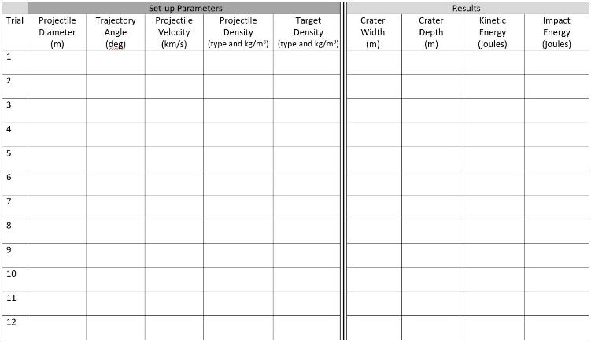
Impact Simulator Exercise
Have your data sheet in front of you.
On your computer, go to:
http://down2earth.eu/impact_calculator

Slide 107
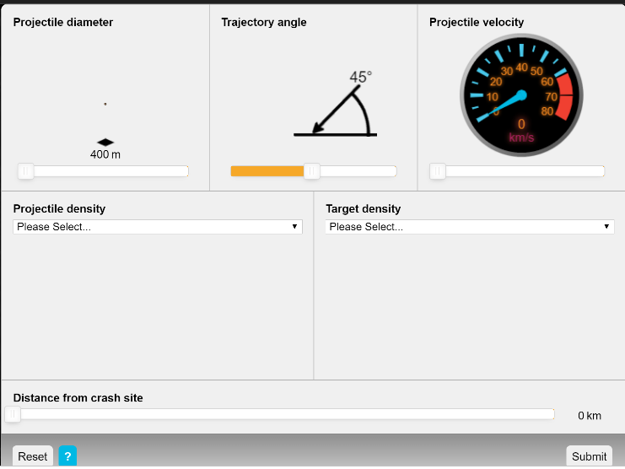
Simulate Meteor Impacts and Examine the Results
You’ll have plenty of time to play, but please start with the following:
Select the Earth.
You will see this screen →
Change the variables…
Be sure record them in your new data sheet.
Click submit.
Notes:
TEACHER NOTES:
The ability of your class will dictate how many variables you wish them to change. There are 6 different aspects you can manipulate, but velocity and diameter (~mass) are the two that we’ve just been discussing and are thus the prescient. However, you may have a class that you feel can handle more complexity, in which case you may have them try changing 2+ variables. Make sure they record accurately, though, so they can delineate the effects they see. As always, it’s good to give them time to do a couple of “fun runs” with this before having them record, just so they get to see the different tools.

Slide 108
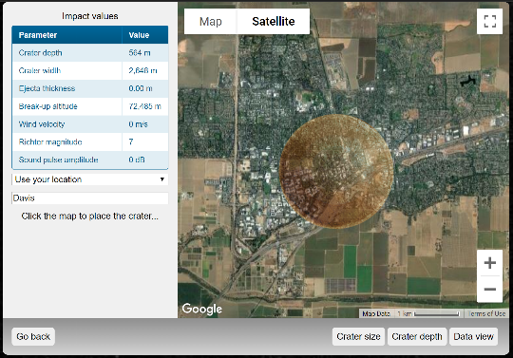
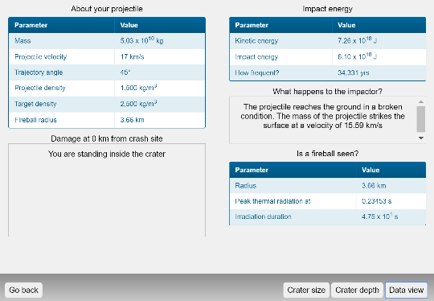
Examine the Results
Select a location on the left.
Then click on the image to see a visual representation of the crater size.
Click on DATA VIEW.
Be sure to record the values for ALL of the columns on your data sheet.
Go back, change the variables, record your results.
Notes:
TEACHER NOTES:
Student instructions are also available as a printable document in the curricular resources.
SOURCES:
Images are screenshots of the pre-impact interface on the Down to Earth Impact Simulator website (http://down2earth.eu/impact_calculator).

Slide 109
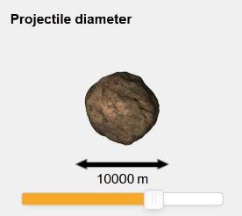
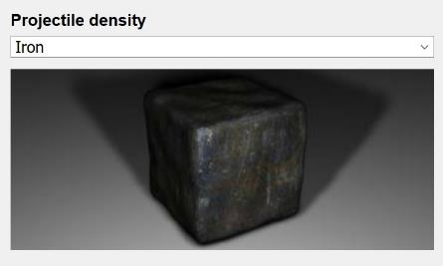
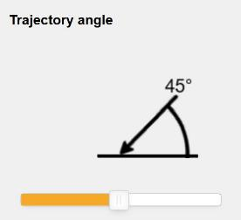
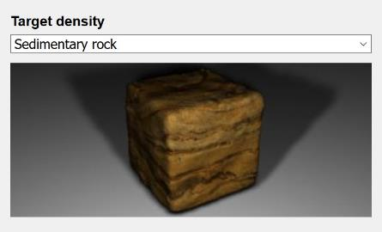
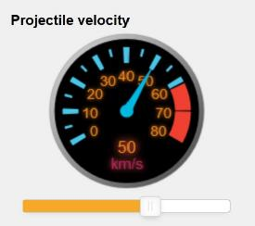
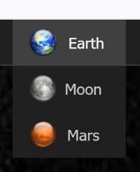
While Observing the Impact Simulator
Some of you changed:
The size of the space rock.
The nature or kind of material.
The angle of approach.
The speed of approach.
What happened in each case?
Notes:
TEACHER NOTES:
Over the course of the next few minutes, you’ll be unpacking some of the patterns with your students. Construct the conversation however you like in order to get a sense of how different input variables affected the outcome. You should give them a chance to consider the patterns in their own data in teams first (using Doodle Box M) and then hold a whole-class discussion to draw out many patterns (Doodle Box N). Following the whole-class discussion, you will have an opportunity to engage in a conversation about what might have effected changes in kinetic energy, the topic of the next learning segment.
You may use the slides provided here to structure the conversation or simply lead a discussion on the board. For example, something like the one outlined here…
On board: So the pattern in the data is:
increased velocity causes bigger impact craters. (Does bigger mean deeper or wider or both?)
increased mass causes bigger impact craters.
These are great patterns, and we could use them to make predictions.
But, we could also go deeper by asking WHY.
WHY does increased velocity cause bigger impact craters?
WHY does increased mass cause bigger impact craters?
SOURCES:
Images are screenshots of the pre-impact interface on the Down to Earth Impact Simulator website (http://down2earth.eu/impact_calculator).

Slide 110
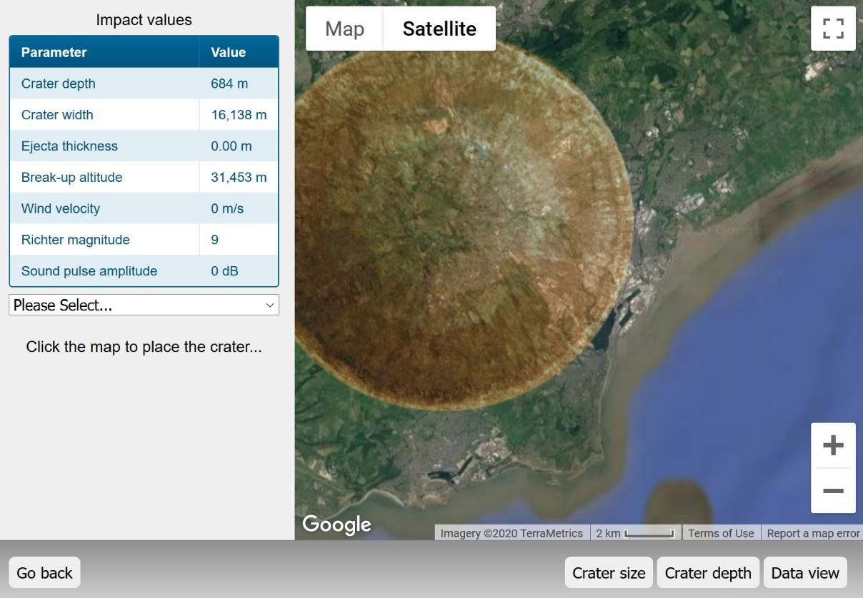
Impact Simulator Results
Notes:
TEACHER NOTES:
Over the course of the next few minutes, you’ll be unpacking some of the patterns with your students. Construct the conversation however you like in order to get a sense of how different input variables affected the outcome. You should give them a chance to consider the patterns in their own data in teams first (using Doodle Box M) and then hold a whole-class discussion to draw out many patterns (Doodle Box N). Following the whole-class discussion, you will have an opportunity to engage in a conversation about what might have effected changes in kinetic energy, the topic of the next learning segment.
You may use the slides provided here to structure the conversation or simply lead a discussion on the board. For example, something like the one outlined here…
On board: So the pattern in the data is:
increased height causes bigger impact craters.
increased mass causes bigger impact craters.
These are great patterns, and we could use them to make predictions.
But, we could also go deeper by asking WHY.
WHY does increased height cause bigger impact craters?
WHY does increased mass cause bigger impact craters?
SOURCES:
Image is a screenshot of the Data View available post-impact on the Down to Earth Impact Simulator website (http://down2earth.eu/impact_calculator).

Slide 111
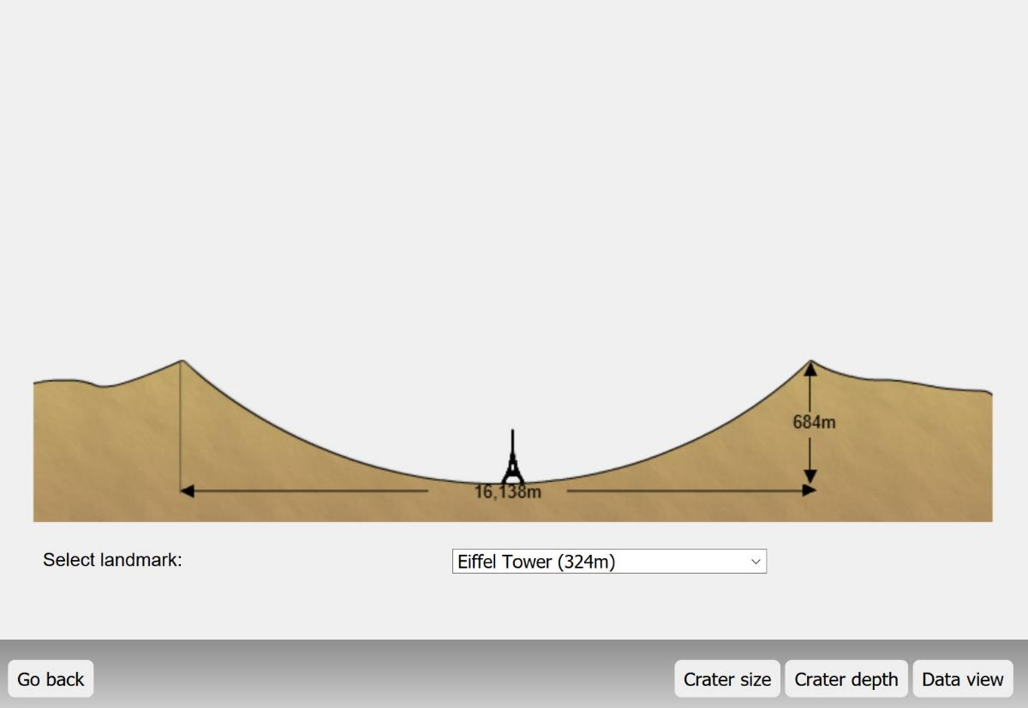
Impact Simulator Results
Notes:
TEACHER NOTES:
Over the course of the next few minutes, you’ll be unpacking some of the patterns with your students. Construct the conversation however you like in order to get a sense of how different input variables affected the outcome. You should give them a chance to consider the patterns in their own data in teams first (using Doodle Box M) and then hold a whole-class discussion to draw out many patterns (Doodle Box N). Following the whole-class discussion, you will have an opportunity to engage in a conversation about what might have effected changes in kinetic energy, the topic of the next learning segment.
You may use the slides provided here to structure the conversation or simply lead a discussion on the board. For example, something like the one outlined here…
On board: So the pattern in the data is:
increased height causes bigger impact craters.
increased mass causes bigger impact craters.
These are great patterns, and we could use them to make predictions.
But, we could also go deeper by asking WHY.
WHY does increased height cause bigger impact craters?
WHY does increased mass cause bigger impact craters?
SOURCES:
Image is a screenshot of the Data View available post-impact on the Down to Earth Impact Simulator website (http://down2earth.eu/impact_calculator).

Slide 112
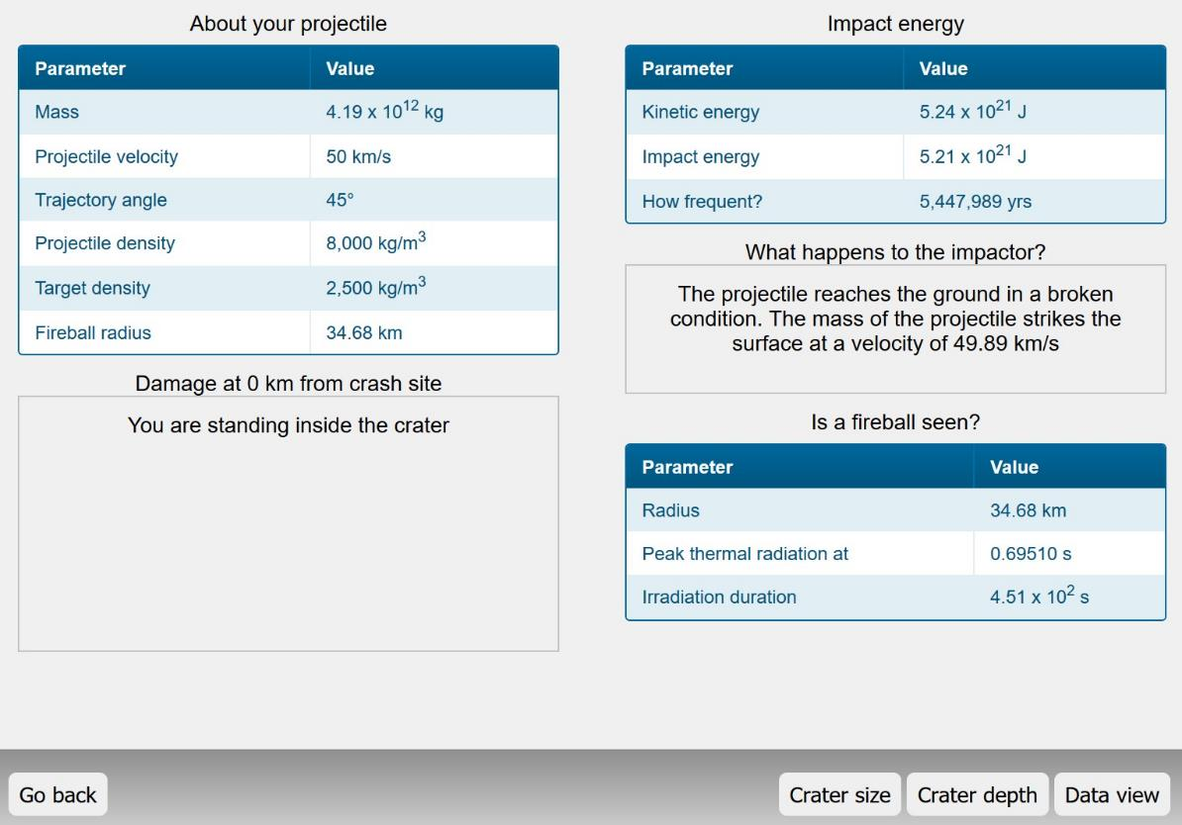
Impact Simulator Results
Notes:
TEACHER NOTES:
Over the course of the next few minutes, you’ll be unpacking some of the patterns with your students. Construct the conversation however you like in order to get a sense of how different input variables affected the outcome. You should give them a chance to consider the patterns in their own data in teams first (using Doodle Box M) and then hold a whole-class discussion to draw out many patterns (Doodle Box N). Following the whole-class discussion, you will have an opportunity to engage in a conversation about what might have effected changes in kinetic energy, the topic of the next learning segment.
You may use the slides provided here to structure the conversation or simply lead a discussion on the board. For example, something like the one outlined here…
On board: So the pattern in the data is:
increased height causes bigger impact craters.
increased mass causes bigger impact craters.
These are great patterns, and we could use them to make predictions.
But, we could also go deeper by asking WHY.
WHY does increased height cause bigger impact craters?
WHY does increased mass cause bigger impact craters?
SOURCES:
Image is a screenshot of the Data View available post-impact on the Down to Earth Impact Simulator website (http://down2earth.eu/impact_calculator).

Slide 113
Do you notice any patterns in your data?
Record two patterns you notice in Doodle Box N.
Notes:
TEACHER NOTES:
Have students work in teams to start to pull out general patterns. What happens, for example, when the projectile diameter increases? Decreases? Giving them time to work on the patterns on their own for a while will help the class engage in the discussion on the next slide. Move on to that discussion when you feel individual groups have had some time to notice at least some of the patterns and that the class (collectively) has noticed the vast majority of the big patterns across parameters.
If you want to structure the group work time a bit more, you can ask individual groups to focus on looking for patterns for an individual parameter—e.g. velocity. How does that one parameter seem to affect the results? (You could further specify which results they focus on as well.) Just be certain you cover most of the parameters space (or the columns you and the students care about) before you pull the class together for the whole group share out / discussion on the next slide.

Slide 114
Impact Simulator Class Data Summary Table
Trial | Rock Size | Angle | Speed | Rock Density | Ground Density | Crater Size | Crater Depth | Kinetic Energy | Impact Energy | Notes
1 | ↑
2 | ↓
3 |  | ↑
4 |  | ↓
5 |  |  | ↑
6 |  |  | ↓
7 |  |  |  | ↑
8 |  |  |  | ↓
9 |  |  |  |  | ↑
10 |  |  |  |  | ↓
What patterns (if any) do we notice?
Notes:
TEACHER
Work carefully with your students to draw out some ideas. If you decide to cold call groups/teams rather than asking for volunteers, be sure to warn them ahead of time and consider assigning a reporter at the start of the task.
You can use the summary table on this slide as a guide: each row represents either the decrease or increase in a single parameter. What are the outcomes (increase/decrease) in the parameters in the columns on the right side of the table? If your students didn’t vary a single parameter at a time, this is a good chance to have a conversation about why that might have been a good idea. ☺
As mentioned in the notes below previous slides, you might choose to unpack this conversation on the board…
On board: So the pattern in the data is:
increased height causes bigger impact craters.
increased mass causes bigger impact craters.
These are great patterns, and we could use them to make predictions.
But, we could also go deeper by asking WHY.
WHY does increased height cause bigger impact craters?
WHY does increased mass cause bigger impact craters?
NOTES:

Slide 115
Impact Simulator Class Data Summary Table
Trial | Rock Size | Angle | Speed | Rock Density | Ground Density | Crater Size | Crater Depth | Kinetic Energy | Impact Energy | Notes
1 | ↑
2 | ↓
3 |  | ↑
4 |  | ↓
5 |  |  | ↑
6 |  |  | ↓
7 |  |  |  | ↑
8 |  |  |  | ↓
9 |  |  |  |  | ↑
10 |  |  |  |  | ↓
What do we think determines the amount of energy in an impact?
Notes:
TEACHER NOTES:
This is a chance to explicitly focus on the kinetic energy if the conversation has not gone that direction naturally. Now is the time to hone in on those columns as we’ll transition to a conversation about energy.
This conversation can be brief as the next learning segment will allow you to unpack student ideas about energy.

Slide 116
LS 06: Learning Segment Summary
What we’ve figured out…
We see that multiple factors change the outcome of impacts, but now we are more focused on wondering what happens with energy when a space rock hits the ground.
LS 06 Teacher Reflection:
What I think worked well…
What I would change…
Notes:
Slide is not meant for students.

Slide 117
LS 07: Learning Segment Overview
We explore how energy is involved in impacts through a lab and run some calculations that show us how much energy is released as heat.
110 minutes
Resources you will need:
FE Doodle Sheet
FE 07 Shaking BBs Lab (for Students)
FE 07 Shaking BBs Lab Teacher Guide
FE 07 Calculating the KE of Meteors (for Students)
FE 07 Calculating the KE of Meteors Teacher Guide
MBER Teacher Guide – Energy and the Earth and Physical Sciences
Notes:
Slide is not meant for students.
For teachers with traditional, 50 to 60-minute periods: Be certain to complete the laboratory activity on Day 1 so that you can review results and engage students in the KE calculation on Day 2.

Slide 118
LS 07: Preparing for the Lab
Coming out of the on-line simulator, students should be ready to further explore the questions and ideas they have about energy during impact events.
Your students may have a fairly good understanding of matter– as particles (molecules and atoms), the phases of matter and how matter generally behaves. They have also (by this point) worked with you to understand that matter is conserved. Student understanding of energy, however, might be a bit less concrete, as it is among adults. Again, please be certain to read the teacher guide on energy as specified in the introductory notes to the previous learning segment.
Beyond completing the preparations outlined in the Shaking BBs Lab Teacher Guide, you’ll also need to decide how you will plant to talk to your students about the following concepts around energy. You do not need to come conclusively to each of these statements by the end of this learning segment, but you should be most of the way there, with students at least wondering where they stand on each.
Energy is conserved.
There are different kinds or forms of energy.
Energy can be transformed from one form to another.
Heat is a form of energy that “appears to disappear”.
We’ve provided some optional, supplemental student-facing slides at the end of this PowerPoint. As always, you are welcome to use them as-is or to modify them for your own purposes. The punchline of this lab is that kinetic energy is often transformed into heat. And that is exactly what is happening to most of the kinetic energy at the time of impact.
Be sure to read the Earth Science Guides on the website for more complete background information. These guides may be particularly germane during enactment of earth science units, but they will more generally inform you instruction using the Living Earth curricular resources. More than one guide is devoted to the topic of energy since this is often a tricky concept for teachers and students alike.
Notes:
Slide is not meant for students.

Slide 119
LS 07: Preparing Your Students for Calculations
A second challenge students will encounter in this learning segment is performing a calculation. As the instructor, you may be wary of having students tackle this, but it is an important opportunity to have students engage in a less commonly enacted Science and Engineering Practice (or SEP) as defined by the NGSS. You may, however, need to scaffold the activity for your particular student population and the wide variation students might exhibit in their computational skills.
Please read the Teacher Guide provided with the unit materials. Decide how much independent work you will require from students. This is an excellent opportunity for them to exercise their understanding of algebra, but the calculations require an attention to conversions and units. The task is not straight forward.
Beyond managing the calculation itself, you’ll want to make sure students understand WHY they are engaged in the calculation. What are we trying to figure out? (Is the heat of impact enough to melt rock?) Why are we trying to figure this out? (We are still wondering if matter vaporizes or melts during impact and we are also wondering what happens to all of the energy in a collision.) During calculations, students often lose sight of the motivation. Help them to ground the lab and calculation in making sense of something. By then end, we want students to have an appreciation of just how much heat meteor impacts produce and how/why such impacts melt huge amounts of rock. If the math prevents them from getting to that conceptual understanding, consider leading the class through the calculations from the front of the room and/or truncating the activity in other ways.
Notes:
Slide is not meant for students.

Slide 120
Navigation: What have we learned over the past couple of days?
Tracking Ideas: What are we wondering? and What have we learned?
Again, these are sample questions and ideas you might develop in the course of this learning segment. Please see the document Teacher Guide – Building the Model for more information on tracking ideas in Learning Segments 03-07.
What are we wondering?
What really happens to matter during an impact?
What happens with energy and heat?
What makes a meteor vaporize or not vaporize if it actually makes it to the ground?
What we have learned:
In special circumstances, matter can be converted to energy, but that’s not what is happening here. (We are pretty sure.)
Energy comes in many forms and can be transformed or converted from one kind to another.
Kinetic energy is the energy of motion (and thus of meteors) and depends on the size (or mass) and speed of an object (like a space rock).
During impacts, most of the kinetic energy is converted to heat.
The heat from an impact is enough to melt rock.
Notes:
Not meant to show to students.

Slide 121
Focusing on Energy…
Up until our work with the online simulator, we were mostly been focused on matter, but what about energy?
How is energy involved in impacts?
Notes:
TEACHER NOTES:
Use this slide to transition back into a conversation about energy if you ended class after filling out the table at the end of the last learning segment, Skip to next slide if you are coming straight out of that conversation or say. Let’s keep thinking about the patterns we saw with energy for the lab where we actually dropped objects.

Slide 122
What is energy?
What do we know about energy?
What does ‘energy’ mean to you?
Give an example from your life.
Give an example of energy in the world- where? What?
Can we see energy? Explain.
How does energy “move”? Can it transfer between things (people, animals, rocks)?
Can you think of any other words that might mean ‘energy’?
When you’re ‘full of energy’, how do you feel?
Write some of your ideas in Doodle O.
Notes:
TEACHER NOTES:
Use this slide to transition back into a conversation about energy if you ended class after filling out the table at the end of the last learning segment, Skip to next slide if you are coming straight out of that conversation or say. Let’s keep thinking about the patterns we saw with energy for the lab where we actually dropped objects.

Slide 123
Shifting to a Focus on Energy…
What is “Kinetic” Energy?
= energy based on motion
KE = ½ (mass) x (velocity)²
KE = ½ m v²
Speed in a certain direction
Based on what we saw in the simulation and the equation above…
→ What happens to the kinetic energy if we increase mass?
→ What happens to the kinetic energy if we increase velocity (speed)?
Notes:
TEACHER NOTES:
Work through the reasoning on this slide with your students. The class should already have noted that increases in velocity and mass (size and density of space rocks in the online simulator) led to an increase in the kinetic energy (and the crater size, etc) but here you are uncovering the mathematical relationship.
We’ve designed the next few slides to help students:
(A) learn about KE – because it directly relates to impact and the patterns we’ve already seen
(B) learn about PE – because we have some experience with how this relates to energy from the Dropping Objects Lab and it sets us up to…
(C) learn about Transformation of Energy – because this is a key principle we need to understand about energy (and one we’ll use to help us in the next lab)

Slide 124
Energy During the Dropping Objects Lab
4
3
2
Some of you tested Scenario A:
Two space rocks about the same size dropped at two different heights.
Some of you tested Scenario B:
Two space rocks of different sizes dropped at the same height.
1
4
3
2
1
What happened in each case?
Notes:
TEACHER NOTES:
Another way for the class to make sense about energy during impacts is to recall what happened in the Dropping Objects Lab. After this initial review of the procedure (as shown on this slide), ask students, “How was kinetic energy involved in this lab? Does our formula for KE help us to understand what is happening here?
The mass piece will be more straightforward: our formula tells us that larger objects have more KE. But how does the drop height affect the formula? Students may connect height with final velocity from their experience, but there might also be some confusion. You’ll unpack the answer in talking about potential energy on the next slide.
Based on the PE formula, an increase in mass creates more Potential Energy, and an increase in height creates more potential energy.
During the fall, PE goes to zero (because of height going to zero), but KE increases throughout the fall (velocity is continuously increasing because of gravity). Note that KE initial is zero, since the object wasn’t moving.
Since KE and PE are related like this, we can say that all the PE before the drop was turned into KE upon impact (PE initial = KE final).
So the higher the starting mass, and the higher the starting height, the more KE final, and the bigger the crater.
On board: So the pattern in the data is:
increased height causes bigger impact craters.
increased mass causes bigger impact craters.
These are great patterns, and we could use them to make predictions.
But, we could also go deeper by asking WHY.
WHY does increased height cause bigger impact craters?
WHY does increased mass cause bigger impact craters?

Slide 125
What happens when we increase height?
What happens when we increase size?
Which ball will have more energy when it hits the pin?
Which ball will have more energy when it hits the pin?
: )
: )
Notes:
TEACHER NOTES:
You could really do this more effectively with a demonstration if you have the means. The images/animations here are provided to you as a means to have the conversation about energy in a few different forms that students can experience. Ultimately we are interested in their understanding of KE and its transformation into heat. The time put into discussing PE, however, will pay off when you discuss chemical reactions in a later unit.
Ideas for demos: toy cars on a ramp, round fruit on a tilted textbook or larger whiteboard…be creative!
SOURCES:
Images modified from, “Bowling Ball Clipart #1652123”
URL: http://clipart-library.com/clipart/8i68Rn6BT.htm
Attribution: http://clipart-library.com/terms.html
Image, “Bowling Pin”
URL: https://freesvg.org/1272138688
Attribution: No attribution required. CC1.0.(https://creativecommons.org/publicdomain/zero/1.0/)

Slide 126
Let’s focus on mass first.
What do we remember about kinetic energy from the simulation?
Kinetic Energy
= energy based on motion
KE = ½ (mass) x (velocity)²
KE = ½ mv²
So, what happens to kinetic energy if we increase mass?
(For example, what happens if we double mass?)
Which ball will have more energy when it hits the pin?
And why?
: )
Notes:
TEACHER NOTES:
You can just take a poll here: thumbs up for an increase in KE with mass, thumbs down for a decrease of KE with an increase in mass. The goal here is to get to the right relationship, but there is a secondary goal: try to get your students to realize the relationship using the formula. You might even have them choose to plug in some numbers.
You could really do this more effectively with a demonstration if you have the means. The images/animations here are provided to you as a means to have the conversation about energy in a few different forms that students can experience. Ultimately we are interested in their understanding of KE and its transformation into heat. The time put into discussing PE, however, will pay off when you discuss chemical reactions in a later unit.
SOURCES:
Images modified from, “Bowling Ball Clipart #1652123”
URL: http://clipart-library.com/clipart/8i68Rn6BT.htm
Attribution: http://clipart-library.com/terms.html
Image, “Bowling Pin”
URL: https://freesvg.org/1272138688
Attribution: No attribution required. CC1.0.(https://creativecommons.org/publicdomain/zero/1.0/)

Slide 127
Now let’s focus on height…
Kinetic Energy
= energy based on motion
KE = ½ (mass) x (velocity)²
KE = ½ mv²
What happens to energy if we increase height?
Potential Energy
Another “kind” of energy = the amount of energy when an object is at rest
PE = (mass) x (acceleration of gravity) x (height)
PE = m x g x h
Which ball will have more energy when it hits the pin?
And why?
: )
Notes:
TEACHER NOTES:
You could really do this more effectively with a demonstration if you have the means. The images/animations here are provided to you as a means to have the conversation about energy in a few different forms that students can experience. Ultimately we are interested in their understanding of KE and its transformation into heat. The time put into discussing PE, however, will pay off when you discuss chemical reactions in a later unit.
SOURCES:
Images modified from, “Bowling Ball Clipart #1652123”
URL: http://clipart-library.com/clipart/8i68Rn6BT.htm
Attribution: http://clipart-library.com/terms.html
Image, “Bowling Pin”
URL: https://freesvg.org/1272138688
Attribution: No attribution required. CC1.0.(https://creativecommons.org/publicdomain/zero/1.0/)

Slide 128
Height and Energy
Kinetic Energy
= energy based on motion
KE = ½ (mass) x (velocity)²
KE = ½ mv²
What happens to energy if we increase height?
Potential Energy
Another “kind” of energy = the amount of energy when an object is at rest
PE = (mass) x (acceleration of gravity) x (height)
PE = m x g x h
Higher Potential Energy
: )
→ Higher Kinetic Energy
Notes:
TEACHER NOTES:
You need to decide what is important for your students to understand without too much challenge or distraction. We really want them to focus more on kinetic energy here, but there are reasons for students to understand the relationship between potential and kinetic energy. We’ll revisit this relationship again during some of the conversations about organismal biology in later units.
SOURCES:
Images modified from, “Bowling Ball Clipart #1652123”
URL: http://clipart-library.com/clipart/8i68Rn6BT.htm
Attribution: http://clipart-library.com/terms.html
Image, “Bowling Pin”
URL: https://freesvg.org/1272138688
Attribution: No attribution required. CC1.0.(https://creativecommons.org/publicdomain/zero/1.0/)

Slide 129
Height and Energy
Kinetic Energy
= energy based on motion
KE = ½ (mass) x (velocity)²
KE = ½ mv²
Why does greater potential energy lead to greater kinetic energy? What is happening?
Potential Energy
Another “kind” of energy = the amount of
energy when an object is at rest
PE = (mass) x (acceleration of gravity) x (height)
PE = m x g x h
Higher Potential Energy
: )
→ Higher Kinetic Energy
Notes:
TEACHER NOTES:
You need to decide what is important for your students to understand without too much challenge or distraction. We really want them to focus more on kinetic energy here, but there are reasons for students to understand the relationship between potential and kinetic energy. We’ll revisit this relationship again during some of the conversations about organismal biology in later units.
SOURCES:
Images modified from, “Bowling Ball Clipart #1652123”
URL: http://clipart-library.com/clipart/8i68Rn6BT.htm
Attribution: http://clipart-library.com/terms.html
Image, “Bowling Pin”
URL: https://freesvg.org/1272138688
Attribution: No attribution required. CC1.0.(https://creativecommons.org/publicdomain/zero/1.0/)

Slide 130
Properties of Energy…
(1) Energy is conserved, just like matter.
(2) But it can be TRANSFORMED from one type to another!
Bowling ball:
Potential Energy is transformed into Kinetic Energy.
Can you think of other examples where one type of energy is transformed into another?
We’re going to do a lab that deals with transforming energy.
Notes:
TEACHER NOTES:
The following information might not really be for students—maybe more for you to understand. You need to decide what is important for your students to understand without too much challenge or distraction. We really want them to focus more on kinetic energy here, but there are reasons for students to understand the relationship between potential and kinetic energy. We’ll revisit this relationship again during some of the conversations about organismal biology in later units.
Based on the PE formula, an increase in mass creates more Potential Energy, and an increase in height creates more potential energy.
During the fall, PE goes to zero (because of height going to zero), but KE increases throughout the fall (velocity is continuously increasing because of gravity). Note that KE initial is zero, since the object wasn’t moving.
Since KE and PE are related like this, we can say that all the PE before the drop was turned into KE upon impact (PE initial = KE final).
So the higher the starting mass, and the higher the starting height, the more KE final, and the bigger the crater.

Slide 131
Thinking about meteors…
Our lab was not realistic…
In thinking about meteors falling to the ground, we’re going to be more focused on
Kinetic Energy
= energy based on motion
KE = ½ (mass) x (velocity)²
KE = ½ mv²
Potential Energy
Another “kind” of energy = the amount of
energy when an object is at rest
PE = (mass) x (acceleration of gravity) x (height)
PE = m x g x h
Normally we don’t just drop space rocks at rest (zero velocity) onto planets.
Real space rocks are already in motion at high speeds, so it turns out the kinetic energy formula will be much more useful for us.
KE is also the focus of our next lab.
Notes:
TEACHER NOTES:
Decide how to wrap up your conversation about energy with students, both attending to the key ideas outlined in the Teacher Guide for Energy and the Earth and Physical Sciences and relating the ideas about KE back to the investigation of meteors.
The risk in asking kids to math in biology class is that they lose sight of the concept—falling meteors have a lot of KE. Remind them of the impact simulator and the trends you highlighted that pointed to faster, larger, more dense meteors having more KE.
For your understanding:
Based on the PE formula, an increase in mass creates more Potential Energy, and an increase in height creates more potential energy.
During the fall, PE goes to zero (because of height going to zero), but KE increases throughout the fall (velocity is continuously increasing because of gravity). Note that KE initial is zero, since the object wasn’t moving.
Since KE and PE are related like this, we can say that all the PE before the drop was turned into KE upon impact (PE initial = KE final).
So the higher the starting mass, and the higher the starting height, the more KE final, and the bigger the crater.

Slide 132
Shifting to a Focus on Energy…
We’re going to do another lab, this time focusing on kinetic energy and what happens with all of that energy when the moving space rock hits another object… for example, a planet.
Notes:
TEACHER NOTES:
Transition slide. You don’t need to show this slide, but you need to say something like this.

Slide 133
What are we doing?
We’re going to create kinetic energy to simulate (on a small scale) the KE of impact… or many small impacts.
One way to do this is to put a bunch of small BBs into a container, and shake it.
The shaking will force the BBs to impact each other and the walls of the container.
We will measure and record the temperature of the BBs before we do any shaking, and after 3 minutes of shaking.
3 minutes is a lot of shaking for one person, so you will take turns in your group.
You need to shake the BBs vigorously, but not so much that you destroy the container.
Notes:
TEACHER NOTES:
Read the Shaking BBs Lab Teacher Guide to decide what you will say to your students both in terms of (1) the procedure and (2) framing the lab.
We want students to know why we are engaging in this lab. We are trying to understand what happens with energy during impacts and have just covered the idea that energy can transform.

Slide 134
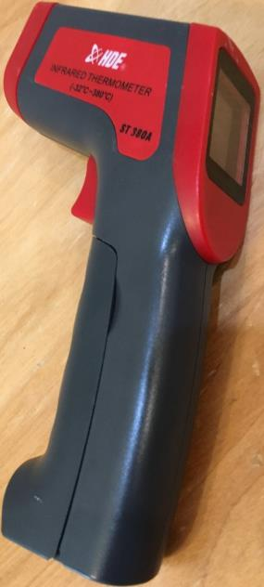
Practice the Procedure Before You Start
We will use infrared temperature guns to measure the temperature of the BBs.
We should practice using the temperature guns before doing the experiment.
Make sure it is set on C (Celsius).
Do NOT look into the laser beam and do NOT point it at someone’s face.
Find the temperature of a wall, the table top, and your arm.
Then pass it to the next person in your group to test.
Notes:
TEACHER NOTES:
We’ve found that there is about a ½ degree Celsius variation among BBs, so when you measure the temperature of the BBs, move the beam around a bit to get a good consistent temperature.
ALSO touch tell the students to avoid the BBs directly! Let’s avoid getting our body heat involved so we can do our best to measure changes in temperature!

Slide 135
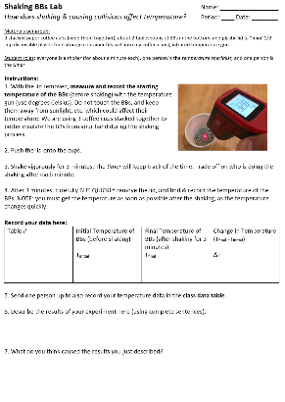
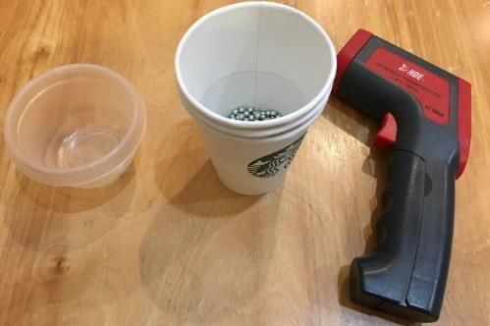
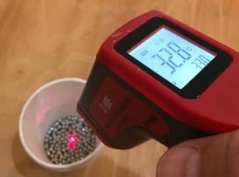
Basically…
Read through the lab.
Then get the materials.
Record initial temperature.
Put on the lid.
Notes:
TEACHER NOTES:
Just some student instructions.

Slide 136
Basically…
Read through the lab.
Then get the materials.
Record initial temperature.
Put on the lid.
Shake for 3 minutes.
Remove lid and record final temperature.
Notes:
TEACHER NOTES:
Just some student instructions.

Slide 137
After the lab procedure…
Each person needs to fill in the data table and answer the questions at the bottom.
We will also be compiling a class data table in the front of the room.
Notes:
TEACHER NOTES:
Just some student instructions.

Slide 138
So what happened?
Discuss results (see Q6).
Is the class data consistent?
Discuss causes (see Q7).
Notes:
TEACHER NOTES:
During the post lab discussion, make sure to clarify that collisions alone don’t cause temperature increases—it is the work I’m doing, the shaking, which is causing collisions, and some of the energy I’m giving to the system is transferring into heat (instead of all going into the motion of the objects).

Slide 139
Conclusion:
Can someone volunteer to summarize what we learned from this lab activity?
Notes:
TEACHER NOTES:
During the BB collisions, some of the kinetic energy is transformed into heat, which we can measure as an increase in temperature.

Slide 140
Applying What We’ve Learned to Impacts:
So what does this tell us about what happens with kinetic energy during an impact event?
Use our formula for kinetic energy and your mime skills or whatever you need to work through this with your group.
Let’s share out our ideas.
Notes:
TEACHER NOTES:
During meteor collisions, nearly all the impacting space rock’s kinetic energy is transformed into heat.
This is because the space rock is going from a very high velocity to zero velocity.
Record ideas on your “What we’ve learned…” sheet.
FYI, we’re going to start building the model in the next learning segment and will leverage a lot of the ideas on this list. You may want to clean the list up a bit before you make that move. (Don’t evaluate and remove kids’ ideas without their consent, but if it’s just as mess, perhaps re-work it in anticipation of the next learning segment.
Heat is something they should be familiar with, though kinetic energy maybe not. A simple example, such as vigorously rubbing their hands together to generate heat, might help drive this point home. It’s not essential that they understand KE per se, but rather that they understand that energy translates into heat, and thus makes early Earth VERY hot.

Slide 141
Today we will compare the energy released in meteor impacts to the energy required to melt rock.
Notes:
TEACHER NOTES:
Transition slide.

Slide 142
More about energy…
We’ve been talking about heat.
How do we usually measure heat?
Temperature is actually a measure of the average kinetic energy in a substance.
Energy (whether kinetic, heat or other forms) is actually measured in Joules!
Notes:
TEACHER NOTES:
Heat and temperature are NOT the same thing. Heat is a form of energy. Adding heat to matter will increase it’s temperature (the average kinetic energy of the particles). Think of heating water. As you go through both increases in temperature and phase changes, the particles move faster and so have more KE. (Recall that KE is a function of mass and VELOCITY.)
These are definitions your kids may not be aware of. Scaffold as appropriate, but be careful to not go too deep “into the weeds”. The main point here is to introduce a way to measure a quantity of energy.

Slide 143
Joules
A joule is the metric (SI) measurement unit of energy.
Mathematically it is equivalent to 1 kg*m²/s².
1 joule is a relatively small amount of energy!
1 J is the energy required to lift a medium-sized (100 gram) tomato up 1 meter
(from the ground to your waist) .
1 J is the energy released when that same tomato falls back down 1 meter.
1 joule used
1 joule returned
Notes:
TEACHER NOTES:
Tell your students they don’t need to memorize this, but it will help them to understand the scale of the energy involved in the meteor (granite cube) impact calculation. You could even have them convert the impact event to “number of flying tomatoes” if you wanted!
SOURCES:
Image, ”Juicy tomato”
URL: https://publicdomainvectors.org/en/free-clipart/Juicy-tomato/49443.html
Attribution: Public Domain (CC0) [https://publicdomainvectors.org/en/public-domain/]

Slide 144
How much kinetic energy do meteors have?
As an example…
Let’s consider a cube of granite rock.
You will use the kinetic energy equation
to calculate the energy:
KE = ½ (mass) x (velocity)²
or KE = ½ mv²
→ So, what do you need to know about the granite cube?
Notes:
TEACHER NOTES:
This is the set up for the calculation. You will need to carefully prepare for this calculation. Please read the Teacher Guide provided with the unit materials. Decide how much independent work you will require from students. This is an excellent opportunity for them to exercise their understanding of algebra, but the calculations require an attention to conversions and units. The task is not straight forward. By then end, we want students to have an appreciation of just how much heat meteor impacts produce and how/why such impacts melt huge amounts of rock. If the math prevents them from getting to that conceptual understanding, consider leading the class through the calculations from the front of the room and/or truncating the activity in other ways.
After this slide, give students the handout, “Calculating the KE of Meteors”.
Students should be asked to respond to the prompt on this slide. (You need to know the mass of the granite cube… so that means know the size and the density.)

Slide 145
Let’s do some math!
Quietly read the top section.
Follow these instructions to fill in boxes 1, 2, and 3.
Leave the 2nd row
(and everything else)
blank for now
Notes:
TEACHER NOTES:
Student instructions. You will need to carefully prepare for this calculation. Please read the Teacher Guide provided with the unit materials.

Slide 146
Let’s do some math…
How much energy does it take to completely melt rock?
To raise the temperature of 1m³ of granite rock from the cold temperatures of the solar system to granite’s melting temperature, and to then keep adding heat until all of the granite is molten requires a total of about 5.45 gigajoules of energy.
Notes:
TEACHER NOTES:
Student instructions. You will need to carefully prepare for this calculation. Please read the Teacher Guide provided with the unit materials.

Slide 147
Then do three more calculations.
Write the following in this box—”Divide by 5.45.”
It takes 5.45 gigajoules
of energy to melt 1m³ of granite rock.
Notes:
TEACHER NOTES:
Student instructions. You will need to carefully prepare for this calculation. Please read the Teacher Guide provided with the unit materials.

Slide 148
Question:
How does the energy released in meteor impacts compare to the energy required to melt rock?
Talk about this with your group for 1 minute.
OK, let’s share out some possible answers.
(I will capture a few of your ideas on the board).
Let’s decide if we need to add anything to our class poster about what we’ve learned.
Notes:
TEACHER NOTES:
Get ideas out and then onto your “What we’ve learned…” poster as appropriate.

Slide 149
Challenge Statements
For each of the following statements,
do you agree or disagree?
Like matter, energy is conserved; it cannot be created nor destroyed.
Energy can switch from one form to another and back to the original form.
Heat is a form of energy that can cause solid objects to vaporize.
Write your ideas about each in Doodle Box P.
Notes:
TEACHER NOTES:
Optional Activity. Once you’ve added some ideas to your “What we’ve learned…” and “What are we wondering about?” posters, you can move onto these challenge statements. This is both a way to “wrap up” your classroom conversations about energy, but it also provides an opportunity for formative assessment.
The ideas here DO need to be covered in some manner. See the Teacher Guide for Energy in the Earth and Physical Sciences. But feel free to skip (and the associated spots on the Doodle Sheet) or modify the activity as you see fit.
During meteor collisions, nearly all the impacting space rock’s kinetic energy is transformed into heat.
This is because the space rock is going from a very high velocity to zero velocity.
Record ideas on your “What we’ve learned…” sheet.
FYI, we’re going to start building the model in the next learning segment and will leverage a lot of the ideas on this list. You may want to clean the list up a bit before you make that move. (Don’t evaluate and remove kids’ ideas without their consent, but if it’s just as mess, perhaps re-work it in anticipation of the next learning segment.
Heat is something they should be familiar with, though kinetic energy maybe not. A simple example, such as vigorously rubbing their hands together to generate heat, might help drive this point home. It’s not essential that they understand KE per se, but rather that they understand that energy translates into heat, and thus makes early Earth VERY hot.

Slide 150
Challenge Statements
Move into to work groups,
deciding who will take on each of the following roles:
The Recorder – records the group’s ideas
The Researcher – recalls what we’ve already learned about this ideas by going back through notes and materials
The Skeptic – challenges the group answer to push the group to support the consensus idea with evidence
The Reporter – reports the group’s ideas out to the class
Do a round of talking sticks to share ideas, and then try to come to consensus on your response to each.
We’ll share out in 5 minutes, so reporters be ready!
Notes:
TEACHER NOTES:
Roles help to structure this round of work in their groups. Use roles such as these regularly to assure student participation. (See the MBER website for more information.)

Slide 151
Challenge Statements: Summary
As a class, do we agree or disagree?
Like matter, energy is conserved; it cannot be created nor destroyed.
Energy can switch from one form to another and back to the original form.
Heat is a form of energy that can cause solid objects to vaporize.
Let’s record our class ideas in Doodle Box Q.
→ Let’s also add any notes to our class poster we think are important (and you can add them to Box Q).
Notes:
TEACHER NOTES:
Bring the class back together to have a conversation. Work with students to resolve disagreement. You should have ideas on your “What we’ve learned…” poster that will help students evaluate the class’s ideas. Be sure to add to that poster when you’ve finished (as needed). You should have at least the minimum set of ideas specified in the Teacher Guide about Building the Model (also recounted on the Learning Segment Table).

Slide 152
LS 07: Learning Segment Summary
What we’ve figured out…
We now see that beyond the movement of a lot of matter on the ground, the generation and deposition of heat is a huge consequence of impacts.
LS 07 Teacher Reflection:
What I think worked well…
What I would change…
Notes:
Slide is not meant for students.

Slide 153
LS 08: Learning Segment Overview
We finally step back to wonder how impact craters might help us understand how the Earth formed through an activity called “Rewind the Clock”.
55 minutes
Resources you will need:
FE Doodle Sheet
FE Teacher Guide – Building the Model (Read this now if you haven’t already!)
FE 08 Rewind the Clock
MBER Essentials:
The Silent Board Meeting
FAQs germane to model building.
Notes:
Slide is not meant for students.

Slide 154
LS 08: Building a Model (Finally)
We finally work to build a model that attempts to answer our Driving Question about the formation of the Earth. You should first review what the class learned about models back in the Setting the Stage unit at the beginning of the year. (If you skipped that unit, please at least prepare an activity on models and modeling and engage your students in completing it before taking on this learning segment.)
Models are often represented in this curriculum as a series of statements, but in the present case a representation can go a long way toward having students generate the key ideas that will become the model statements. We therefore have students engage in an activity called “Rewind the Clock” in order to make their thinking about the model visible. Given all that we’ve talked about so far, how do we think the Earth came together? We ask our students to create a multi-panel comic strip of sorts that shows in steps how the rocky ball (geosphere) of Earth may have come to exist from the swirling mass of gas and dust that was the proto-solar system. After framing the activity for students, you will co-create both the first panel and last panel of the comic strip so that we have a common understanding of how things began and how they ended. The three panels in between will reveal what your students think happened in between the swirling mass and the formed geosphere. Be certain you’ve read the FE Teacher Guide – Building the Model.
Students will have a chance to see the work of other groups and then to revise their own representations before you then ask them to share out their model statements.
Notes:
Slide is not meant for students.

Slide 155
LS 08: Building a Model (Finally)
This first model-building conversation with the whole class is one you should prepare for. After reading through the coming student-facing slides, consider how you will choose to elicit student ideas, record them, and when and how you will provide an opportunity for those ideas to be evaluated.
The suggested method here involves asking student groups to share out a single idea, which you will record on the board. Brainstorming is key at this point… you’ll have time to evaluate as a class at a couple of later points. Remind students of classroom norms that explicitly state the importance of getting all voices into the room and all ideas on the table. That’s how we do our best science: we consider all ideas as a starting point. Having groups share instead of individuals also provides a degree of anonymity and safety as well: if the idea I’m speaking into the class belongs to my group, there’s much less personal risk in “being wrong”.
If you are concerned about crazy ideas you see coming up during the Rewind the Clock activity, find subtle ways to address those while students are working in their small groups. You can also problematize aspects of the model they may be missing. A couple of ideas may not be evident to students, even though we feel they are central to a final model. For example, there are two ideas that describe the consequences of energy transformation:
Early on, space rocks were colliding frequently, converting enormous amounts of kinetic energy into heat. There was so much heat that the solid rocks melted into liquid rocks (magma/lava).
The earth was a sphere of lava being constantly hit (and therefore heated) by more space rocks.
Notes:
Slide is not meant for students.

Slide 156
LS 08: Building a Model (Finally)
Don’t worry if your students don’t put these ideas together immediately, but try to think of ways to help them connect the discussion of energy, the Shaking BBs Lab, and the ensuing calculation about melting rock with the task in front of them. How do these ideas connect to the formation of the Earth. This is why it is SO important to have your record of “What we’ve learned…” posted or visible in some other way to students as they piece together the model.
Students may also completely miss the idea of gravity. It’s not something we’ve explicitly talked about, but it is a key component of several model ideas as listed in the curricular sample:
Gravity increases when (A) the mass of an object increases and (B) the distance between objects decreases.
More gravitational attraction caused more collisions as the proto-Earth gained mass.
These ideas will be more formally generated in the next learning segment, but we hope and expect gravity will at least come up in their initial models.
There are also model statements about the abundance of space rocks through time, i.e. As more and more nearby space rocks collided with the forming Earth, the number of nearby space rocks decreased. These are logic-based inferences, but they have real consequences for the model. For example, if the number of space rocks never decreases, then proto-Earth would continue to be bombarded and would never have a chance to cool. (Cooling will be addressed in learning segment 10.) Be sure to read through the MBER Essentials related to building and finalizing models for further guidance on the important moves you’ll need to facilitate as you come to these final few learning segments in Formation of the Earth.
Notes:
Slide is not meant for students.

Slide 157
Navigation: What have we learned over the past couple of weeks?
Here we provide a fairly complete list of what you may have recorded. The minimal list is provided in the FE Teacher Guide – Building the Model and is highlighted in a learning segment by learning segment manner on the FE Learning Segment Table.
What we have learned:
There are lots of space rocks floating around the solar system.
Sometimes they enter our atmosphere and are visible as “shooting stars”.
We see evidence that they have hit both Earth and other planets in the past.
Our atmosphere breaks up most space rocks that are headed toward Earth.
Minerals near impact craters sometimes show evidence of heat and pressure from the impact, even when the space rock itself is not found.
Mass is conserved during (at least a) simulated impact.
Matter is conserved in the universe, so the matter in a real impact has to go somewhere.
In special circumstances, matter can be converted to energy (E=mc²), but that’s not what is happening during an impact. (We are pretty sure.)
The size and speed of a meteor affects what happens at impact and the size of the crater. The material the meteor and ground are made up of also affect the size or width of the hole.
Energy comes in many forms and can be transformed or converted from one kind to another.
Kinetic energy is the energy of motion (and thus of meteors) and depends on the size (or mass) and speed of an object (like a space rock).
During impacts, most of the kinetic energy is converted to heat.
The heat from an impact is enough to melt rock.
Notes:
Not meant to show to students.

Slide 158
Back to the Beginning
What does all of this have to do with Earth’s formation? What do you think?
Let’s return to our Driving Question and see if we can’t begin to piece together a model.
In a minute, we’re going to engage in an activity called “Rewind the Clock”.
Notes:
TEACHER NOTES:
This is not a discussion… yet. You are just preparing students to build the model for the formation of the Earth.
There are a few things we’ll need to tackle before jumping into the Rewind the Clock activity (our visual means for constructing the initial model).
We start this learning segment by reminding ourselves quickly of the Driving Question. You should have this posted in your classroom, and students should have it written on their doodle sheets.
The next step will be to remind students what models are and how we decide if they’re good.
See the Teacher Guide for Building the Model for more detail on how to engage the model-building aspect of this Learning Segment.

Slide 159
But first… What does it mean to develop a model?
Let’s review: What is a model?
How would we decide if we like our model? (Do we have criteria or rules for models?)
Notes:
TEACHER NOTES:
This is a review you need to run based on how you presented models in the unit “Setting the Stage.” You just want your students to recall what you decided on back then in mind as they work on their Rewind the Clock comic strips.
You might choose to insert some slides from your Setting the Stage PowerPoint here to provide a visual reminder or to point to your model criteria on the wall if you decided to post them.
See the Teacher Guide for Building the Model for more detail on how to engage the model-building aspect of this Learning Segment.

Slide 160
Rewind the clock…
Let’s first try to build a model that addresses our Driving Question visually.
In order to figure out how earth formed, we could take what we’ve figured out about impacts and go back in time.
In teams, take a white board and draw your ideas about what we’ve figured out so far and where that leaves us with our understanding of how the Earth formed.
Notes:
TEACHER NOTES:
Start to outline the activity for your students through the next several slides.
See the Teacher Guide for Building the Model for more detail on how to engage the model-building aspect of this Learning Segment.
If you choose to use whiteboards for this activity, try to time class breaks so that students don’t need to recreate their work. Poster paper or a series of 8.5” x 11” papers adhered to a whiteboard might be the preferred alternative in this case. If using whiteboards, have students snap an image of their group’s work at the end of class for the record.

Slide 161
Rewind the clock…
We’re going to USE our ideas about space rock impacts to…
Create a visual “comic strip” representation of how Earth formed.
Guidelines for the boards → 3 requirements:
Drawing: Five panels (LABELED) representing 5 different time points. You will be given the first and last in a moment, so your job is just to fill in the other three.
Questions: Record questions that are coming up as you talk about how this process works. They can just be added neatly to each panel or to wherever you prefer on your whiteboard.
Model Ideas: Clearly stated proposed model ideas for Earth formation.
Someone should take a pic of your board. We will be holding a “board meeting” during the last 10 minutes of class.
Notes:
TEACHER NOTES:
It’s likely important to emphasize that creating a stunning piece of visual art is not the central intention of this activity. That said, it is an opportunity for more artistically-inclined students to contribute and have an outlet. Challenge these students to create a meaningful representation.

Slide 162
Rewind the clock…
Guidelines for the boards → 3 requirements:
Drawing: Five panels (LABELED) representing 5 different time points. You’ll be given the first and last…
IN THE
BEGINNINGOF THE
SOLAR SYSTEM
EARLY
MIDDLE
LATE
… and then there
was “Earth”!
Questions: Record questions that are coming up as you talk about how this process works. They can just be added neatly to each panel or to wherever you prefer on your whiteboard.
Model Ideas: Clearly stated proposed model ideas for Earth formation.
Notes:
TEACHER NOTES:
The Rewind the Clock activity is the first step in building the model with your students.
Note: As you’ll see in better detail in a few slides, the image of Earth is supposed to represent a newly formed, crater-covered planet without actually reflecting the artist illustrations of a molten Earth. (We intentionally did not include an image that implied a molten, volcanic planet since as a class we may not have built that idea by this point.) This image is in fact a modified version of our earlier image of Mercury.
SOURCES:
Image modified from earlier image of Mercury, “This image shows an orthographic projection of this global mosaic centered at 0°N, 0°E. The rayed crater Debussy can be seen towards the bottom of the globe and the peak-ring basin Rachmaninoff can be seen towards the eastern edge.”
URL: https://commons.wikimedia.org/wiki/File:Mercury_Globe-MESSENGER_mosaic_centered_at_0degN-0degE.jpg
Attribution: NASA/JHUAPL [Public domain]

Slide 163
How did things start out? (Panel 1) What can we agree on as a starting point?
Our model begins with a collection of gas, dust, and small rocks orbiting a star (the sun).
The gas, dust, and small rocks are concentrated in a spinning, disk-shaped area surrounding the sun.
Side view:
Notes:
TEACHER NOTES:
We are giving students the starting point for their thinking and delineating the boundaries of what we are wondering about and what we are NOT wondering about here.
SOURCES:
Image, “Silicate Crystal Formation in the Disk of an Erupting Star”
URL: https://www.jpl.nasa.gov/spaceimages/details.php?id=PIA12008
Attribution: NASA/JPL (https://www.jpl.nasa.gov/imagepolicy/)

Slide 164
Closer in, it might have looked something like this.
We are not trying to understand where this gas, dust, and small rocks came from.
We are not trying to understand why this stuff orbits the sun in a disk-shape.
We are not trying to understand what causes the sun to produce heat and light.
We are not even trying to understand how the other planets formed… unless we think it helps us to understand our driving question…
We ARE focused on understanding how Earth formed from the gas, dust, and small rocks orbiting the sun that you see in this picture.
Notes:
TEACHER NOTES:
So we don’t need to worry about the Big Bang, or Supernovas!
SOURCES:
Image, “Silicate Crystal Formation in the Disk of an Erupting Star”
URL: https://www.jpl.nasa.gov/spaceimages/details.php?id=PIA12008
Attribution: NASA/JPL (https://www.jpl.nasa.gov/imagepolicy/)

Slide 165
The endpoint = “Earth” (geosphere only)
We just need to get to a version of Earth that is a big, spherical rock like Mercury and the other terrestrial planets.
Think of all of the ideas you’ll need (some of which we likely already have) in order to go from the swirling gas and dust of the solar system to a rocky planet.
“proto-Earth”
(why does this image look familiar?)
Notes:
TEACHER NOTES:
The endpoint here is a newly formed, crater-covered planet. Don’t spend time point out details here. We just want students to work toward a geosphere, however they might imagine it at this point. The image is supposed to remind them, however, that we are not worrying about oceans, clouds, life, etc. (We intentionally did not include an image that implied a molten, volcanic planet since as a class we may not have built that idea by this point. This image is in fact a modified version of our earlier image of Mercury.)
Image modified from earlier image of Mercury, “This image shows an orthographic projection of this global mosaic centered at 0°N, 0°E. The rayed crater Debussy can be seen towards the bottom of the globe and the peak-ring basin Rachmaninoff can be seen towards the eastern edge.”
URL: https://commons.wikimedia.org/wiki/File:Mercury_Globe-MESSENGER_mosaic_centered_at_0degN-0degE.jpg
Attribution: NASA/JHUAPL [Public domain]

Slide 166
So what is our model for Earth formation at this point?
If the solar system started out as a bunch of dust, gas and tiny space rocks, how might we think the Earth formed?
Think first in terms of the matter (all of the stuff that makes up proto-Earth).
Then think about how what we know about energy might also be part of our model.
Be sure to draw upon the ideas we’ve already learned about to see what might help us to make sense of Earth’s formation.
Notes:
TEACHER NOTES:
These instructions that help guide the task are included on the student handout “FE 08 Rewind the Clock Student Instructions”.

Slide 167
Rewind the clock!
Guidelines for the boards → 3 requirements:
Drawing: Five panels (LABELED) representing 5 different time points. Your job is to fill in the middle three.
EARLY
MIDDLE
LATE
Dust and gas swirled around the sun.
… and then there
was “Earth”!
TIME
Questions: Record questions that are coming up as you talk about how this process works. They can just be added neatly to each panel or to wherever you prefer on your whiteboard.
Model Ideas: Clearly stated proposed model ideas for Earth formation.
Notes:
TEACHER NOTES:
You can leave this slide up while student work.
After you’ve reviewed this slide with your students, hand out the instructions for Rewind the Clock. As your students work to complete the task, you’ll want to wander the room for a number of reasons: to keep students on task, to monitor the ideas that are coming up for them, to push them on holes in their model so that they can develop ideas or ask questions to address the holes, and to prepare them for coming steps such as the Silent Board Meeting (or Galley Walk if you choose) and the whole-class discussion around model building.
SOURCES:
Image, “Silicate Crystal Formation in the Disk of an Erupting Star”
URL: https://www.jpl.nasa.gov/spaceimages/details.php?id=PIA12008
Attribution: NASA/JPL (https://www.jpl.nasa.gov/imagepolicy/)
Image modified from earlier image of Mercury, “This image shows an orthographic projection of this global mosaic centered at 0°N, 0°E. The rayed crater Debussy can be seen towards the bottom of the globe and the peak-ring basin Rachmaninoff can be seen towards the eastern edge.”
URL: https://commons.wikimedia.org/wiki/File:Mercury_Globe-MESSENGER_mosaic_centered_at_0degN-0degE.jpg
Attribution: NASA/JHUAPL [Public domain]

Slide 168
Silent “Board Meeting”
Let’s gather to see the ideas that other groups have…
Process:
Silently view each other’s boards. Just read and appreciate what other groups did for a minute.
Identify some differences and similarities.
Notice any unresolved questions about Earth’s formation. Are there pieces still missing?
Return to your tables and record some notes in Doodle Box R.
Notes:
TEACHER NOTES:
The point here is simply for students to notice what has come up in other drawings and then to go back into their groups to discuss changes they’d like to consider for their drawing and model. In this way, we learn from each other, moving the class toward a more complete, more critical consensus model.
The Silent Board Meeting provides an opportunity for students to see each other’s work. You’ll likely need to divide the class into subsections of three (or so) groups facing each other in “triangles”, though it can work as a whole class circle activity. Decide how long your students will need, whether or not they need to rotate through groups, and if they’ll need a more scaffolded version of this exercise (e.g. a half sheet that includes prompts such as “Record two similarities you notice between your poster and those from other groups.”).
You could also structure this activity as a Gallery Walk. (See the MBER website for more information about both of these in-class tools.)

Slide 169
Back to the Drawing Board
Return to your group to edit your poster / model.
Process:
Do one round of talking sticks to share what you noticed about other posters.
Decide what you might like to edit or add to your poster.
Record any new unresolved questions about Earth’s formation you may have noticed or thought about in Doodle Box S.
Notes:
TEACHER NOTES:
The Silent Board Meeting provides an opportunity for students to see each other’s work. You could also structure this activity as a Gallery Walk. (See the MBER website for more information about these in-class tools.) The point here is simply for students to notice what has come up in other drawings and then to go back into their groups to discuss changes they’d like to consider for their drawing and model. In this way, we learn from each other, moving the class toward a more complete, more critical consensus model.

Slide 170
So what is our model for Earth formation at this point?
What are the key ideas we have?
What rules or laws might be important to controlling this process?
How would we describe the formation of the Earth in terms of the matter? Of energy?
Take a minute in your group to pull out two key ideas that you can tell the class about.
→ Record these in Doodle Box S.
Notes:
TEACHER NOTES:
Start with something like, “We’ve now had some time to look over each other’s posters and to go back and add ideas or make changes to our own. So, what’s our model?”
You are setting the class up for THE KEY CONVERSATION that will DEVELOP A FIRST-DRAFT MODEL. This MAY NOT BE EASY or go smoothly the first time. Consider planning this discussion ahead of time. (See the resources about planning whole-class discussions on the MBER Essentials page.)

Slide 171
Our model for Formation of the Earth
What are the key ideas we have?
What rules or laws might be important to controlling this process?
How would we describe the formation of the Earth in terms of the matter? Of energy?
I’m going to call on each group for one idea and will record them on the board.
We’re taking up all ideas that groups thought were important at this point.
Notes:
TEACHER NOTES:
This is the key conversation. Record the ideas, honoring student language. See teacher notes and the Teacher Guide for Building the Model for a set of essential ideas and decide how you will proceed if your students don’t generate these ideas. (You should also check out the MBER Essentials FAQs on the MBER website for strategies germane to model-building.)
Students may focus initial on matter (in both their drawings and what they report out). Prompt them to talk separately about their ideas about energy. You are trying to work toward a model that incorporates some of the consequences of impacts. The following two statements are included in the example model provided as part of the curriculum:
Early on, space rocks were colliding frequently, converting enormous amounts of kinetic energy into heat. There was so much heat that the solid rocks melted into liquid rocks (magma/lava).
The earth was a sphere of lava being constantly hit (and therefore heated) by more space rocks.

Slide 172
LS 08: Learning Segment Wrap-Up
What we’ve figured out…
We’ve pulled together an accretion-based model of Earth’s formation but have begun to wonder about the role of gravity.
LS 08 Teacher Reflection:
What I think worked well…
What I would change…
Notes:
Slide is not meant for students.

Slide 173
LS 09: Learning Segment Overview
We explore gravity and consider its role in Earth’s formation.
30-55 minutes
Resources you will need:
FE Doodle Sheet
Prepared video clip of astronauts on the moon.
A plan for engaging students in the Gravity PhET (online simulator) from the University of Colorado.
Read the Earth Science Guide “About Gravity” on the website.
Notes:
Slide is not meant for students.

Slide 174
LS 09: Exploring Gravity
The goal of this learning segment is fairly straightforward: you need to formalize some ideas about gravity with your students. If they already asserted its role in their model (last learning segment), the transition will be easier. If, however, they did not bring up gravity (and you did not seed the idea), you’ll have to problematize it now. “How would rocks just randomly come together as planets? Why isn’t the solar system just a giant asteroid belt?”
Once you’ve motivated an exploration of gravity, proceed through the activities here, which are designed to get your students thinking about the relationship between gravity, mass and distance. (If you need to brush up on this, consider a lunchtime chat with a physics colleague.)
Perhaps the more difficult part of this learning segment is working with students to add to the model. What feels important to record about gravity in terms of our model for the formation of Earth? One idea is that gravity was a factor all the way from the start in pulling even small particles together. Other models might really assert that gravity was a driving force as clumps of larger rock formed. Both are true. Use the model we’ve provided in the MBER resources as a guide, but as always, try to honor student language.
If your students wonder how some of the first particles came together and are not convinced that gravity played a role, consider exploring an optional slide included at the end of the learning segment. The recent characterization of Ultima Thule by New Horizons has provided NASA with some of the best evidence yet for how early accretion might work. (There’s a great NOVA special if you have time to watch it outside of class.)
Notes:
Slide is not meant for students.

Slide 175
Thinking About Gravity
Have you ever seen videos of astronauts bouncing on the surface of the moon?
Why can they do this?
Notes:
TEACHER NOTES:
Show one of the videos linked below or one of your own choosing if you are able. Consider showing an excerpt if selecting a video longer than a couple of minutes.
SOURCES:
Image, “Astronaut Buzz Aldrin on the moon.”
URL: https://commons.wikimedia.org/wiki/File:Aldrin_Apollo_11_original.jpg
Attribution: NASA / Public domain
YouTube Video (user = PlasmaBen), “Bunny Hopping on the Moon” (1 minute)
URL: https://www.youtube.com/watch?v=HKdwcLytloU
YouTube Video (user = Martian Archaeology), “Astronauts on the Moon, Throwing Stuff & Falling Down, Lunar Rover, Moon Buggy” (5 minutes)
URL: https://www.youtube.com/watch?v=RkXETqJgpBQ
YouTube Video (user = NASA), “Restored Apollo 11 Moonwalk - Original NASA EVA Mission Video - Walking on the Moon” (3 hours)
URL: https://www.youtube.com/watch?v=S9HdPi9Ikhk&t=6s

Slide 176
Gravity, Weight and Mass
How much would you weigh on the moon?
A person weighing 100 lbs on the Earth would only weigh about 16 lbs (16.6 lbs more precisely) on the Moon.
Some definitions:
Your mass is the amount of matter you are made up of.
Your weight, however, is a measure of the amount of force you exert on the ground because of your mass and the acceleration due to gravity.
Your mass and weight are related.
Notes:
TEACHER NOTES:
Walk students through these definitions. The point here is to set up mass as an immutable quantity. (Well, our mass fluctuates and that’s what causes our weight to fluctuate on Earth, but the amount of stuff you are made of does not change just because you—for example—go to the Moon.) Weight depends on gravity. (And gravity does change depending on your location in the universe.)

Slide 177
Gravity, Weight and Mass
If you were to travel to other planets, your mass would not change, but your weight would change.
Mass (kg) | Weight (lbs) | Planet
45 | 38 | Mercury
45 | 91 | Venus
45 | 100 | Earth
45 | 16 | Moon
45 | 38 | Mars
Why do you think this is?
What patterns do you notice?
Notes:
TEACHER NOTES:
Weight changes because gravity changes when you go to other planets. Some students will know this.
The point of this slide is to also seed the idea that gravity might be dependent on the mass of the planet or moon you are standing on.
(Note: including outer planets complicates the pattern since the radius of gas giants among other factors affects the force of gravity at their defined surface. Sticking to inner planets will help to keep the pattern clear.)
SOURCES:
Image, “This diagram shows the approximate relative sizes of the terrestrial planets, from left to right: Mercury, Venus, Earth and Mars. Distances are not to scale.”
URL: https://commons.wikimedia.org/wiki/File:Terrestrial_planet_size_comparisons.jpg
Attribution: wikipedia user Brian0918 [Public domain]

Slide 178
Gravity, Weight and Mass
Mass (kg) | Weight (lbs) | Planet
45 | 38 | Mercury
45 | 91 | Venus
45 | 100 | Earth
45 | 16 | Moon
45 | 38 | Mars
Why do you think this is?
What patterns do you notice?
Write your thoughts in Doodle Box T.
Notes:
TEACHER NOTES:
Just a slight alteration of the previous slide to include a prompt for students to write their individual thoughts on their doodle sheet.
SOURCES:
Image, “This diagram shows the approximate relative sizes of the terrestrial planets, from left to right: Mercury, Venus, Earth and Mars. Distances are not to scale.”
URL: https://commons.wikimedia.org/wiki/File:Terrestrial_planet_size_comparisons.jpg
Attribution: wikipedia user Brian0918 [Public domain]

Slide 179
What’s going on with gravity?
Work with a partner on the following simulation:
https://phet.colorado.edu/sims/html/gravity-force-lab/latest/gravity-force-lab_en.html
You can also navigate there by going to:
https://phet.colorado.edu
Then click on Earth Science.
Find the “Gravity Force Lab” on the list.
Notes:
TEACHER NOTES:
Give students a little time to play (5 minutes) and then pull the group back together. The point here is to begin to recognize there is a mathematical relationship relating the force of attraction to the combined mass of the objects and the distance between them.
The PhET (Physics Education Technology) simulation reports forces in Newtons, which is a bit less than ideal for our purposes. You might unpack what a “Newton” is with your students, or you might instruct them to focus on the patterns of magnitude (as a function of distance and mass) and not the units of the force.
If computer access is difficult, students can engage with the simulator on their phones. Alternatively, you could run the simulator as a demo.

Slide 180
What did we learn?
What did you notice in the simulation?
Record your ideas in Doodle Box U.
Let’s share out our ideas about gravity.
Notes:
TEACHER NOTES:
Give students a little time to play (5 minutes) and then pull the group back together. The point here is to begin to recognize there is a mathematical relationship relating the force of attraction to the combined mass of the objects and the distance between them.
The PhET (Physics Education Technology) simulation reports forces in Newtons, which is a bit less than ideal for our purposes. You might unpack what a “Newton” is with your students, or you might instruct them to focus on the patterns of magnitude (as a function of distance and mass) and not the units of the force.
If computer access is difficult, students can engage with the simulator on their phones. Alternatively, you could run the simulator as a demo.

Slide 181
How does gravity relate back to the Formation of Earth?
“As our infant planet grew larger, it was like both a gravitational vacuum cleaner and a leaf blower.”
—quote from “The Life and Death of Planet Earth”
by Peter Ward and Donald Brownlee
What does it mean to be a gravitational vacuum?
AND
What did that mean for the frequency of impacts from large meteors over time?
Notes:
TEACHER NOTES:
Lead a discussion here. You can send students back into their groups and then share out. You might ask them to refer back to some of their thoughts about how gravity contributed to the formation of the Earth as they drew it on their Rewind the Clock posters (if you had them keep a record of those).
Regardless of what statements you might already have about gravity in your class model, this quote might help you to draw out some ideas around gravity’s role in the formation of the planet. We need to make the connection at this point so that we can add to or revise our model on the next slide before wrapping up this learning segment.
Going further, you could ask students…what does this mean for the ENERGY coming into the system?

Slide 182
Let’s revisit our model…
Do we need to change or add anything?
Notes:
TEACHER NOTES:
This is a move where you will have to work with students to decide how to add a statement about gravity (if missing) or how to modify any statement about gravity.
Also address the question, “What makes rocks stick together?” if it comes up. Many classes won’t even consider this, and you don’t need to problematize it for them. But if they do, try to honor their curiosity. Gravity explains attraction but not necessarily accretion at early stages. The next slide which explores this directly is optional.

Slide 183
Rewind, Rewind, Rewind the Clock All the way back to the VERY beginning.
Scientists have been wondering for a long time how the first space rocks on our solar system might have stuck together.
What do we think might have caused the first space rocks to stick together? What role might gravity play and why?
Notes:
TEACHER NOTES:
Optional slide. Decide if this is a useful conversation for your class. Scientists are still a bit uncertain about the details of how the first chunks of rock that made Earth and other planets came together. Certainly gravity plays a role, but with small masses, there is an element of chance that led to the first collisions. And then most collisions would have led to ricochet or fragmentation. Under particular circumstances the velocities of colliding rocks would have led to enough heat to “melt” them together enough to allow sticking.
The image here shows Ultima Thule (observed by New Horizons in the outer, outer solar system), a fused asteroid which provided perhaps some of the first direct evidence for early accretion of planetary rock. The image on the right shows even more dramatically the different sources of rock that needed to come together to create this asteroid. Perhaps Earth started in a similar manner, and, at some point (when?) gravity took over in drawing in more and more space rocks.
You could come to this slide any day after the initial model has been build. Perhaps entering into the conversation using a warm-up: “What makes the space rocks come together in the first place? What ideas do you have about why they stick together?”
The New Horizons mission (NASA) was designed to better engage the outer planets—Uranus and Neptune– as well as provide the first fly by of Pluto. In 2019, however, it engaged an asteroid in the Kuiper Belt that had long intrigued scientists. Ultima Thule provides some of the first evidence for the accretionary model for planet-building. When
SOURCES:
Image, “This composite image of the primordial contact binary Kuiper Belt Object 2014 MU69 (nicknamed Ultima Thule) – featured on the cover of the May 17 issue of the journal Science – was compiled from data obtained by NASA's New Horizons spacecraft as it flew by the object on Jan. 1, 2019. The image combines enhanced color data (close to what the human eye would see) with detailed high-resolution panchromatic pictures.”
URL: https://commons.wikimedia.org/wiki/File:UltimaThule_CA06_color_vertical_(rotated).png
Attribution: NASA/Johns Hopkins University Applied Physics Laboratory/Southwest Research Institute/Roman Tkachenko. [Public domain]
Image, “Black lines mark troughs, notched lines mark scarp crests. The lineation circling unit mh has been nicknamed "The Road to Nowhere". The large crater lc is the "Maryland Crater" on Thule, and sp are smaller pits or craters. The areas labeled bm and dm are made of bright material and dark material, respectively. The magenta areas labeled pm are patterned material, while the green areas labeled rm are rough material, and the blue areas labeled um are undifferentiated material. The eight subunits of Ultima, labeled ma to mh, are rolling topography units that might be smaller subunits of Ultima.”
URL: https://commons.wikimedia.org/wiki/File:NASA-UltimaThule-Geology-NewHorizons-20190318.jpg
Attribution: NASA/Johns Hopkins University Applied Physics Laboratory/Southwest Research Institute/ESA [Public domain]

Slide 184
LS 09: Learning Segment Summary
What we’ve figured out…
We now have a fairly complete model for molten Earth.
LS 09 Teacher Reflection:
What I think worked well…
What I would change…
Notes:
Slide is not meant for students.

Slide 185
LS 10: Learning Segment Overview
We consider the final pieces of the model and work to understand how Earth must have cooled enough to form an exterior crust.
55 minutes
Resources you will need:
FE Doodle Sheet
FE 10 Cooling Butter Lab (for Students), FE 10 Cooling Butter Lab Teacher Guide, FE 10 Butter Lab Teacher Guide Video
FE 10 Optional Reading – Earth’s Formation
FE 10 Optional Reading Summary Sheet
MBER Essentials: FAQ Finalizing the Model, FAQ Close Enough
Notes:
Slide is not meant for students.

Slide 186
LS 10: A Last Step
In this learning segment, you’ll need to be certain you develop ideas about two processes instrumental in Earth’s formation: (1) heating and (2) cooling.
Heating: If the class has not already established the idea of a “molten Earth”—that the collisions and impacts that formed the growing proto-Earth generated enough heat to make the entire mass of rock molten—you’ll need to do so at this time.
Cooling: Once the idea of molten Earth is on the table, it’s a relatively easy push toward asking students, “How then did the Earth cool?”
Though we haven’t formally established that contemporary (i.e. “cooled”) Earth still has a molten core, your students will likely have this idea from middle school science or informal education experiences. This is not the time to unpack all of the layers of the Earth’s interior, but we do need to address the cooling of the exterior before moving on to the development of the other spheres (hydro, atmo, bio) in the next unit.
You’ll give students an opportunity to offer their own ideas about cooling (or rearticulate the ideas if already present in the class’s model). Following the discussion, you can engage kids in a demo using cooled butter to simulate the process of planetary cooling (or have them do it individually at home). The big idea here is that planets—and other hot objects—cool from the outside inward. This sets us up to understand the molten interior later during plate tectonics.
At the end of this learning segment, you should have completed your model for formation of the Earth’s geosphere. (See notes on “Finalizing the Model” on the next slide and tips about doing so on the MBER website.) The final slides provide a transition to the next unit.
Notes:
Slide is not meant for students.

Slide 187
LS 10: A Last Step
Some teachers find it helpful to reinforce the model with their students at this point. You may have students engage with a reading or video that recaps current thinking on the origins of the Solar System and of the Earth. Keep in mind that we have only explored the formation of the rocky geosphere. Anything you show students will likely need to be muted and screen for the stealing of “ahas!” from the next, shorter unit which explores the origin of both the oceans (hydrosphere) and atmosphere.
See the optional resources we’ve provided for ideas. But if your students are ready to move on to the next unit, move on! There will be an opportunity to assess their understanding of the origin of the geosphere at the end of the next unit (after we’ve added ideas about the oceans and atmosphere).
Notes:
Slide is not meant for students.

Slide 188
LS 10: Finalizing the Model
Models in science are never really "final", but in the classroom, there are times when we need to put a "period" (or at least a "comma") on our model so that we can move on to new phenomena and ideas. Working through the process of finalizing the model with your students can be tricky, especially if there are ideas that still need to be evaluated or even generated before you are ready to do so. Here are some tips for handling pieces of this process that teachers have found useful.
How do you guide the class to settle on a “final" working model?
First, note that there is no final model. Models are always subject to revision in the light of new data. Once you have completed all of the activities designed to test and deepen the model, the class decides whether or not further revisions are needed. To do this, we direct the class to consider whether or not our model meets the model criteria:
Does it fit our data and explain our observations?
Is it realistic/plausible, given what we know about the natural world?
Using it, can we make accurate predictions?​
Note that any re-evaluation of the model is not a discussion about what is right or wrong, but a judgment as to what is best based on the criteria. Because the model ideas came from the whole group, no one is personally associated with them and there are no hurt feelings if an idea is discarded or changed. Our goal is to develop the best possible model for the benefit of all.
Once everyone is happy with the model it is considered “final” (unless future evidence suggests it should be revised). You can use a number of strategies for determining when the class is happy with the model such as five-finger voting.
Notes:
Slide is not meant for students.

Slide 189
LS 10: Finalizing the Model
What do you do if students are happy with the model but you know there is still something missing? In this case you may need to ask some probing questions to help students see that the model does not have all the ideas needed to answer the original question. You may need to find another activity, reading, or video to provide the information students need to complete the model.
What do you do / can you do with the model now? Models in science do not work in isolation: they are inextricably linked to one another. Any model can be connected to others, and this provides incredible opportunities for students to make connections across the curriculum. Be ready to revisit models as the year goes along. Some models, such as Natural Selection, are revised very intentionally as student understanding of biology deepens throughout the year. Others may not be so directly re-addressed, but the opportunities are there should you want or need them.
Classroom models are ALWAYS subject to revision. (Are you sensing this point is important?) Be prepared for both planned and spontaneous revisions as student ideas or understandings shift in light of new phenomena. This is how science works. Our understanding of what's going on with the universe shifts as new data is generated, new observations made, new patterns recognized. This is the exciting part of science: we may never get to a complete "right" answer!
A "final" list of model ideas is NEVER to be the subject of an assessment. The ideas are tools for students in their evaluation of natural phenomena. If you want to test their understanding of a model, why not give them a pattern or phenomenon and ask them to apply appropriate models. Alternately, you can give them a scenario (phenomenon) and ask which model ideas apply. Some teachers allow students to use their "model summary" sheet as a "cheat sheet" for such exams. Importantly here we are evaluating student understanding of how to use model ideas, not their ability to memorize the components of a model.
Notes:
Slide is not meant for students.

Slide 190
LS10: Sample model statements about cooling…
The curricular resources offer this statement as an outgrowth of the class’s exploration of cooling: Earth was molten, as space rocks decrease in number, their were fewer collisions so the cold empty vacuum of space cooled the earth down. The parts of earth closest to the surface cooled down first, while the deepest center of earth remained molten rock.
The statement above came from an actual 9th grade classroom and was the product of a consensus-making conversation that started with the following offerings:
Asteroids became less common, letting the earth cool. The outside cooled, but the inside was still molten, just like the butter.
I think the atmosphere helped cool the earth down, the atmosphere was kind of like insulation similar to the freezer.
The crust of earth is like the solid top of the butter, the inside was molten also, similar earth. When we re-mixed (added energy) the materials, it turned them back into liquids.
When earth’s orbit was clear of meteors, their were less collisions, which resulted in less KE which decreased the temperature. When it started to cool down, the shallowest part of earth cooled down quickest and became the most solid, whereas the deeper the earth was, the more molten the materials.
Earth was molten, as space rocks decrease in number, their were fewer collisions so the cold empty vacuum of space cooled the earth down. The parts of earth closest to the surface cooled down first, while the deepest center of earth remained molten rock.
-OR- As the number of impacts declined, earth began to cool from the outside. A solid crust of rock formed on the outside of sphere, but it was still molten on the inside.

Slide 191
Reviewing Our Model
As the Earth was forming, was it hot or cold?
Why?
Notes:
Prior to this slide:
Use this as a transition into talking about cooling or develop your own.

Slide 192
Cooling
If the Earth was a molten fireball during its creation and is no longer a fiery planet…
Why might the Earth have cooled?
Share with an elbow partner and be ready to offer some ideas.
How might the Earth have cooled?
Again, share with peers first. Then we’ll discuss.
Notes:
TEACHER NOTES:
Part of the intellectual work here is that students should realize the proto earth vacuumed up most things in its orbit eventually, and this lead to a decrease in impacts. Less KE was converted into heat, so the earth began to cool.
Following these two conversations, you’ll transition into the Cooling Butter Lab (which addresses the “HOW” piece).

Slide 193
Cooling Lab: Prep the Butter
Materials for each group:
Molten butter, shot glass, spoon, waste/dump cup, small piece of blue tape to label shot glass.
Materials for class:
Microwave or hot plate to melt butter, freezer for cooling.
Procedure:
Use a small piece of blue tape to label the side of the shot glass with your table #.
Send one person to fill the shot glass with 2-3 tablespoons of molten butter. Show your group.
Drop off the shot of butter on top of the freezer (the teacher will put all of the shots in at the same time).
Notes:
TEACHER NOTES:
Consider having students run this at home or simply run it as a demo. We’ve set it up as a student lab in case you feel your kinds need some hands-on time, but consider truncating this activity.
This slide includes instructions for students. Be sure you read the Teacher Guide for the lab and are prepared for not only the procedure, but also for the student prompts and ensuing conversation.

Slide 194
Cooling Lab: While we wait…
The butter will cool for about 12 minutes.
Work on Box A now.
Instructions for Butter Box A: Predict
Draw and label the glass-butter system (side view recommended) and what you think will happen.
Specifically:
Draw & label what you predict will happen to the matter (butter & glass).
Draw & label what you predict will happen to the energy (heat).
Notes:
TEACHER NOTES:
Instructions for students. Be sure you read the Teacher Guide for the lab and are prepared for not only the procedure, but also for the student prompts and ensuing conversation.

Slide 195
Cooling Lab: After Cooling
Instructions for Butter Box B: Notice
How exactly did the molten butter cool? Record your observations.
Specifically:
Use the spoon to gently tap on the surface until small cracks appear and you can see beneath the surface. Draw and label what you observe.
Make a bigger crack in the surface with the spoon, then pour the molten butter into the waste/dump cup. Examine the inside of the glass. Draw and label what you observe.
Instructions for Butter Box C: Wonder
List a couple of questions you are wondering about related to this activity.
Notes:
TEACHER NOTES:
Instructions for students. Be sure you read the Teacher Guide for the lab and are prepared for not only the procedure, but also for the student prompts and ensuing conversation.

Slide 196
Cooling Lab: After Cooling
Also complete Butter Box D: Relating it Back to Earth
How does this activity relate to the early Earth?
Use our Model Tracking Sheet (Earth’s Formation) to help you.
Write several complete sentences.
Instructions for Butter Box E: Writing A Model Statement
What should we add to our Model Tracking Sheet on Earth’s Formation after today’s activity?
Write out your draft model statement in Box E.
Include WHY “lava earth” began to cool, and HOW it would cool.
Notes:
TEACHER NOTES:
Instructions for students. Be sure you read the Teacher Guide for the lab and are prepared for not only the procedure, but also for the student prompts and ensuing conversation.
Consider hosting a class discussion after Box D is filled out. You can have groups share out what happened (Box B), what they are wondering about (Box C), and how this related to the Earth’s formation (Box D).

Slide 197
Our model.
How should we add ideas about cooling?
OK, so…
What do we think about our model?
Are we done?!? ☺
Have we answered the Driving Question?
Does our model fit the criteria we agreed upon?
Notes:
TEACHER NOTES:
This is a move where you will have to work with students to decide how to add a statement about cooling. Students will likely offer ideas about HOW Earth cooled given that is the focus of the butter lab. You will, however, also want ideas about why the Earth cooled in your model. You discussed this earlier. Revisit those ideas here and have students help you add those ideas to the model.
This is also the place where you will work to finalize the model. We have not provided slides with prompts for you to take on that work, but you should plan for that class activity carefully, attending to problems as they arise. (See Teacher Slides at the start of this learning segment, the FE Teacher Guide – Building the Model, and the FAQs about building and finalizing models on the MBER website for tips and resources for engaging students in model revision.)
The next unit will take us into an exploration of how Earth moved from a simple geosphere to a planet with oceans, atmosphere and life.

Slide 198
Review Activities
(Optional)
Notes:
TEACHER NOTES:
Optional Slides. The ensuing few slides provide an opportunity to reinforce student understanding of the accretion model for formation of the Earth through review of a YouTube video or through a structured group reading.

Slide 199
Let’s watch a video.
https://www.yout-ube.com/watch?v=Tz8ithgTBj4&ab_channel=MIKOLBZ
What did you notice?
Did what you saw align with our class model?
Was there anything new we need to consider?
What questions do we have now?
Notes:
TEACHER NOTES:
Oceans do appear around 3:20 in the video so STOP before you reach this point! (As always, be sure to preview videos before shoeing them to your class.)
Rather than having students engage in another reading, you might do better to have them instead watch a video such as:
“Big Bang & Birth of the Earth”
https://www.yout-ube.com/watch?v=Tz8ithgTBj4&ab_channel=MIKOLBZ
Oceans do appear around 3:20 in the video so STOP before you reach this point!
After watching the first 3 minutes and 20 seconds of the video, you can ask students if what the YouTuber depicted in the video generally agrees with their model. Were there any surprises? (The origin of Earth’s moon appears in the video. This may be a topic your students have yet to take up!) The discussion here can be rich. Play the video a second or third time. Revise the class model as needed if students strongly feel they need more ideas to explain new phenomena or to clarify the class’s thinking about different portions of the video. Do not have students add ideas about the Big Bang. This goes beyond the scope of what we’re trying to explain in the early solar system.
SOURCES:
Video, “Big Bang & Birth of the Earth”
URL: https://www.yout-ube.com/watch?v=Tz8ithgTBj4&ab_channel=MIKOLBZ
Attribution: MIKOLBZ (Youtube Channel); attribution for music is given at the link

Slide 200
You will get two handouts:
1 per person
1 per group
Notes:
TEACHER NOTES:
Optional Slide. If you do the reading instead of the video, show students the next two slides.

Slide 201
Reading Protocol
One student reads the first paragraph aloud, while the other students quietly listen and follow along. The listening students underline, highlight, or take notes on two or three statements from the paragraph that they think are most important.
When the first student finishes reading the first paragraph aloud, each of the listeners (in turn) describes the ideas that they think are most important (usually something they underlined, highlighted, or noted).
Next, the person that read the paragraph aloud writes a one sentence summary (with the group’s help!) of the important ideas in the paragraph on the Summary Sheet provided.
Then the next student in the circle becomes the reader of the next paragraph, while the others listen (etc.) and the process repeats, until all the paragraphs have been read and the Summary Sheet has been completed.
Notes:
TEACHER NOTES:
Optional slide. Only show if you have students engage in the reading. Reading protocols such as this are important for the continued development of English language arts proficiency across the high school curriculum. However, please be sensitive to differing abilities, especially when it comes to reading aloud. Sometimes, however, reading in small groups can provide a safe alternative to reading aloud in front of the whole class.
Have students volunteer to read each step.
“I should hear only one reading while the other students are listening and following along. Then I should see each person in the group taking turns talking.”
Finally the last reader can take on writing out the group’s summary sentence.

Slide 202
What’s next?
We’ve just come to some sense of what we’ve figured out.
So, what’s next? What do you think we have left to figure out given our exploration of Earth’s unique features at the beginning of the unit?
Talk to a neighbor and be ready to share out.
Notes:
TEACHER NOTES:
This is an optional navigation step. If students offer serious questions, be sure to record them and take them up with the class. Are they immediately relevant? Are they simply things we can look up rather quickly? Do they require we make sense of an unexplained portion of the phenomenon (the oceans and atmosphere, for example) or a new phenomenon we have considered? Sort the questions into the parking lot as needed and assure students that you will revisit their ideas. Be sure to acknowledge that the phenomenon we started the unit with (the uniqueness of Earth) has not been fully explained. Questions that address the unexplained portions of our current phenomenon seem like the right items to take up next. However, there may be related questions we can explore simultaneously.
If your kids are fatigued with the model at this point, skip this slide and quickly move on to the next unit, Atmosphere and Oceans. The PowerPoint in that unit starts with parallel navigation about where we’ve been and where we’re going.
The next unit will take us into an exploration of how Earth moved from a simple geosphere to a planet with oceans, atmosphere and life.

Slide 203
LS 10: Learning Segment Summary
What we’ve figured out…
Now that we’ve considered both the conditions necessary for cooling and the process of planetary cooling, we have a final model for how the Earth (the geosphere) formed.
LS 10 Teacher Reflection:
What I think worked well…
What I would change…
Notes:
Slide is not meant for students.

Slide 204
Supplemental Materials (for Learning Segment 03)
This set of slides addresses a number of students questions that may come up in the course of Learning Segment 03, including the following:
What do other craters look like on Earth?
What happened to the space rock from the 2013 Russian meteorite that streaked across the sky?
Do we find space rocks in suspected craters? Or what kinds of evidence DO we find at craters?
What is NASA doing to track space rocks that might hit Earth?
What about the meteor that “killed the dinosaurs”?
What is the likelihood that a space rock will hit in the near future?
The slides are loosely organized by question, but you will likely want to pull from several sections depending on what conversations you plan to entertain with student. Be sure to supplement further with your own resources: these are limited by the restrictions of our commitment to using and providing opens-source materials.

Slide 205
Could this phenomenon in Arizona have been caused by a space rock hitting the Earth?
Question: Are there other craters on Earth?
and What do they look like?
Notes:
TEACHER NOTES: Supplemental Resource Slide.
If your students ask a question such as : Are there other craters on Earth? The answer is, yes, there are a lot of confirmed, documented craters.
You can read more, browse a table of information and view an interactive form of the map on this slide all at: https://en.wikipedia.org/wiki/List_of_impact_craters_on_Earth
SOURCES:
Wikipedia article, “List of impact craters on Earth”
(https://en.wikipedia.org/wiki/List_of_impact_craters_on_Earth)
Image, “World map of craters on the Earth Impact Database by CMG Lee. Hover over or tap a circle or cross to highlight it and show its details. Background map is from https://earthquake.usgs.gov/learn/topics/plate_tectonics/majplatecolor.pdf and crater data is from http://passc.net/EarthImpactDatabase/.”
URL: https://upload.wikimedia.org/wikipedia/commons/c/cc/Earth_Impact_Database_world_map.svg
Attribution: Cmglee, United States Geological Survey, Earth Impact Database / CC BY-SA (https://creativecommons.org/licenses/by-sa/4.0)

Slide 206
Could this phenomenon in Arizona have been caused by a space rock hitting the Earth?
Are there other craters on Earth?
and What do they look like?
Lake El’gygytgyn
(Eastern Russia)
Manicouagan Resevoir
(Northern Canada)
Lake Bosumtwi
(Ghana, Africa)
Notes:
TEACHER NOTES: Supplemental Resource Slide.
This is just an introduction to a few craters. Some students might make a comparison to other craters—Crater Lake in Oregon, for example. Be sure you know the origins of those craters or leave open a question about whether all craters we see are caused by impacts. (You should have already generated the idea that craters can be caused by volcanic eruptions. Crater Lake fits into that category of crater.)
On the next slides we’ll see more and talk about how and why these craters look different than the craters we’ve seen in other images of the solar system.
SOURCES:
Image, “Meteor Crater Aerial View 2010”
URL: https://commons.wikimedia.org/wiki/File:Meteorcrater.jpg
Attribution: Shane.torgerson [CC BY (https://creativecommons.org/licenses/by/3.0)]
Image, “El'gygytgyn, Russia, is a impact crater with a diameter of 18 km. Its age is estimated to be 3.5 million years.”
URL: https://commons.wikimedia.org/wiki/File:Elgygytgyn.jpg
Attribution: User:Vesta / Public domain (via Wikimedia Commons CC0)
Image, “STS009-048-3139 Manicouagan Reservoir, Canada December 1983. Located in a rugged, heavily timbered area of the Canadian Shield in Quebec Province, Manicouagan Reservoir is impressive in this low-oblique, west-looking photograph. The reservoir, a large annular lake, marks the site of an impact crater 60 miles (100 kilometers) wide. Formed almost 212 million years ago when a large meteorite hit Earth, the crater has been worn down by many advances and retreats of glaciers and other processes of erosion. The reservoir is drained at its south end by the Manicouagan River, which flows from the reservoir and empties into the Saint Lawrence River nearly 300 miles (483 kilometers) south.”
URL: https://commons.wikimedia.org/wiki/File:STS009_Manicouagan.jpg
Attribution: National Aeronautics &amp; Space Administration / Public domain
Image, “Lake Bosumtwi, Ghana, view from Southwest. Bosumtwiis a lake-filled impact crater, about 10.5 km in size an 1.3 million years old. Vertical exaggeration 3x.”
URL: https://commons.wikimedia.org/wiki/File:Bosumtwi_Worldwind_SW.jpg
Attribution: User:Vesta / Public domain
Image, “

Slide 207
Pingualuit Crater (Northern Canada)
Our Arizona Phenomenon
What’s happened to the hole on the left?
Notes:
TEACHER NOTES: Supplemental Resource Slide.
This slide helps the to see the relationship between the images, highlighting one process that might obscure craters on Earth, or at least make them look different.
SOURCES:
Image, “Pingualuit crater in Nunavik, northern Quebec, Canada, looking west. It contains a lake named Lake Pingualuk.”
URL: https://commons.wikimedia.org/wiki/File:Pingualuit_aerial_2007.jpg
Attribution: NASA. Courtesy of Denis Sarrazin. / Public domain
Image, “Meteor Crater Aerial View 2010”
URL: https://commons.wikimedia.org/wiki/File:Meteorcrater.jpg
Attribution: Shane.torgerson [CC BY (https://creativecommons.org/licenses/by/3.0)]

Slide 208
Hidden craters…
Here are more “craters”.
How do these look different?
Popigai Crater
(Russia)
Siljan Crater
(Sweden)
Vredefort Dome
(South Africa)
What do you think has happened to these “craters”?
Notes:
TEACHER NOTES: Supplemental Resource Slide.
Lead a short class discussion here about HOW these impact sites look different and then a discussion about WHY they look different. The real punchline here is that the Earth *does* have craters. They’re just harder to see because of these processes of erosion, pooling of water, and growth of plants and the biosphere in general. In this way, the other three spheres that make Earth look more unique from space in-general are the key to understanding why craters on Earth might look different or even completely disappear over time!
SOURCES:
Image, “Popigai crater Russia”
URL: https://commons.wikimedia.org/wiki/File:Popigai_crater_russia.jpg
Attribution: NASA via Wikimedia Commons. (This file is in the public domain in the United States because it was solely created by NASA. NASA copyright policy states that "NASA material is not protected by copyright unless noted".)
Image, “Siljan impact crater. Several lakes trace the remnants of the eroded impact crater that was formed by a meteorite impact about 370 million years ago. With a diameter of 55 km it is the largest impact structure in Europe. Lake Siljan is the large lake in the south of the ring.”
URL: https://commons.wikimedia.org/wiki/File:Siljan_WorldWind.jpg
Attribution: User:Vesta / Public domain
Image, “Vredefort Dome, Free State, South Africa.”
URL: https://commons.wikimedia.org/wiki/File:Vredefort_Dome_STS51I-33-56AA.jpg
Attribution: Júlio Reis (User:Tintazul) / Public domain

Slide 209
Craters and their ages:
The older they get…
3,500,000
years old
215,000,000
years old
1,100,000 years old
Lake El’gygytgyn
(Eastern Russia)
Manicouagan Resevoir
(Northern Canada)
Lake Bosumtwi
(Ghana, Africa)
Popigai Crater
(Russia)
Siljan Crater
(Sweden)
Vredefort Dome
(South Africa)
35,700,000
years old
376,000,000
years old
2,023,000,000
years old
Notes:
TEACHER NOTES: Supplemental Resource Slide.
Have students continue to offer ideas about what might have happened at these impact sites over time.
There are a number of processes such as erosion, pooling of water, and the growth of the biosphere.
Note to you as the teacher: in this way, the evidence of Earth’s geosphere and its formation is obscured by the work of the other three spheres: atmosphere (erosion), hydrosphere (pooling of water), and biosphere (growth of plants and ecological succession). This connection might be valuable to point out now or at a later time. You can even map these processes back to your representation of the four spheres if that feels coherent.
SOURCES:
Image, “El'gygytgyn, Russia, is a impact crater with a diameter of 18 km. Its age is estimated to be 3.5 million years.”
URL: https://commons.wikimedia.org/wiki/File:Elgygytgyn.jpg
Attribution: User:Vesta / Public domain (via Wikimedia Commons CC0)
Image, “STS009-048-3139 Manicouagan Reservoir, Canada December 1983. Located in a rugged, heavily timbered area of the Canadian Shield in Quebec Province, Manicouagan Reservoir is impressive in this low-oblique, west-looking photograph. The reservoir, a large annular lake, marks the site of an impact crater 60 miles (100 kilometers) wide. Formed almost 212 million years ago when a large meteorite hit Earth, the crater has been worn down by many advances and retreats of glaciers and other processes of erosion. The reservoir is drained at its south end by the Manicouagan River, which flows from the reservoir and empties into the Saint Lawrence River nearly 300 miles (483 kilometers) south.”
URL: https://commons.wikimedia.org/wiki/File:STS009_Manicouagan.jpg
Attribution: National Aeronautics &amp; Space Administration / Public domain
Image, “Lake Bosumtwi, Ghana, view from Southwest. Bosumtwiis a lake-filled impact crater, about 10.5 km in size an 1.3 million years old. Vertical exaggeration 3x.”
URL: https://commons.wikimedia.org/wiki/File:Bosumtwi_Worldwind_SW.jpg
Attribution: User:Vesta / Public domain
Image, “Popigai crater Russia”
URL: https://commons.wikimedia.org/wiki/File:Popigai_crater_russia.jpg
Attribution: NASA via Wikimedia Commons. (This file is in the public domain in the United States because it was solely created by NASA. NASA copyright policy states that "NASA material is not protected by copyright unless noted".)
Image, “Siljan impact crater. Several lakes trace the remnants of the eroded impact crater that was formed by a meteorite impact about 370 million years ago. With a diameter of 55 km it is the largest impact structure in Europe. Lake Siljan is the large lake in the south of the ring.”
URL: https://commons.wikimedia.org/wiki/File:Siljan_WorldWind.jpg
Attribution: User:Vesta / Public domain
Image, “Vredefort Dome, Free State, South Africa.”
URL: https://commons.wikimedia.org/wiki/File:Vredefort_Dome_STS51I-33-56AA.jpg
Attribution: Júlio Reis (User:Tintazul) / Public domain

Slide 210
Craters and their ages:
21,000 years old
The older they get…
Tenoumer Crater
(Mauritania, Africa)
3,500,000
years old
215,000,000
years old
1,100,000 years old
1,140,000
years old
Lake El’gygytgyn
(Eastern Russia)
Manicouagan Resevoir
(Northern Canada)
Lake Bosumtwi
(Ghana, Africa)
Popigai Crater
(Russia)
If caused by a space rock, how old do you think our hole in the ground in Arizona might be?
Siljan Crater
(Sweden)
Vredefort Dome
(South Africa)
35,700,000
years old
376,000,000
years old
2,023,000,000
years old
Notes:
TEACHER NOTES: Supplemental Resource Slide.
This is supposed to be a fun guessing game—low stakes. But they should use some reasoning related to the processes or erosion, pooling and succession you just talked about to make an educated guess. Remind them to leverage what you’ve all just discussed.
We’re not going to reveal the answer at this time because we haven’t definitively decided that the hole in the Arizona desert was caused by an impact.
SOURCES:
Image, “landsat image of Tenoumer meteorite impact crater in Mauritania. Screen capture from NASA World Wind.”
URL: https://commons.wikimedia.org/wiki/File:Tenoumer.jpg
Attribution: NASA via Wikimedia Commons. (This file is in the public domain in the United States because it was solely created by NASA. NASA copyright policy states that "NASA material is not protected by copyright unless noted".)
Image, “El'gygytgyn, Russia, is a impact crater with a diameter of 18 km. Its age is estimated to be 3.5 million years.”
URL: https://commons.wikimedia.org/wiki/File:Elgygytgyn.jpg
Attribution: User:Vesta / Public domain (via Wikimedia Commons CC0)
Image, “STS009-048-3139 Manicouagan Reservoir, Canada December 1983. Located in a rugged, heavily timbered area of the Canadian Shield in Quebec Province, Manicouagan Reservoir is impressive in this low-oblique, west-looking photograph. The reservoir, a large annular lake, marks the site of an impact crater 60 miles (100 kilometers) wide. Formed almost 212 million years ago when a large meteorite hit Earth, the crater has been worn down by many advances and retreats of glaciers and other processes of erosion. The reservoir is drained at its south end by the Manicouagan River, which flows from the reservoir and empties into the Saint Lawrence River nearly 300 miles (483 kilometers) south.”
URL: https://commons.wikimedia.org/wiki/File:STS009_Manicouagan.jpg
Attribution: National Aeronautics &amp; Space Administration / Public domain
Image, “Lake Bosumtwi, Ghana, view from Southwest. Bosumtwiis a lake-filled impact crater, about 10.5 km in size an 1.3 million years old. Vertical exaggeration 3x.”
URL: https://commons.wikimedia.org/wiki/File:Bosumtwi_Worldwind_SW.jpg
Attribution: User:Vesta / Public domain
Image, “Popigai crater Russia”
URL: https://commons.wikimedia.org/wiki/File:Popigai_crater_russia.jpg
Attribution: NASA via Wikimedia Commons. (This file is in the public domain in the United States because it was solely created by NASA. NASA copyright policy states that "NASA material is not protected by copyright unless noted".)
Image, “Meteor Crater Aerial View 2010”
URL: https://commons.wikimedia.org/wiki/File:Meteorcrater.jpg
Attribution: Shane.torgerson [CC BY (https://creativecommons.org/licenses/by/3.0)]
Image, “Siljan impact crater. Several lakes trace the remnants of the eroded impact crater that was formed by a meteorite impact about 370 million years ago. With a diameter of 55 km it is the largest impact structure in Europe. Lake Siljan is the large lake in the south of the ring.”
URL: https://commons.wikimedia.org/wiki/File:Siljan_WorldWind.jpg
Attribution: User:Vesta / Public domain
Image, “Vredefort Dome, Free State, South Africa.”
URL: https://commons.wikimedia.org/wiki/File:Vredefort_Dome_STS51I-33-56AA.jpg
Attribution: Júlio Reis (User:Tintazul) / Public domain

Slide 211
What happened in Russia (in 2013)?
As the space rock entered the atmosphere, there was a large “sonic boom”.
It blew out windows and damaged buildings in the area.
But there was no impact crater!
Notes:
TEACHER NOTES: Supplemental Resource Slide.
What happened with the 2013 Russian meteor? It sure looked like it was going to hit! (And oftentimes, brighter objects are frightening in this way!)
Turns out that it did *NOT* hit the ground in a manner that would have left an impact crater. Instead, it broke up in the atmosphere as it entered. You can even see evidence of the fragmentation in some of the videos. (Look for “flashes” in the illuminated meteorite as it streaks across the sky.) In fact, you’ll struggle to find any substantial historical accounts of impacts. They have been few and far between. The most recent documented impact with a crater is the Wabar impact in Saudi Arabia (see supplemental slides), but even those accounts are a bit vague.
SOURCES:
Image, “2013 Russian meteor event consequences in Chelyabinsk Drama Theatre”
URL: https://commons.wikimedia.org/wiki/File:Chelyabinsk_meteor_event_consequences_in_Drama_Theatre.jpg
Attribution: Nikita Plekhanov / CC BY-SA (https://creativecommons.org/licenses/by-sa/3.0)
Image, “”
URL: https://commons.wikimedia.org/wiki/File:Chelyabinsk_meteor_event_consequences_in_Drama_Theatre.jpg
Attribution:

Slide 212
What happened in Russia (in 2013)?
Chelyabinsk Event
direction of travel
The yellow line represents the path the space rock took as it flashed in the sky.
The red specks on the map represent sites where pieces of space rock were found.
Wider portions are where the shooting star burned brighter.
This chunk us about 4 cm in diameter. (The “N” cube is 1 cm.)
Notes:
TEACHER NOTES: Supplemental Resource Slide.
This map shows what we know about how the Chekyabinsk meteor broke up in the atmosphere as it entered. The meteorite chunk shown is about the size of a tennis ball, though many, many times heavier of course. This chunk and others found in the area did not leave impact craters and followed an altered trajectory from the original path of the object, falling more immediately downward as explosions breaking the main body up lead to shifts in momentum and conversion of energy.
SOURCES:
Image modified from , “Location map of Russia.” [dot and location name added for Chelyabinsk]
URL: https://commons.wikimedia.org/wiki/File:Russia_edcp_location_map.svg
Attribution: Uwe Dedering / CC BY-SA (https://creativecommons.org/licenses/by-sa/3.0)
Image, “Trajectory projection of the Chelyabinsk superbolide and strewnfield map of recovered meteorites.”
URL: https://commons.wikimedia.org/wiki/File:Strewnfield_map_of_Chelyabinsk_meteorites.jpg
Attribution: Svend Buhl: user Meteorite Recon, OpenStreetMap community / CC BY-SA (https://creativecommons.org/licenses/by-sa/3.0)
Image, “112.2 g fragment of the Chelyabinsk (Cherbakul) meteorite. This specimen was found on a field between the villages of Deputatsky and Emanzhelinsk on February 18, 2013. The broken fragment displays thick primary fusion crust with flow lines and a heavily shocked matrix with melt veins and planar fractures. Scale cube is 1 cm.”
URL: https://commons.wikimedia.org/wiki/File:Cheljabinsk_meteorite_fragment.jpg
Attribution: Svend Buhl / Meteorite Recon / CC BY-SA (https://creativecommons.org/licenses/by-sa/3.0)

Slide 213
The Tunguska Event (1908)
Again, no impact crater.
But 830 square miles of trees were flattened! That’s almost the size of the state of Rhode Island.
Notes:
TEACHER NOTES: Supplemental Resource Slide.
This is another relatively recent historical account of an impact or “near-impact”. (Depends on how you want to define “impact”. Does there have to be a crater?) This one occurred in a more remote region of Russia in Siberia. Trees were flattened at the site even though no hole was left in the ground. Even today, the site shows evidence of near-impact: no trees grow in the central ring where the explosion that flattened the trees show in the image above. (Feel free to post images from Getty to this slide. They are not open source and as such could not be included as part of the MBER resources.)
SOURCES:
Image, “Map showing the approximate location of the Tunguska event of 1908.”
URL: https://commons.wikimedia.org/wiki/File:Russia-CIA_WFB_Map--Tunguska.png
Attribution: English: This is a hacked version of the public domain map Russia-CIA WFB Map.png.User:Bobby D. Bryant made the modifications and uploaded it under the GFDL on May 21, 2005. / CC BY-SA (http://creativecommons.org/licenses/by-sa/3.0/)
Image, “”

Slide 214
Comparing the Space Rocks (1908 and 2013)
So, why didn’t these objects
(the two on the right)
hit the surface?
Chelyabinsk Space Rock
in 2013
1908
Tunguska Space Rock
Empire State Building
Eiffel
Tower
Notes:
TEACHER NOTES: Supplemental Resource Slide.
This slide just shows some comparisons in size among the space rocks and other objects that help students imagine scale (a recurring “cross-cutting concept” in this and other units). The same reference objects will appear in the on-line impact simulator in Learning Segment 6.
SOURCES:
Image, “Comparison of sizes Tunguska and Chelyabinsk meteoroids to Eiffel Tower and Empire State Building”
URL: https://commons.wikimedia.org/wiki/File:Tunguska_and_Chelyabinsk_meteoroid_size.png
Attribution: Phoenix CZE / CC BY-SA (https://creativecommons.org/licenses/by-sa/4.0)

Slide 215
The Wabar Craters
We think these craters represent the most recent impacts on Earth, an impact where a space rock has actually made it to the surface.
(But, again, no direct witnesses.)
Saudi Arabia
Wabar Craters
Shown here is one of the medium-sized craters, measuring 11 meters across. The largest is 116 meters. Much of the site has now been obscured by migrating sand dunes.
Notes:
TEACHER NOTES: Supplemental Resource Slide.
Wabar Craters in the Arabian Desert likely represent the most recent terrestrial impacts on Earth. (Who knows about impacts affecting the vast expanse of our oceans?)
Remind students that the Russian 2013 episode didn’t even hit. There were minerals at this desert site that don’t exist naturally anywhere in the region. (The Wikipedia page has a lot of info.) One big piece of evidence here that the craters are from impact (as is the case with Barringer Crater) is the presence of foreign minerals. These don’t exist in the area and point to an extraterrestrial origin. Some of the native materials, however, show very nice direct evidence of the heat of impact: the silica (sand) has been turned to glass (well, impactite) near portions of the crater rim.
From the Wikimedia Commons image description of the 11 meter crater.(See link below.)
SAND-FILLED CRATER, 11 meters (36 feet) in diameter, was discovered by the authors on their expedition to Wabar in December 1994. Under the sand the crater is lined with a bizarre kind of rock—impactite—thought to have formed when immense pressures glued sand grains together. Around the crater rim are centimeter-size chips of iron and nickel. From the size of the crater geologists estimate that it formed when a dense metallic meteorite just one meter across smacked into the sand. This meteorite had split off from the larger bodies responsible for the other two craters at Wabar.
The original meteorite likely measured 16 meters in diameter, but it was thought to have broken into four pieces right before impact. Meteorites and fragments have been uncovered at the sire across multiple expeditions. The largest fragment measures just over a meter across! The rather size of the space rocks relative to the size of the impact craters is thought to be the result of a shallow angle of entry into the atmosphere (a more gentle slope to impact) and the nature of the sandy substrate.
More information on the Wabar Craters:
https://volcanoes.usgs.gov/jwynn/1998SciAm-Wabar.pdf
https://en.wikipedia.org/wiki/Wabar_craters
We’re exploring the following series of questions… (quickly, please)
Q: are there rocks in space that could potentially hit the earth?
P: view NASA simulation of tracked space objects.
Answer: yes, there are lots of rocks in space that could potential hit the earth. (And NASA is trying to find all of them and map their orbits so we would have some advanced notice.)
Q: can we see evidence of space rocks having hit other planets and moons?
P: view pics of the moon and other planets/moons. Most are covered with visible craters.
Answer: yes, there is evidence that space rocks hit other planets and moons.
Q: do we have any recent evidence of space rocks are hitting the earth?
P: View pics/videos of meteors/shooting stars entering the atmosphere. (For example, YouTube dash cam videos, etc.)
Answer: yes, just look on the internet!
SOURCES:
More information on the Wabar Craters:
https://volcanoes.usgs.gov/jwynn/1998SciAm-Wabar.pdf
https://en.wikipedia.org/wiki/Wabar_craters
Image modified from, “Location map of Saudi Arabia” [dot and text representing location added to blank map]
URL: https://commons.wikimedia.org/wiki/File:Saudi_Arabia_location_map.svg
Attribution: NordNordWest / CC BY-SA (https://creativecommons.org/licenses/by-sa/3.0)
Image, “SAND-FILLED CRATER, 11 meters (36 feet) in diameter, was discovered by the authors on their expedition to Wabar in December 1994. Under the sand the crater is lined with a bizarre kind of rock—impactite—thought to have formed when immense pressures glued sand grains together. Around the crater rim are centimeter-size chips of iron and nickel. From the size of the crater geologists estimate that it formed when a dense metallic meteorite just one meter across smacked into the sand. This meteorite had split off from the larger bodies responsible for the other two craters at Wabar.”
URL: https://commons.wikimedia.org/wiki/File:Meteorite_crater_at_Wabar.jpg
Attribution: Jeffrey C. Wynn and Eugene M. Shoemaker / CC BY-SA (https://creativecommons.org/licenses/by-sa/4.0)

Slide 216
The Comet that Killed the Dinosaurs
SEA
.
LAND
The Chicxulub crater is thought to be what is left of the impact site for the comet that was responsible for the KT extinction event that eventually killed off most dinosaurs.
Notes:
TEACHER NOTES: Supplemental Resource Slide.
Show this slide only once your students have made sense of impact craters. This is an impact they will likely have heard about. If questions about this impact don’t arise in this unit, they may arise in the Speciation unit during the discussion of dinosaur extinction.
If you visit the Wikipedia page listed in the resources below, you will also find an animation of the impact. This could be useful for reviewing the process of impact at a point where students are trying to make sense of what is happening with matter and energy.
From the image description on the Wiki page for the image on the right:
Gravity anomaly map of the Chicxulub impact structure. The coastline is shown as a white line. A striking series of concentric features reveals the location of the crater. White dots represent water-filled sinkholes (solution-collapse features common in the limestone rocks of the region) called cenotes after the Mayan word dzonot. A dramatic ring of cenotes is associated with the largest peripheral gravity-gradient feature. The origin of the cenote ring remains uncertain, although the link to the underlying buried crater seems clear.
SOURCES:
Image modified from,” Location map of North America with national borders.” [added location of crater per Wikipedia page -
URL: https://commons.wikimedia.org/wiki/File:North_America_laea_location_map.svg
Attribution: Uwe Dedering, CC BY-SA 3.0 <https://creativecommons.org/licenses/by-sa/3.0>, via Wikimedia Commons
Image, “Gravity anomaly map of the Chicxulub impact structure. The coastline is shown as a white line. A striking series of concentric features reveals the location of the crater. White dots represent water-filled sinkholes (solution-collapse features common in the limestone rocks of the region) called cenotes after the Maya word dzonot. A dramatic ring of cenotes is associated with the largest peripheral gravity-gradient feature. The origin of the cenote ring remains uncertain, although the link to the underlying buried crater seems clear.”
URL: https://commons.wikimedia.org/wiki/File:Chicxulub-Anomaly.jpg
Attribution: USGS, Public domain, via Wikimedia Commons

Slide 217
Supplemental Resources & Information
Size Comparison of Craters in Solar System (including Earth):
https://togalaxy.com/a-size-comparison-of-craters/
Wabar Craters Article:
https://volcanoes.usgs.gov/jwynn/1998SciAm-Wabar.pdf
Moon formation and evolution resources:
Quora - https://www.forbes.com/sites/quora/2018/07/11/what-did-the-moon-look-like-from-earth-4-billion-years-ago/#76112d541151
Center for Lunar Science and Exploration - https://www.lpi.usra.edu/exploration/training/illustrations/earthMoon/
Gravity simulations:
https://phet.colorado.edu/sims/html/gravity-force-lab/latest/gravity-force-lab_en.html
https://lab.nationalmedals.org/gravity/
And one weight calculator:
https://www.exploratorium.edu/ronh/weight/

