Slide 1
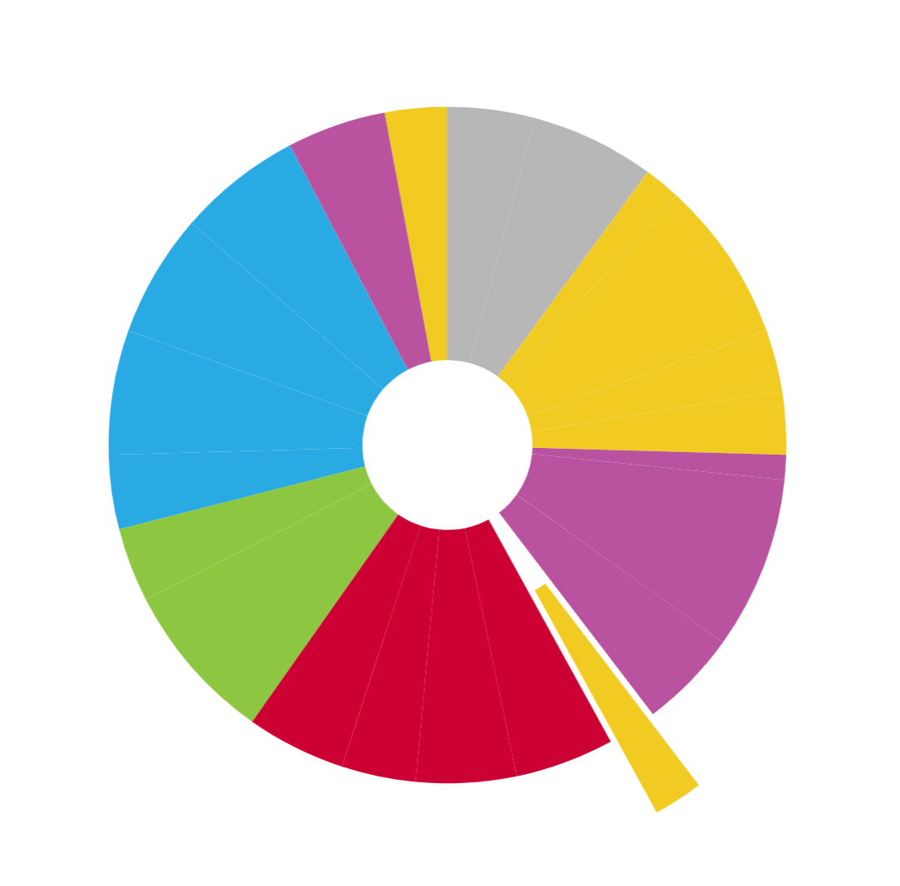
CF
Continent Formation
Question
CF version August 2021

Slide 2
How to use these slides…
The following presentation was designed to support the implementation of the MBER-Living Earth curriculum. It is NOT ready to show to students in its current form. You will notice there are two kinds of slides.
(1) Teacher Notes slides that provide information and notes for teacher and are not meant to be shown to students. These slides are marked by a colored band in the header (as displayed above on this slide).
(2) Student slides designed to facilitate student sense-making as you move through the Learning Segments. These slides are intended for use in the classroom during instruction. In the “Presenter Notes” field (under each slide) you will find useful information for each particular slide.
We have combined teacher slides and student slides into this single file so you can have almost everything you need in one place as you explore the flow of each triangle. You will need to either hide or delete the Teacher Notes slides to use it as a presentation in your classroom.
This presentation is not meant to stand alone, however. Instead, we hope you use it in conjunction with the website. As you step through the slides, reference the table on the triangle webpage. The Learning Segments and associated resources outlined in the PowerPoint directly correspond to the Learning Segments described in the table featured on the webpage. It may also help you to print out and have the student Doodle Sheet in front of you. Looking over the table as you preview the slides will help you stay oriented to the overall flow while keeping in mind the high-level goals of each learning segment and how the model is developed over the course of days.
We expect (and hope) you will modify this presentation keeping in mind the MBER philosophy. As a contributor you will be part of a community that helps improve the curriculum over time.

Slide 3
How to use these slides continued…
Please remember that these slides are not for taking “Notes.” Many of the slides are animated to allow for think time, time to write out ideas (doodle) and share with a partner or the class. The slides are meant to be interactive. When it is time to make student thinking public, we have provided a slide to type in their ideas (usually noted in electric blue text). This can also be done on a classroom whiteboard or poster paper. When possible, post the model where everyone can see it. Yes, it will be messy with revisions until the end of the triangle when you can make and post the best version of the working model, but learning is messy. Making sense of things takes time and is not always neat and simple. So, take your time, have fun, make a mess, and your students will figure it out.
We feel strongly that it is your decision regarding what to actually show students. The goal in each triangle is to engage your students in making sense of the phenomenon at hand and to have that sensemaking process be purposeful and coherent. Sometimes reading from the PowerPoint slides can actually oppose that over-arching goal. Trust your teacher instincts!
We have at times been constrained by less-than-ideal images or videos because of our commitment to keep the materials open source. You, however, can swap in whatever you like for your own classroom version!
Many teachers have reworked the slides, re-sequenced learning segments (with attention to coherent knowledge-building of course), modified materials such as doodle sheets, or invented their own tools such as model trackers. We highly encourage you to do so as you become more familiar with the units in MBER. And we invite you to post ideas about what has worked well and what could work better to the Forums on the website.
Thank you again for all of the work you do on behalf of your students! We appreciate it and hope that some of what we provide supports you in your work!

Slide 4
Symbols
We use these symbols to communicate to students the following actions:
Think
Write down
Share
Pair-Share
Work in research groups

Slide 5
Phenomenon - Question - Model
Phenomenon: Over time the surface of the Earth has gained land masses and the age of the crust is not uniform across the surface of the Earth.
Question: How did the continents form?
Model:
Earth’s crust is broken into big chunks called plates.
Plates can be moving away from each other (diverging), toward each other (converging), or sliding along each other (transforming).
New oceanic crust forms at diverging plate boundaries. As oceanic plates diverge, magma from the mantle flows up, cools, forms new oceanic crust, and fills in the gap
On average, oceanic crust is more dense than continental crust so when they converge the more dense plate (oceanic) subducts, or slides beneath, the less dense plate
Over Earth’s surface, the amount of new crust forming must be in balance with the amount of old crust being subducted back into the mantle.
New continental crust forms along converging boundaries where one plate subducts under another one. The action of subduction produces low-density magma which can rise to the surface and form new continental crust: volcanic islands, mountain ranges, and granite formations.
Once low-density rock (continental crust) forms on Earth’s surface, it can’t sink again. It is stuck on the surface because of its density.
The total amount of continental crust on Earth slowly increases over time.
Converging plates can cause continental crust (such as islands) to accumulate into larger and larger land masses (continents and supercontinents). New diverging boundaries can cause existing land masses to break apart.

Slide 6
Learning Segment 01 Overview
P
10
We are coming out of figuring out natural selection and speciation so we begin by taking stock of where we are in our study of the Earth and its Spheres

Slide 7
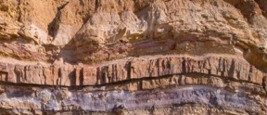
Recently we’ve been studying the biosphere.
Atmosphere
Hydrosphere
Biosphere
Geosphere
Notes:
TEACHER NOTES:
Here we make our entry or launch into this unit by connecting to the speciation model that came before. Use this slide and the ones that follow to connect students back to the idea that we can consider our study of this unique planet of ours by considering the four interconnected spheres that we have used to organize our thinking and model development.
SOURCES:
Image: Cloudy Sky
URL: https://pixabay.com/photos/clouds-blue-sky-cloudy-sky-cumulus-4258726/
Attribution: None required
Image: Seawater
URL: https://pixabay.com/photos/sea-waves-ocean-salt-water-1867215/
Attribution: None required
Image: Green Plant
URL: https://www.publicdomainpictures.net/en/view-image.php?image=35464&picture=green-plant
Attribution: None Required
Image: Sedimentary Rock
UrL: https://upload.wikimedia.org/wikipedia/commons/f/fe/Layers_of_sedimentary_rock_in_Makhtesh_Ramon_%2850749%29.jpg
Attribution: Rhododendrites, CC BY-SA 4.0 <https://creativecommons.org/licenses/by-sa/4.0>, via Wikimedia Commons

Slide 8
But Earth’s spheres are interconnected.
Geosphere
For example, we’ve learned how the geosphere formed from the accretion of space rocks.
Notes:
TEACHER NOTES: This brings us back to where we started with “Formation of the Earth” unit and the model development we did around how the Earth formed.
SOURCES:
Image: Sedimentary Rock
UrL: https://upload.wikimedia.org/wikipedia/commons/f/fe/Layers_of_sedimentary_rock_in_Makhtesh_Ramon_%2850749%29.jpg
Attribution: Rhododendrites, CC BY-SA 4.0 <https://creativecommons.org/licenses/by-sa/4.0>, via Wikimedia Commons
Animation removed

Slide 9
Atmosphere
Geosphere
Geosphere
We’ve learned that as the Earth’s geosphere was cooling, gases from volcanoes produced Earth’s early atmosphere.
Notes:
TEACHER NOTES: Next we figured out how the atmosphere formed from the gases that were present in the rocks.
SOURCES:
Image: Sedimentary Rock
UrL: https://upload.wikimedia.org/wikipedia/commons/f/fe/Layers_of_sedimentary_rock_in_Makhtesh_Ramon_%2850749%29.jpg
Attribution: Rhododendrites, CC BY-SA 4.0 <https://creativecommons.org/licenses/by-sa/4.0>, via Wikimedia Commons
Image: Cloudy Sky
URL: https://pixabay.com/photos/clouds-blue-sky-cloudy-sky-cumulus-4258726/
Attribution: None required

Slide 10
Atmosphere
Hydrosphere
Geosphere
Geosphere
When Earth cooled enough, water vapor in the atmosphere turned into a liquid which fell to Earth and formed the oceans.
Notes:
TEACHER NOTES: And then we discussed how the oceans formed.
SOURCES:
Image: Sedimentary Rock
UrL: https://upload.wikimedia.org/wikipedia/commons/f/fe/Layers_of_sedimentary_rock_in_Makhtesh_Ramon_%2850749%29.jpg
Attribution: Rhododendrites, CC BY-SA 4.0 <https://creativecommons.org/licenses/by-sa/4.0>, via Wikimedia Commons
Image: Cloudy Sky
URL: https://pixabay.com/photos/clouds-blue-sky-cloudy-sky-cumulus-4258726/
Attribution: None required
Image: Seawater
URL: https://pixabay.com/photos/sea-waves-ocean-salt-water-1867215/
Attribution: None required

Slide 11
Atmosphere
Hydrosphere
Biosphere
Geosphere
Geosphere
The oceans provided a habitat for Earth’s early living organisms, such as cyanobacteria.
Notes:
TEACHER NOTES: In our Oxygen unit we considered evidence for early life and figured out how the biosphere influenced the atmosphere over long periods of time.
SOURCES:
Image: Cloudy Sky
URL: https://pixabay.com/photos/clouds-blue-sky-cloudy-sky-cumulus-4258726/
Attribution: None required
Image: Seawater
URL: https://pixabay.com/photos/sea-waves-ocean-salt-water-1867215/
Attribution: None required
Image: Green Plant
URL: https://www.publicdomainpictures.net/en/view-image.php?image=35464&picture=green-plant
Attribution: None Required
Image: Sedimentary Rock
UrL: https://upload.wikimedia.org/wikipedia/commons/f/fe/Layers_of_sedimentary_rock_in_Makhtesh_Ramon_%2850749%29.jpg
Attribution: Rhododendrites, CC BY-SA 4.0 <https://creativecommons.org/licenses/by-sa/4.0>, via Wikimedia Commons

Slide 12
Atmosphere
Hydrosphere
Biosphere
Geosphere
Geosphere
Cyanobacteria produced Earth’s first oxygen through photosynthesis which accumulated in the oceans, then oxidized (rusted) iron and created Banded Iron Deposits found in rocks.
Notes:
TEACHER NOTES: In our Oxygen unit we considered evidence for early life and figured out how the biosphere influenced the atmosphere, hydrosphere and geospehere over long periods of time.
SOURCES:
Image: Cloudy Sky
URL: https://pixabay.com/photos/clouds-blue-sky-cloudy-sky-cumulus-4258726/
Attribution: None required
Image: Seawater
URL: https://pixabay.com/photos/sea-waves-ocean-salt-water-1867215/
Attribution: None required
Image: Green Plant
URL: https://www.publicdomainpictures.net/en/view-image.php?image=35464&picture=green-plant
Attribution: None Required
Image: Sedimentary Rock
UrL: https://upload.wikimedia.org/wikipedia/commons/f/fe/Layers_of_sedimentary_rock_in_Makhtesh_Ramon_%2850749%29.jpg
Attribution: Rhododendrites, CC BY-SA 4.0 <https://creativecommons.org/licenses/by-sa/4.0>, via Wikimedia Commons
Animation removed

Slide 13
Atmosphere
Hydrosphere
Biosphere
Geosphere
Geosphere
Once the other spheres couldn’t absorb any more, the oxygen began to accumulate in the atmosphere.
Notes:
TEACHER NOTES: In our Oxygen unit we considered evidence for early life and figured out how the biosphere influenced the atmosphere over long periods of time.
SOURCES:
Image: Cloudy Sky
URL: https://pixabay.com/photos/clouds-blue-sky-cloudy-sky-cumulus-4258726/
Attribution: None required
Image: Seawater
URL: https://pixabay.com/photos/sea-waves-ocean-salt-water-1867215/
Attribution: None required
Image: Green Plant
URL: https://www.publicdomainpictures.net/en/view-image.php?image=35464&picture=green-plant
Attribution: None Required
Image: Sedimentary Rock
UrL: https://upload.wikimedia.org/wikipedia/commons/f/fe/Layers_of_sedimentary_rock_in_Makhtesh_Ramon_%2850749%29.jpg
Attribution: Rhododendrites, CC BY-SA 4.0 <https://creativecommons.org/licenses/by-sa/4.0>, via Wikimedia Commons

Slide 14
Atmosphere
Hydrosphere
Biosphere
Geosphere
Geosphere
The increase in oxygen levels corresponds to a boom in the diversity of living things on Earth.
Notes:
TEACHER NOTES: In yet another example of the interconnectedness of the spheres we recall that once there was ample atmospheric oxygen, then there was an increase in biodiversity.
SOURCES:
Image: Cloudy Sky
URL: https://pixabay.com/photos/clouds-blue-sky-cloudy-sky-cumulus-4258726/
Attribution: None required
Image: Seawater
URL: https://pixabay.com/photos/sea-waves-ocean-salt-water-1867215/
Attribution: None required
Image: Green Plant
URL: https://www.publicdomainpictures.net/en/view-image.php?image=35464&picture=green-plant
Attribution: None Required
Image: Sedimentary Rock
UrL: https://upload.wikimedia.org/wikipedia/commons/f/fe/Layers_of_sedimentary_rock_in_Makhtesh_Ramon_%2850749%29.jpg
Attribution: Rhododendrites, CC BY-SA 4.0 <https://creativecommons.org/licenses/by-sa/4.0>, via Wikimedia Commons

Slide 15
Atmosphere
Hydrosphere
Biosphere
Geosphere
Geosphere
Living things in the biosphere began to inhabit the land masses of the geosphere.
Notes:
TEACHER NOTES: This slide comes back again to our speciation unit in which we considered changes in biodiversity over time.
SOURCES:
Image: Cloudy Sky
URL: https://pixabay.com/photos/clouds-blue-sky-cloudy-sky-cumulus-4258726/
Attribution: None required
Image: Seawater
URL: https://pixabay.com/photos/sea-waves-ocean-salt-water-1867215/
Attribution: None required
Image: Green Plant
URL: https://www.publicdomainpictures.net/en/view-image.php?image=35464&picture=green-plant
Attribution: None Required
Image: Sedimentary Rock
UrL: https://upload.wikimedia.org/wikipedia/commons/f/fe/Layers_of_sedimentary_rock_in_Makhtesh_Ramon_%2850749%29.jpg
Attribution: Rhododendrites, CC BY-SA 4.0 <https://creativecommons.org/licenses/by-sa/4.0>, via Wikimedia Commons

Slide 16
The Earth’s Spheres are Interconnected
Atmosphere
Hydrosphere
Biosphere
Geosphere
Geosphere
Life in the biosphere is causing changes to Earth’s other spheres, and in turn, the other spheres cause changes to the life in the biosphere.
Notes:
TEACHER NOTES: This is the punchline for this set of slides that is, again, meant to help student connect the ideas they have learned so far this year and see how the bigger questions we have about how Earth got to be the way it is today point us toward the interconnected nature of this amazing place.
SOURCES:
Image: Cloudy Sky
URL: https://pixabay.com/photos/clouds-blue-sky-cloudy-sky-cumulus-4258726/
Attribution: None required
Image: Seawater
URL: https://pixabay.com/photos/sea-waves-ocean-salt-water-1867215/
Attribution: None required
Image: Green Plant
URL: https://www.publicdomainpictures.net/en/view-image.php?image=35464&picture=green-plant
Attribution: None Required
Image: Sedimentary Rock
UrL: https://upload.wikimedia.org/wikipedia/commons/f/fe/Layers_of_sedimentary_rock_in_Makhtesh_Ramon_%2850749%29.jpg
Attribution: Rhododendrites, CC BY-SA 4.0 <https://creativecommons.org/licenses/by-sa/4.0>, via Wikimedia Commons

Slide 17
But there is one key thing we haven’t investigated yet in our story of how Earth and the spheres formed.
Atmosphere
Hydrosphere
Biosphere
Geosphere
Notes:
TEACHER NOTES: Here we begin the transition into the unit at hand. What have we left un-explored about the formation of the Earth and its spheres?
SOURCES:
Image: Cloudy Sky
URL: https://pixabay.com/photos/clouds-blue-sky-cloudy-sky-cumulus-4258726/
Attribution: None required
Image: Seawater
URL: https://pixabay.com/photos/sea-waves-ocean-salt-water-1867215/
Attribution: None required
Image: Green Plant
URL: https://www.publicdomainpictures.net/en/view-image.php?image=35464&picture=green-plant
Attribution: None Required
Image: Sedimentary Rock
UrL: https://upload.wikimedia.org/wikipedia/commons/f/fe/Layers_of_sedimentary_rock_in_Makhtesh_Ramon_%2850749%29.jpg
Attribution: Rhododendrites, CC BY-SA 4.0 <https://creativecommons.org/licenses/by-sa/4.0>, via Wikimedia Commons

Slide 18
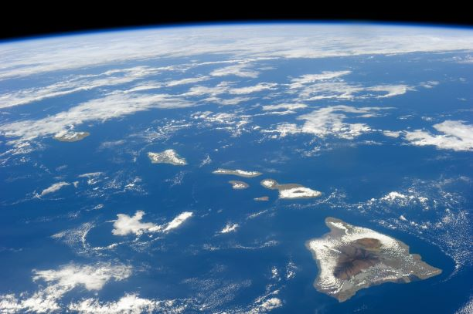
We left off with Earth consisting of volcanic islands scattered across a global ocean. There is life. There is oxygen.
Notes:
TEACHER NOTES: This is a moment to make explicit something that students may or may not remember from earlier units. When we finished our oxygen unit we were really thinking of the Earth as a watery world with few land masses. Then we kind of glossed over that fact and went through a broader timeframe in our examination of biodiversity. Here is the point that all those plants and animals had to live somewhere. Use this slide and the three that follow to make the transition back to thinking about the geosphere.
SOURCES:
Image: The Hawaiian Islands from space
URL: This is a NASA image: https://visibleearth.nasa.gov/images/82975/hawaii/82976l
Attribution: NASA image courtesy Jeff Schmaltz

Slide 19
But there are no large land masses. There are no continents.
Notes:
TEACHER NOTES: Following on from the previous slide to remind us of what the geosphere/hydrosphere was like when last we thought about it.
SOURCES:
Image: The Hawaiian Islands from space
URL: This is a NASA image: https://visibleearth.nasa.gov/images/82975/hawaii/82976l
Attribution: NASA image courtesy Jeff Schmaltz

Slide 20
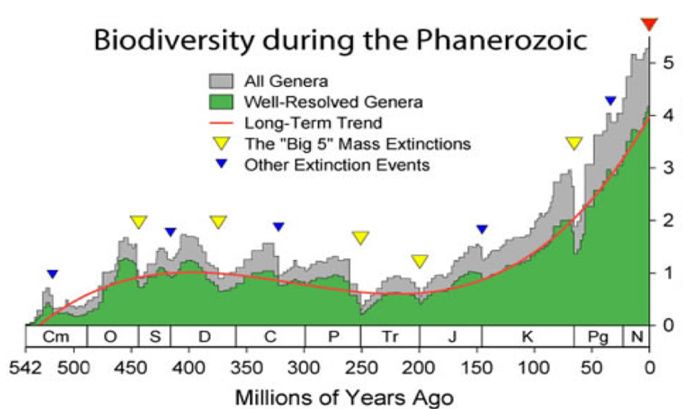
Where did all of those emerging plants and animals live?
But we know from our last unit that life on Earth has increased dramatically during this time.
Notes:
TEACHER NOTES: This is again meant to connect explicitly to the unit we just finished on speciation. Hopefully this graph is familiar to your students at this point so no need to unpack it here. We are just using the expansion of biodiversity as a way to motivate the exploration the accompanying changes in the geosphere.
SOURCES:
Image,” This image shows the biodiversity during the Phanerozoic. Note that this is a result of changes in both the rate of extinctions and the rate of new originations. The Dresbachian extinction event particular is obscured by nearly immediate replacement with new genera.”
(https://commons.wikimedia.org/wiki/File%3APhanerozoic_Biodiversity.svg)
By SVG version by Albert Mestre (Phanerozoic_Biodiversity.png) [GFDL (http://www.gnu.org/copyleft/fdl.html), CC-BY-SA-3.0 (http://creativecommons.org/licenses/by-sa/3.0/), GFDL (http://www.gnu.org/copyleft/fdl.html) or CC-BY-SA-3.0 (http://creativecommons.org/licenses/by-sa/3.0/)], via Wikimedia Commons

Slide 21
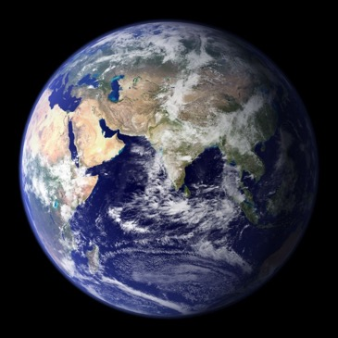
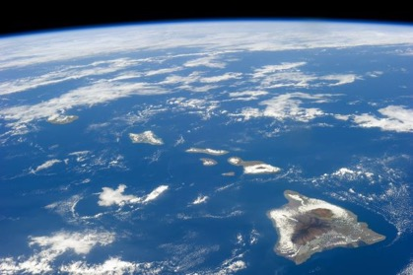
Let’s come back to the geosphere and consider how Earth’s surface was transformed over time from from…
To a planet with large land masses like we have today:
Something like this:
How did the Earth’s continents form?
(record this question in the model tracker section of your doodle sheet)
Notes:
TEACHER NOTES: Here we simply provide the driving question which is not a typical move in our curriculum. We leave it to you to decide if you want to draw it out of your students a bit more. Either way, you should highlight the phenomenon we are trying to explain which is that early Earth (post ocean formation) did not have large continents. Your students may ask how we know that. One important clue is the age of rocks and this is really what forms the more specific phenomena we explore in this unit beginning in the next learning segment. So, you may decide to go into that here, or, you may choose to wait until you begin the next learning segment and take up the idea that the rocks on the surface of the Earth are different ages and that the age of rocks in different places provides important clues to how the continents formed. This is a good opportunity to make use of your parking lot. Note that in the next learning segment the students will have a chance to develop a revision to this question based on a deeper look at data about the surface of the Earth.
SOURCES:
Image: The Hawaiian Islands from space
URL: This is a NASA image: https://visibleearth.nasa.gov/images/82975/hawaii/82976l
Attribution: NASA image courtesy Jeff Schmaltz
Image: Earth from space
URL: https://commons.wikimedia.org/wiki/File:Earth_Eastern_Hemisphere.jpg
Attribution: NASA, Public domain, via Wikimedia Commons

Slide 22
LS01 Summary
We realize that all the spheres are interconnected. We recall that when last we discussed the formation the Earth’s spheres we were talking about a world with just a small amount of dry land. We ask the broad question “how did the continents form?”

Slide 23
Learning Segment 02 Overview
Phenomenon to Question
You will need:
Doodle sheet
Crust age maps (color copies)
25
We begin by reminding ourselves of some things about the Earth we may have learned before or heard about: that the Earth’s crust is made of plates. This is an important idea so we add it to our model as the first idea.
Next we examine 2 maps that show crust age of ocean and continents. We notice that generally the ocean crust is younger than the continental crust. We spend a bit more time with the ocean crust map and generate 3 more specific questions to investigate.

Slide 24
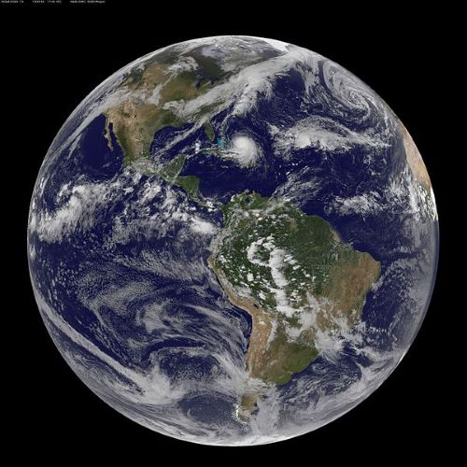
We will begin by investigating the Earth’s crust.
Notes:
TEACHER NOTES: It may be obvious but we have this transition slide to make the transition to focusing directly on the Earth’s crust. If your students have not had much Earth science before, you might consider taking a moment here to review the layers of the Earth. In particular, in this unit they are going to be invoking ideas about the crust and the mantle. They don’t need much, simply that the crust is the “outer shell” of the Earth and that it rests on the mantle that is made of a thick layer of molten rock. Here is a link to a handy explainer if you need to brush up on this info: https://www.sciencenewsforstudents.org/article/explainer-earth-layer-layer
SOURCES:
Image: Earth from space
URL: https://commons.wikimedia.org/wiki/File:Hurricane_Joaquin_9-30-15_(21655415258).jpg
Attribution: NASA Goddard Space Flight Center from Greenbelt, MD, USA, Public domain, via Wikimedia Commons

Slide 25
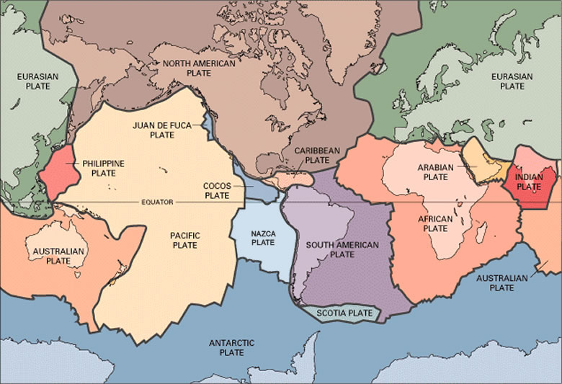
Way back in 6th grade you may have studied plate tectonics.
We need to remember these ideas to understand how the continents formed.
What is the big idea here? (Record in Doodle Box A)
Notes:
TEACHER NOTES: This unit relies on the idea that the crust is broken up into tectonic plates that are moving. Hopefully there is some science classroom experience from earlier in your students’ schooling that you can draw on here. We find that this in an idea that some kids may have even if they did not formally learn about plate tectonics. Use this slide and any other resources you deem necessary to make sure your students are on the same page about this. We do NOT develop a model for plate movement in this unit. Instead we rely on the ideas already being in place to consider how the continents formed. Use Doodle Box A as an opportunity to hear what your kids already know about this idea and proceed accordingly.
SOURCES:
Image: Plate tectonics
URL: https://www.usgs.gov/media/images/tectonic-plates-earth
Attribution: Public Domain
Give students a minute to respond to the question. We found many students remembered interesting things about plate tectonics.
The single key idea we need right now is simply: Earth’s crust is broken into big chunks called plates.
Later—not for a bit—we need to discuss that these plates are moving. It would be great if students mention this now, but it is not required.
The idea of moving plates leads to the different things that happen along plate boundaries (converge, diverge, transform), but again none of this is needed for some time.
Animation removed

Slide 26
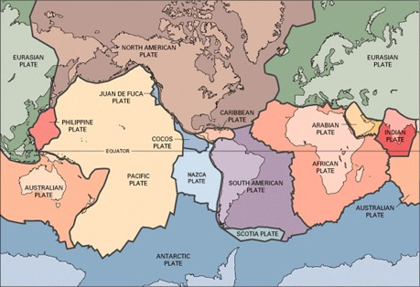
[place your students’ idea here]
This is really our first model idea. Let’s add it to our model tracker on our doodle sheet.
Notes:
TEACHER NOTES: After you attend to what your students already know and build from there, ask them to formulate a model statement. This is again, not an idea that we develop in the unit per se, instead relying on prior knowledge (and maybe review) to get this important idea into our model. Use your students language here but the ideas should be something like: Earth’s crust is broken into big chunks called plates.]
Image: Plate tectonics
URL: https://www.usgs.gov/media/images/tectonic-plates-earth
Attribution: Public DOmain
Animation removed

Slide 27
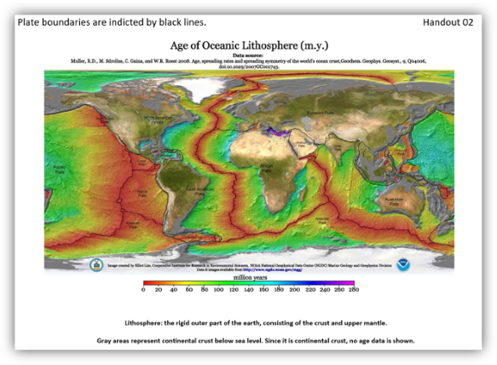
Let’s examine a map showing the age of the crust beneath the oceans (oceanic crust)
Record some things you notice in Doodle Box B.
Notes:
TEACHER NOTES: At this point we want to give students some data to explore. Pass out the handout (must be color printed) and have student do some ”notice and wonder”. At this point you may have students ask how we know about the age of rocks. This is a great question and one you should definitely engage with if it comes up. However, this is not something we take up in this unit as it is beyond the scope of the Living Earth class. You can decide how you want to finesse this without shutting kids down. Here is an article that goes over many techniques related to dating rocks: https://www.nature.com/scitable/knowledge/library/dating-rocks-and-fossils-using-geologic-methods-107924044/
Use this article to review yourself if you’d like and/or decide what ideas to bring in. If your students are asking “how do we know” questions that is GREAT and something we want to consider even if we don’t always have time to go into all of it.
SOURCES:
Image: Age of Oceanic Lithosphere
URL: https://www.ngdc.noaa.gov/mgg/ocean_age/data/2008/ngdc-generated_images/whole_world/2008_age_of_oceans_plates.pdf
Attribution: Mr. Elliot Lim, CIRES & NOAA/NCEI
Notice:
New oceanic crust is always found along a plate boundary.
But not along all plate boundaries.
The youngest ocean crust is generally located near the center of the oceans, and the crust gets older on each side, toward the continents.
Oceanic crust ranges in age from new (0 MYA) to about 220-280 MYA.

Slide 28
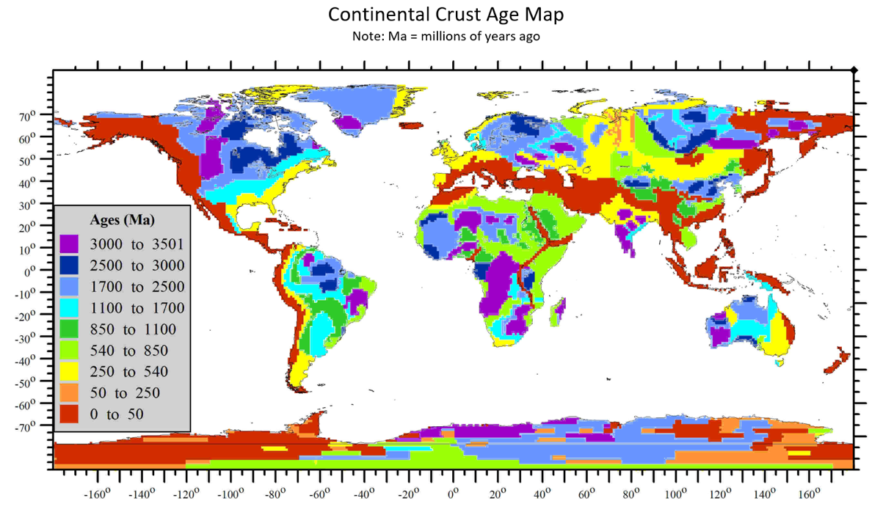
Now, let’s Examine a Continental Crust Age Map
Carefully examine the map. What do you notice? Record your ideas in Doodle Box C.
Notes:
TEACHER NOTES: Next we ask students to look at the age of continents. NOTE: the timescale on this figure. You will likely need to help students notice that 3000 MILLION is the same as 3 BILLION
Notice:
Continental crust ranges in age from new (0 MYA) to 3500 MYA.
Continental crust is mostly much older than oceanic crust.
The oldest continental crust is mostly located toward the middle of continents, with less old crust surrounding it.
The pattern isn’t very clear, and it doesn’t occur everywhere, but it is almost as if the oldest crust is in the middle of continents, and the crust gets younger as you move away from the middle toward the oceanic crust.

Slide 29
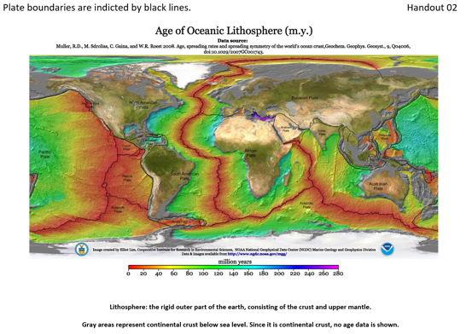
Share out some of the things you noticed.
Add new things to your list when someone says something you didn’t have.
Notes:
TEACHER NOTES: We suggest a simple popcorn or round robin share-out here. The students can keep sharing ideas until nothing new is coming up. The main ideas you want to be probing for are about the relative age of the oceanic versus the continental crust. You may need to really make sure that students are attending very carefully to the timescales on each of these maps. You also want to be attending to the positions of the age distribution. In other words, where on the maps is the youngest versus the oldest rock.
SOURCES:
Image: Age of Oceanic Lithosphere
URL: https://www.ngdc.noaa.gov/mgg/ocean_age/data/2008/ngdc-generated_images/whole_world/2008_age_of_oceans_plates.pdf
Attribution: Mr. Elliot Lim, CIRES & NOAA/NCEI

Slide 30
Based on what you noticed . . .
Something significantly different must be going on with the oceanic crust compared to the continental crust.
Notes:
TEACHER NOTES: This is meant to serve as a transition after students have shared their ideas. If students say something like this themselves, feel free to skip.

Slide 31
How can we revise our driving question based on our observations of crust age? [write your class revised question here]
Record the revised question on your doodle sheet.
Notes:
TEACHER NOTES: Recall that we essentially gave the original question to the students so this is an opportunity to pull out more specific wording from them based on the phenomena related to the crust age maps. Something like:
”What explains the patterns of crust age across the earth and what does that have to do with continent formation?"

Slide 32
Let’s turn your observations into several key questions. Write these in Doodle Box D.
Why is new crust (almost) always along a plate boundary? BUT, why ISN’T there new crust along all of these boundaries?
Why is the youngest crust in the middle of the oceans, with the crust getting older toward the continents?
Why is continental crust so much older than oceanic crust?
Notes:
TEACHER NOTES: In this move you now turn some of the observations students have made on the maps into more specific questions to guide our continuing work. You can have kids come up with these or give them, but we want something like these questions on the table as they will guide the next few steps. If you choose to give them the questions, please make sure you provide enough time for the students to process the ideas and perhaps discuss them.

Slide 33
LS02 Summary
We review the big idea that we hopefully learned before that the Earth’s crust is broken up into plates and add that as our first model idea. We find that the age of ocean crust is younger than continental crust.
This leads us to revise our driving question slightly to something like: ”What explains the patterns of crust age across the earth and what does that have to do with continent formation?"
We look more closely at ocean crust and come up with three questions to investigate:
Why is new oceanic crust (almost) always along a plate boundary?
Why isn’t there new oceanic crust along ALL plate boundaries?
Why is the youngest oceanic crust in the middle of the oceans, with the oceanic crust getting older toward the continents?

Slide 34
Learning Segment 03 Overview
Question to Model
You will need:
Crust age map, map of plate boundaries
20 minutes
We begin by exploring how plates move on Earth and look at how that is measured. By examining more maps with movement data we are able to describe the various ways that plates interact with each other based on their movements. We look again at our crust age map and see that the newest crust on Earth is found at diverging boundaries and we explore what is happening there to create new crust.

Slide 35
In order to answer our three questions, we may need to know more about the plates and what they are doing.
Our Questions:
Why is new crust (almost) always along a plate boundary? BUT, why ISN’T there new crust along all of these boundaries?
Why is the youngest crust in the middle of the oceans, with the crust getting older toward the continents?
Why is continental crust so much older than oceanic crust?
Our model so far:
[place your class ideas here]
Notes:
TEACHER NOTES: This slide is a transition from the last learning segment in preparation for going a bit deeper on the plates and how they move. It is a good time to review what you have already figured out and added to the model. Remember to swap out the language of the questions from the last learning segment if you had your students generate them.

Slide 36
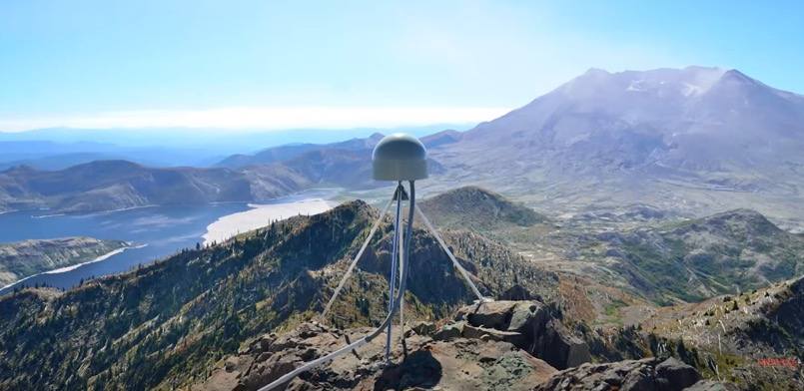
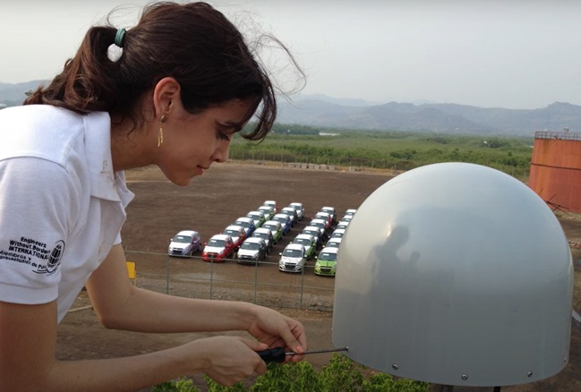
Each plate of crust moves slowly in certain directions over long periods of time. The movement of plates is measured using GPS satellites and ground-based sensors placed all over the world.
Notes:
TEACHER NOTES: We begin our study of plates and their movements with a quick foray into how scientists track the movements of plates.
SOURCES:
Images from UNAVCO educational video (NSF project, public usage)
URL: https://www.youtube.com/watch?v=BCK5Zj--w7w&list=PLzmugeDoplFOAgD_N-rBdvOTIOQt8hv8l

Slide 37
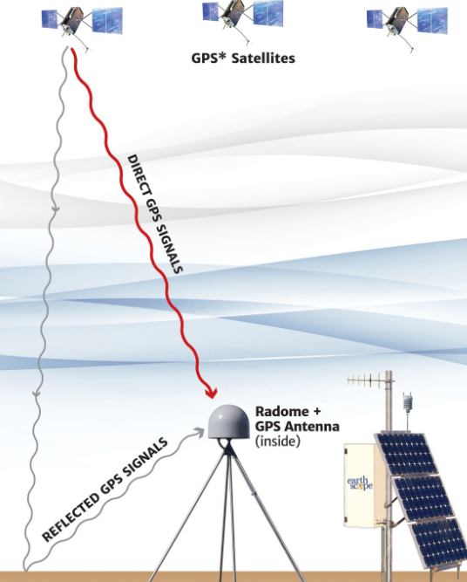
The movement of tectonic plates is measured using GPS satellites and ground-based sensors placed all over the world.
Notes:
TEACHER NOTES: We begin our study of plates and their movements with a quick foray into how scientists track the movements of plates.
SOURCES:
Left image (GPS satellites etc.) from UNAVCO educational poster (NSF project)
URL: https://www.unavco.org/education/education-resources/posters/#whatgpscantellus
Attribution: Public Domain
Right image from UNAVCO educational video (NSF project, public usage)
URL: https://www.youtube.com/watch?v=BCK5Zj--w7w&list=PLzmugeDoplFOAgD_N-rBdvOTIOQt8hv8l

Slide 38
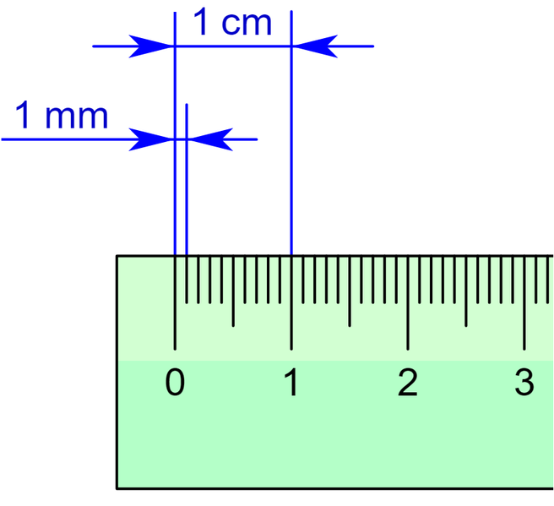
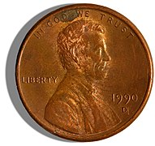
These instruments can detect millimeter-sized movements, even over long time periods.
Notes:
TEACHER NOTES: We begin our study of plates and their movements with a quick foray into how scientists track the movements of plates.
SOURCES:
Image: Penny
URL: https://commons.wikimedia.org/wiki/File:1990-issue_US_Penny_obverse_2.jpg
Attribution: Daniel Schwen, Public domain, via Wikimedia Commons
Image: Ruler
URL: Wikimedia commons: https://commons.wikimedia.org/wiki/File:Ruler_with_millimeter_and_centimeter_marks.png
Attribution: https://commons.wikimedia.org/wiki/User:Dnu72, CC BY-SA 4.0 <https://creativecommons.org/licenses/by-sa/4.0>, via Wikimedia Commons
A Penny’s diameter is about 19 mm.

Slide 39
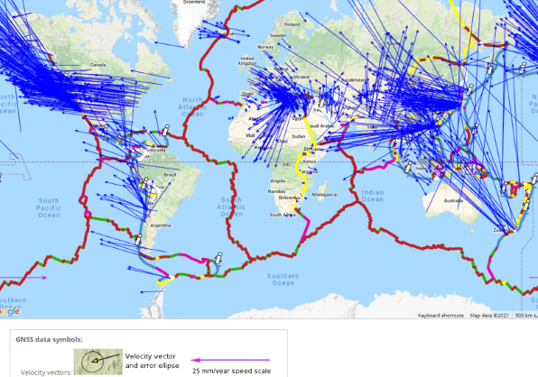
This is a sample of GPS determined velocity vectors (with respect to Africa) indicating plate motion and direction.
Doodle here?
Notes:
TEACHER NOTES: There is a fair bit to unpack about this figure but don’t feel you need to dwell on this for too long. Basically what we want out of this slide is for students to notice that the movement is fairly chaotic in preparation to make the point that because the plate movement is not uniform it means that there is a lot going on at plate boundaries. We want students to come to the idea that plates are moving in a lot of different ways.
SOURCES:
Image: Map of tectonic plate velocity vectors
URL: https://www.unavco.org/software/visualization/GPS-Velocity-Viewer/GPS-Velocity-Viewer.html
GNSS Data Source: African, GEM GSRM [all movement vectors are in relation to Africa]
Vector length 1x
Show 1 in 20 data stations.

Slide 40
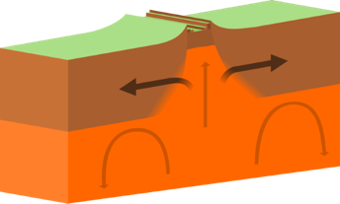
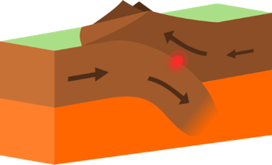
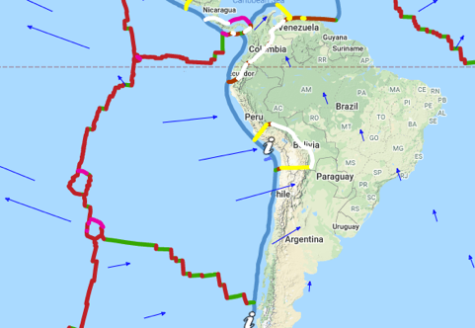
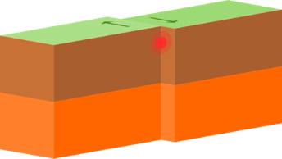
This means that in some locations, two plates will be:
Moving away from each other (diverging)
Moving toward each other (converging)
Sliding along each other (transforming)
A single plate can have all three things going on along different edges!
Nazca Plate
Notes:
TEACHER NOTES: Based on what students noticed from the last slide we can help them label these different types of movement. THE IDEAS ABOUT PLATE MOVEMENTS SHOULD HAVE ALREADY COME UP IN DISCUSSION. So this is not a lecture on plate boundaries just a moment to take stock and provide some labels. Make sure to emphasize the point on the right of the slide. Focus on the Nazca plate. You can see it is diverging on the left, converging with S. America on the right, so it must be transforming along the north and south parts of the boundary. You may want to animate this slide.
SOURCES:
Image: Map of plate velocity vector
URL: https://www.unavco.org/software/visualization/GPS-Velocity-Viewer/GPS-Velocity-Viewer.html
Image: Diverging Plates
URL: https://upload.wikimedia.org/wikipedia/commons/d/d9/Continental-continental_constructive_plate_boundary.svg
Attribution: domdomegg, CC BY 4.0 <https://creativecommons.org/licenses/by/4.0>, via Wikimedia Commons
Image: Converging Plates
URL: https://upload.wikimedia.org/wikipedia/commons/e/e2/Continental-continental_destructive_plate_boundary.svg
Attribution: domdomegg, CC BY 4.0 <https://creativecommons.org/licenses/by/4.0>, via Wikimedia Commons
Image: Sliding/Transforming Plates
URL: https://upload.wikimedia.org/wikipedia/commons/a/a4/Continental-continental_conservative_plate_boundary_opposite_directions.svg
Attribution: domdomegg, CC BY 4.0 <https://creativecommons.org/licenses/by/4.0>, via Wikimedia Commons
GNSS Data Source: Modeled, IGS08/NNR, GSRM
Vector length 0.25x
Show 1 in 20 data stations.
Animation removed

Slide 41
Let’s turn this idea into a second model statement:
[Place your students model idea here]
Add this to the model tracking section on your doodle sheet.
Notes:
TEACHER NOTES: This is basically an extension of the model idea we already have about the crust being made up of plates. This is a chance to formalize the idea that the plates are moving around and describe that movement with regard to what is happening at the boundary where two plates hit each other. Have your kids express something like this and add it to the doodle model spot: [Plates can be moving away from each other (diverging), toward each other (converging), or sliding along each other (transforming).]
Animation removed

Slide 42
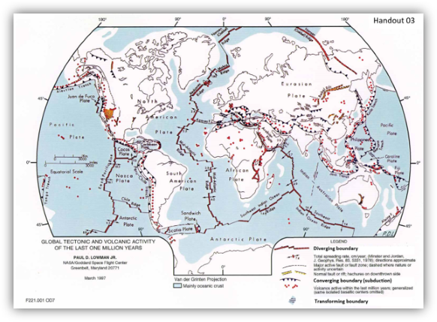
Let’s examine handout 02 which has labels along each plate boundary indicating the type of boundary.
Diverging boundaries are red and you can see arrows indicating the speed of the spreading in centimeters per year.
Converging boundaries have round marks along them.
Transforming boundaries have an arrow (or two) along the plate edge.
Notes:
TEACHER NOTES: As we begin to go deeper on the consequence for plate movement we use data displayed on this map to examine the boundaries more closely. Pass out the printed maps to your students and take a moment to make sure your students know how to read the map.
SOURCES:
Image: Map of Plate Boundary Types
URL: https://core2.gsfc.nasa.gov/research/lowman/lowman.html
Attribution: Illustration prepared by Paul D. Lowman Jr., NASA Goddard Space Flight Center. Van der Grinten projection, April 1997.
While this is a NASA based map found at https://core2.gsfc.nasa.gov/research/lowman/lowman.html
(direct image link here: https://core2.gsfc.nasa.gov/research/lowman/Lowman_map1_lg.jpg)
It appears that NASA doesn’t support this map, and has replaced it with a new map that I don’t like:
https://visibleearth.nasa.gov/images/88415/digital-tectonic-activity-map/88416w
I don’t like it because, once again, it is very difficult to see the continents.
I think we can keep using this map for now. We can probably make a map using UNVAVCO or even Google Earth. We just need to see all visible continents easily, along with plate boundaries marked.
Animation removed

Slide 43
To help us answer our 3 questions, let’s look for a relationship between the TYPE of plate boundary and where NEW OCEANIC CRUST is forming.
Notes:
TEACHER NOTES: This a a pause point to make sure it is clear what we are looking at the map to figure out. To do this they will coordinate information from two maps (supported on next slide)

Slide 44
Each person will get a highlighter.
Instructions:
On the plate boundary map, highlight the areas which have new/young oceanic crust.
Add ___ = new oceanic crust (somewhere on the map)
Use this map to help you find the new/young crust (shown in red).
Notes:
TEACHER NOTES: For this brief activity we have students coordinate information on these two maps to help them see the relationship between crust age and boundary types. Basically, RED on the oceanic crust age map means “new crust”. So, students will highlight the plate boundary map wherever they see RED on the ocean crust age map. We suggest you have students do this as individuals or at most pairs because this is detail work that might be hard for larger groups to see. It only takes a few minutes.
SOURCES:
Image: Map of Plate Boundary Types
URL: https://core2.gsfc.nasa.gov/research/lowman/lowman.html
Attribution: Illustration prepared by Paul D. Lowman Jr., NASA Goddard Space Flight Center. Van der Grinten projection, April 1997.
Image: Age of Oceanic Lithosphere
URL: https://www.ngdc.noaa.gov/mgg/ocean_age/data/2008/ngdc-generated_images/whole_world/2008_age_of_oceans_plates.pdf
Attribution: Mr. Elliot Lim, CIRES & NOAA/NCEI
Animation removed

Slide 45
What do you notice now?
Is there a relationship between the type of plate boundary and the location of new crust?
If so, what is the relationship?
Write your answers in Doodle Box E.
Notes:
TEACHER NOTES: Once students have done the highlighting activity that is supported by the previous slide and the two handouts they are ready to look for patterns. Give them a moment to collect their thoughts on the Doodle sheet. The key things we want out of this activity:
New oceanic crust is mainly found along diverging plate boundaries.
New oceanic crust is not found along converging plate boundaries.
SOURCES:
Image: Map of Plate Boundary Types
URL: https://core2.gsfc.nasa.gov/research/lowman/lowman.html
Attribution: Illustration prepared by Paul D. Lowman Jr., NASA Goddard Space Flight Center. Van der Grinten projection, April 1997.
Animation removed

Slide 46
Share out.
I’ll try to capture some things.
Add new things to your list.
Notes:
TEACHER NOTES: Have students share their ideas with the class.
Again, the key things we want out of this activity:
New oceanic crust is mainly found along diverging plate boundaries.
New oceanic crust is not found along converging plate boundaries.
SOURCES:
Image: Map of Plate Boundary Types
URL: https://core2.gsfc.nasa.gov/research/lowman/lowman.html
Attribution: Illustration prepared by Paul D. Lowman Jr., NASA Goddard Space Flight Center. Van der Grinten projection, April 1997.
Image: Age of Oceanic Lithosphere
URL: https://www.ngdc.noaa.gov/mgg/ocean_age/data/2008/ngdc-generated_images/whole_world/2008_age_of_oceans_plates.pdf
Attribution: Mr. Elliot Lim, CIRES & NOAA/NCEI

Slide 47
What is happening at diverging plate boundaries that is creating the new oceanic crust?
To answer this question, we need more data.
We need to observe what is happening in those areas.
We need a deep-sea submersible and some cameras!
Notes:
TEACHER NOTES: Transition slide to go from the data on the maps to real world observations.

Slide 48
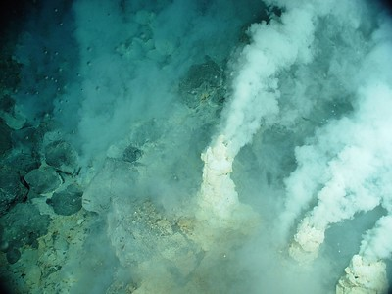
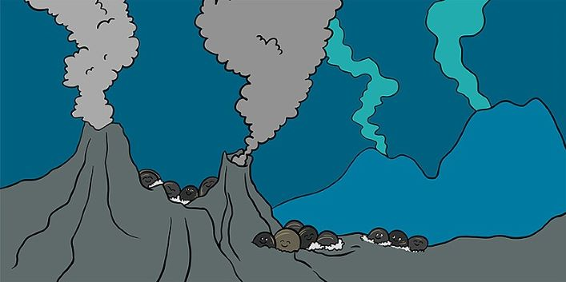
Along diverging boundaries, there are a lot of vents in the crust with very hot water and gases rising up.
Think about what that might mean.
Notes:
TEACHER NOTES: These slides are meant to help students visualize what is going on and diverging plate boundaries that are underwater.
SOURCES:
Image: White chimneys at Champagne vent site, NW Eifuku volcano.
URL: https://www.flickr.com/photos/noaaphotolib/5102285718
Attribution: Pacific Ring of Fire 2004 Expedition. NOAA Office of Ocean Exploration; Dr. Bob Embley, NOAA PMEL, Chief Scientist.
Image: Deep Sea Hydrothermal Vents Cartoon
URL: https://upload.wikimedia.org/wikipedia/commons/c/c9/A_mussel%27s_life_around_deep-sea_hydrothermal_vents.jpg
Attribution: Sébastien Duperron, Sylvie M. Gaudron and Sven R. Laming, CC BY-SA 4.0 <https://creativecommons.org/licenses/by-sa/4.0>, via Wikimedia Commons

Slide 49
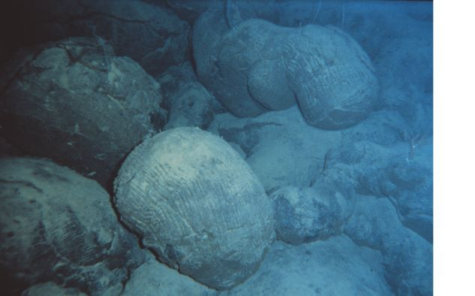
We also find a lot of rocks like this, shaped like pillows.
Notes:
TEACHER NOTES: These slides are meant to help students visualize what is going on and diverging plate boundaries that are underwater.
SOURCES:
Image: Pillow Lavas off Hawaii
URL: https://commons.wikimedia.org/wiki/File:Nur05018-Pillow_lavas_off_Hawaii.jpg
Attribution: OAR/National Undersea Research Program (NURP)

Slide 50
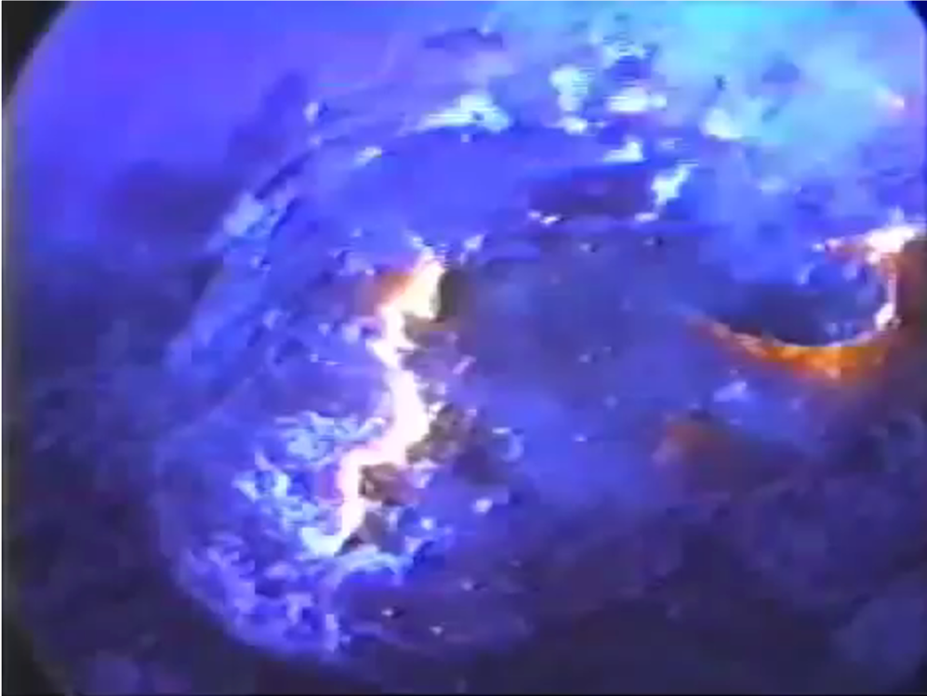
Check out this video of lava flows underwater
Notes:
TEAHCHER NOTES: Here is a link to a BBC video: https://www.youtube.com/watch?v=y3YNpzZWbmU
The image on the slide is just a static screen shot from the video. You can skip to the 1:00 minute mark and just play for 45 seconds or so to connect to the next slide and the image of pillow lava.

Slide 51
Those forming rocks we just saw look suspiciously familiar….
This is called pillow lava.
Notes:
TEACHER NOTES: These slides are meant to help students visualize what is going on and diverging plate boundaries that are underwater.
SOURCES:
Image: Pillow Lavas off Hawaii
URL: https://commons.wikimedia.org/wiki/File:Nur05018-Pillow_lavas_off_Hawaii.jpg
Attribution: OAR/National Undersea Research Program (NURP)
Animation removed

Slide 52
Back to our question… What is happening at diverging plate boundaries that is creating the new crust?
Any thoughts on this based on what we just saw? Write some ideas in Doodle Box F
(leave some space because you’ll be adding to this later)

Slide 53
In Doodle Box F, sketch a side view of a diverging boundary.
Add the label “new crust” where appropriate.
What is happening at diverging boundaries that is creating the new crust?
Then in Doodle Box F write 1-2 sentences that answer the question. We will use these to come up with a model statement.
Diverging Plate Boundary
Notes:
TEACHER NOTES: The ideas depicted here have likely already come up from your students. This is an opportunity for you to work with your students to take stock of the class thinking about diverging boundaries and represent those ideas with a sketch or drawing.
SOURCES:
Image: Mid Ocean Ridge
URL: https://picryl.com/media/new-ocean-basin-diagram-0769bd?zoom=true
Attribution: Public Domain

Slide 54
Share some ideas (What is happening at diverging boundaries that is creating the new crust?)
Notes:
TEACHER NOTES: Now that they have drawn a visualized what is happening at boundaries to create new crust, provide your students with an opportunity to describe the processes in words. These are intended to be student generated, you might want to use this slide to record what your students say.
In the past students have said things like:
When plates diverge they create a space between them for magma to flow up from below. When magma reaches the surface it cools and forms new crust (usually basalt).
As the plates diverge, magma from the mantle will begin to seep through the created space and solidify.
The faster the diverging boundaries move apart the more area of new crust there will be.

Slide 55
Let’s come up with a Model Statement to capture our ideas.
[write your class version here]
Notes:
TEACHER NOTES: This is a place to distill the ideas from the activities in this learning segment so far into a clear model statement or two. Please use the wording your students come up with but it could be something like: [New oceanic crust forms at diverging plate boundaries. As oceanic plates diverge, magma from the mantle flows up, cools, forms new oceanic crust, and fills in the gap.]

Slide 56
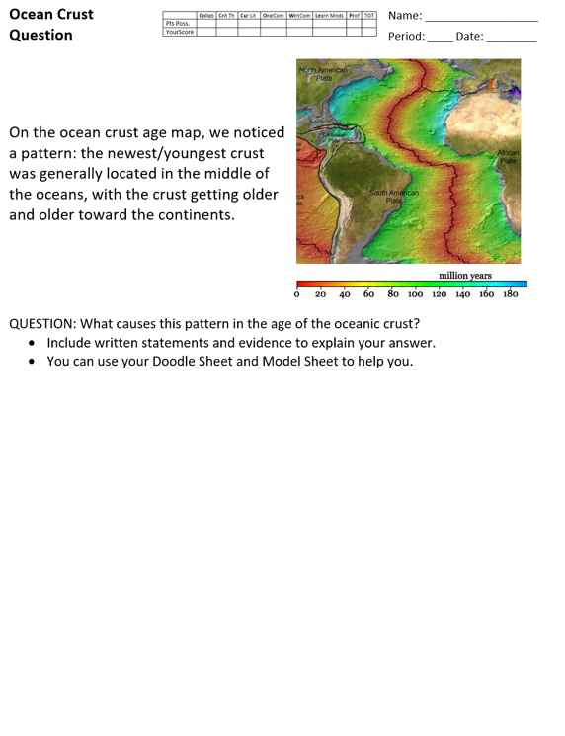
Ocean Crust Question
You will work on this quietly, on your own.
You can use your map, Doodle Sheet, and Model Sheet to help you.
Notes:
TEACHER NOTES: This is a slide to support an optional assessment opportunity. Handout is included in the downloadable files.

Slide 57
LS03 Summary
We realize that plates are moving in many ways on Earth and that causes them to have different kinds of plate boundaries: converging, diverging and sideways (transforming). We add this as a model idea. Next, we figure out that new crust is formed at diverging plate boundaries in the oceans and comes from magma that seeps up through the cracks and hardens. This becomes our third model idea.

Slide 58
Learning Segment 04 Overview
Question to Model
You will need:
Maps
Materials for the Crust Lab
55 minutes
We notice that there are other plate boundaries where new crust is forming that must be different from the diverging ones in the oceans. This, along with the crust age differences, pushes us to wonder about the differences between continental and ocean crust. We do a lab to look at some of the key rock types found in oceanic versus continental crust and consider what that might mean when the two types of plates interact at converging boundaries.

Slide 59
We started our exploration of plate boundaries with 3 questions in order to answer our DQ about continent formation.
Our Questions:
Why is new crust (almost) always along a plate boundary? BUT, why ISN’T there new crust along all of these boundaries?
Why is the youngest crust in the middle of the oceans, with the crust getting older toward the continents?
Why is continental crust so much older than oceanic crust?
Collect your thoughts about these questions in Doodle box G
We figured out…
[write your students’ ideas here]
Notes:
TEACHER NOTES: Here we pause to take stock of what we have figured out so far. Customize this to reflect your class discussions.

Slide 60
We’ve gotten about all we can out of the ocean crust age map. Let’s now go back and examine the continental crust age map.
Let’s look for a relationship between the TYPE of plate boundary and where NEW CONTINENTAL CRUST is forming.
Notes:
TEACHER NOTES: Transition to next activity with continental crust map instead to oceanic map. Remember that the timescales on these two maps are different.

Slide 61
Each person will get a highlighter (new color!)
Plate boundary map
Instructions:
On the plate boundary map, highlight the areas which have new/young continental crust.
Add ___ = new CONTINENTAL crust (somewhere on the map)
Use this map to help you find the new/young crust (shown in red).
Notes:
TEACHER NOTES: This is very similar to what they just did with oceanic crust so hopefully it will be quick. Make sure they have a DIFFERENT color highlighter to use from that activity. Basically, RED on the crust age map means “new crust”. So students will highlight the Plate Boundary Map wherever they see RED on the continental crust age map. Again, this a a chance for the students to coordinated two different data sets (plate boundary type and crust age) to look for patterns.
SOURCES:
Image: Map of Plate Boundary Types
URL: https://core2.gsfc.nasa.gov/research/lowman/lowman.html
Attribution: Illustration prepared by Paul D. Lowman Jr., NASA Goddard Space Flight Center. Van der Grinten projection, April 1997.
Animation removed

Slide 62
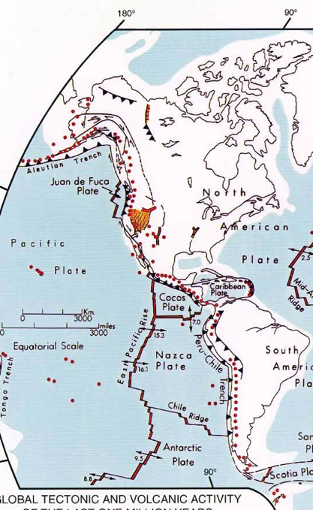
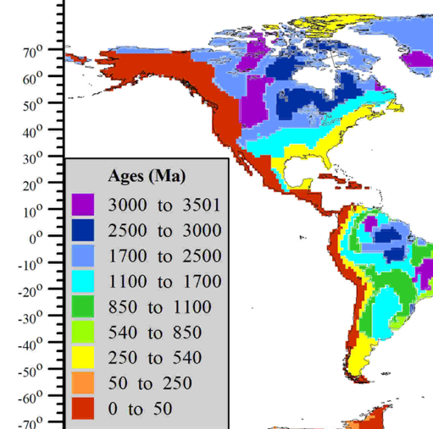
Just focus on the west coast of North & South America!
What did you notice about the type of boundary and the age of the continental crust in this area of the world?
Use this map to help you find the new/young crust (shown in red).
Add ___ = new CONTINENTAL crust (somewhere on the map)
Notes:
TEACHER NOTES: For discussion you may want to focus in on one area. They should note that the crust all along the west coast of North and South America is young AND that those areas also have converging plate boundaries.
SOURCES:
Image: Map of Plate Boundary Types
URL: https://core2.gsfc.nasa.gov/research/lowman/lowman.html
Attribution: Illustration prepared by Paul D. Lowman Jr., NASA Goddard Space Flight Center. Van der Grinten projection, April 1997.
Animation removed

Slide 63
What do you notice now?
Is there a relationship between the type of plate boundary and the location of new continental crust?
If so, what is the relationship?
How does that compare to what we found in the ocean?
Write your answers in Doodle Box H.
Be prepared to share your answers.
Notes:
TEACHER NOTES: Have the students see if the relationship they saw along North and South America holds in other parts of the world. The key thing we want out of this activity: New continental crust is mostly found near converging plate boundaries.
Also note that this is interesting because new continental crust forms at CONVERGING boundaries while new oceans crust forms at DIVERGING boundaries. So that leads us to consider what might be going on that is going on when ocean crust meets continental crust.
SOURCES:
Image: Map of Plate Boundary Types
URL: https://core2.gsfc.nasa.gov/research/lowman/lowman.html
Attribution: Illustration prepared by Paul D. Lowman Jr., NASA Goddard Space Flight Center. Van der Grinten projection, April 1997.
Animation removed

Slide 64
Now we might be wondering what is happening at converging plate boundaries that is creating the new continental crust?
To answer this question, we need more data.
First, we need to understand some of the differences between oceanic crust and continental crust by doing the Crust Lab.
Notes:
TEACHER NOTES: Use this slide as a transition to the lab. Would be best to get your kids to wonder about the differences in oceanic and continental crust before showing this slide.

Slide 65
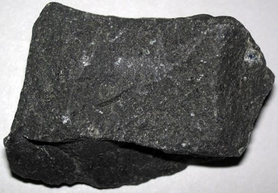
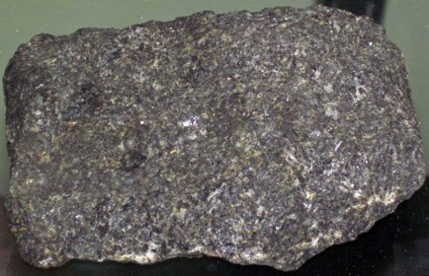
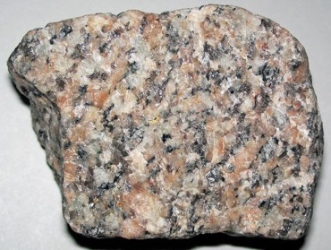
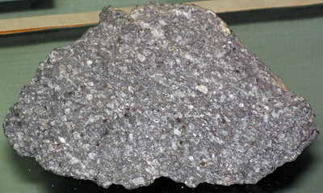
Oceanic Crust Vs. Continental Crust
Oceanic crust is mostly made of the igneous rocks basalt and gabbro.
Continental crust is mostly made of the igneous rocks granite and rhyolite.
What happens when a plate of that hits a plate of this?
Notes:
TEACHER NOTES: You may want to just take pictures of the rock samples you have so they look more similar to students. This is the set up to the lab in which they will investigate properties of these different types of rock. Be sure the reason for the lab is clear before beginning. We want to know if there are any important differences between the rocks that make up the continents compared to those that make up the oceans.
SOURCES:
Image: Basalt Rock
URL: https://upload.wikimedia.org/wikipedia/commons/9/9c/Basalt_13_%2848674789992%29.jpg
Attribution: James St. John, CC BY 2.0 <https://creativecommons.org/licenses/by/2.0>, via Wikimedia Commons
Image: Gabbro Rock
URL: https://upload.wikimedia.org/wikipedia/commons/7/71/Olivine_gabbro_%28Pigeon_Point_Sill%2C_Mesoproterozoic%2C_~1.1_Ga%3B_Pigeon_Point%2C_Minnesota%2C_USA%29_%2840770721514%29.jpg
Attribution: James St. John, CC BY 2.0 <https://creativecommons.org/licenses/by/2.0>, via Wikimedia Commons
Image: Granite Rock
URL: https://upload.wikimedia.org/wikipedia/commons/b/bf/Granite_20_%2849200364626%29.jpg
Attribution: James St. John, CC BY 2.0 <https://creativecommons.org/licenses/by/2.0>, via Wikimedia Commons
Image: Porphyritic rhyolite from the Pleistocene of Wyoming, USA.
URL: https://www.flickr.com/photos/jsjgeology/26755758577
License: https://creativecommons.org/licenses/by/2.0/
Attribution: James St. John
Animation removed

Slide 66
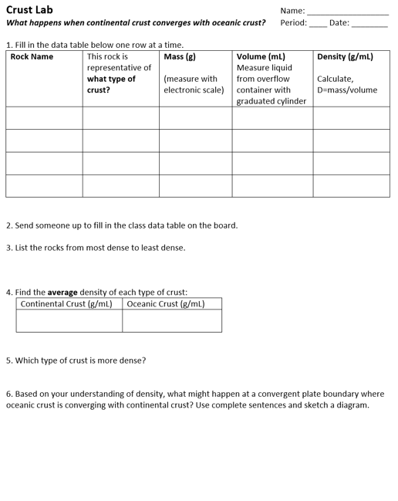
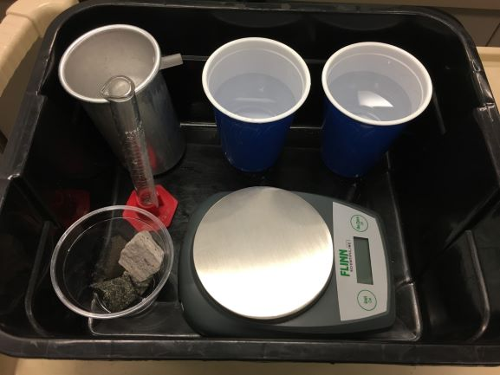
Let’s collect some data and find out!
Materials: rock samples, electronic scale, overflow container, graduated cylinder, water, and tub.
Notes:
TEACHER NOTES: Use these images or pics of your own set up to provide instructions to students on the lab. More images and complete instructions are found in the teacher guide for the crust lab. The slides that follow take the students through the lab questions step by step. You may want to do that or you may want to just discuss after students have worked through the questions on their own.
SOURCES:
Image courtesy of MBER team

Slide 67
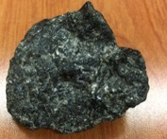
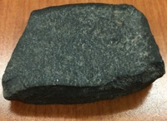
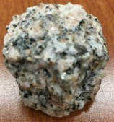
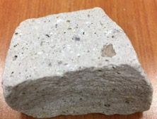
Class Data
Oceanic Crust
Continental Crust
Your Name or Group | Density of Gabbro | Density of Basalt | Density of Granite | Density of Rhyolite
Notes:
TEACHER NOTES: Use this slide to collect/display class data.
Sources:
Images courtesy of MBER team

Slide 68
Discussion Question
What are some potential sources of error in the rock densities you found?
Notes:
TEACHER NOTES: (Optional)
Depending on how your class data turns out you may want to spend a bit of time considering why different groups may have different values.
SOURCES:
Image courtesy of MBER team

Slide 69
Let’s look for patterns in our data. Remember we are interested in comparing the composition of the oceanic crust and continental crust.
[insert your class data here or elsewhere in the room so everyone can examine it together]
Notes:
TEACHER NOTES: Display your class data and look for patterns. It should come out that:
gabbro density > basalt density > granite density > rhyolite density

Slide 70
Since crust is a complex mixture of many different types of rocks (not just two as in the lab), it is easiest to compare average density values.

Slide 71
What about your average density of each type of crust?
[insert your class data here or elsewhere in the room so everyone can examine it together]
Notes:
TEACHER NOTES: Here we transition from finding the densities of individual rock types to an average density. In this case we just have two types to average together but oceanic and continental crusts will be made up of more than two types, of course.
These slides take the students through the questions on the lab one by one. You may decide to do this as a class or have a more general summary conversation at the end.

Slide 72
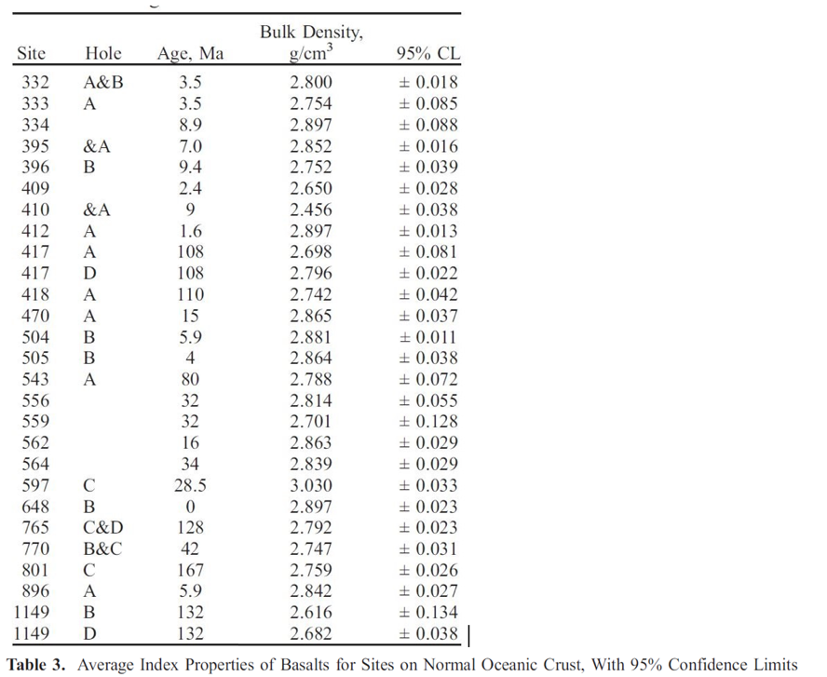
Ocean Crust Actual Density Data
Side note: g/mL = g/cm³
Crust density is calculated in two ways:
Using actual rock samples, like the table to the left (and your lab).
Measuring the speed of earthquake waves through the crust.
I found values such as:
Avg density oceanic crust: 3.0 g/mL
Avg. density continental crust: 2.7 g/mL
While there is variation in density depending on the crust composition, in general, the average density of oceanic crust is denser than the average density of continental crust.
Diff. Source
2.90 g/mL
2.83 g/mL
Notes:
TEACHER NOTES: more depth on crust density data. This gives away the pattern so make sure it has been established by your class data before showing this slide.

Slide 73
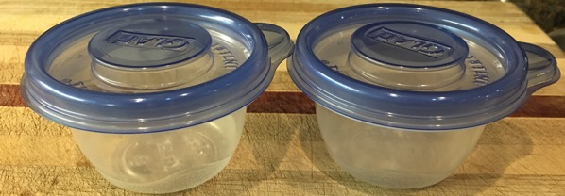
Let’s look at one more thing that happens with differences in average density:
Here are two empty plastic containers.
They both have the same average density (total mass/total volume)
What if we dropped them in a tub of water?
Notes:
TEACHER NOTES: These slides contain a short demo to show that objects with different densities will float at different heights. You can do the demo in class yourself or use these slides.
Image courtesy of MBER team

Slide 74
Video clip
Notes:
TEACHER NOTES: These slides contain a short demo to show that objects with different densities will float at different heights. You can do the demo in class yourself or use these slides.
SOURCES:
Video courtesy of MBER team

Slide 75
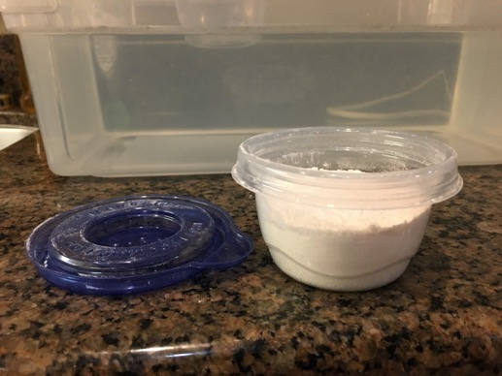
One is filled with flour to increase its average density.
More mass in the same volume—therefore higher average density.
Place this container in the tub of water next to the container with no flour (lower density).
Notes:
TEACHER NOTES: These slides contain a short demo to show that objects with different densities will float at different heights. You can do the demo in class yourself or use these slides.
SOURCES:
Image courtesy of MBER team
Animation removed

Slide 76
Video clip
Notes:
TEACHER NOTES: These slides contain a short demo to show that objects with different densities will float at different heights. You can do the demo in class yourself or use these slides.
SOURCES:
Video courtesy of MBER team

Slide 77
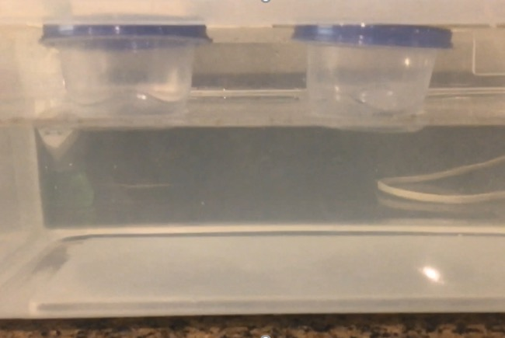
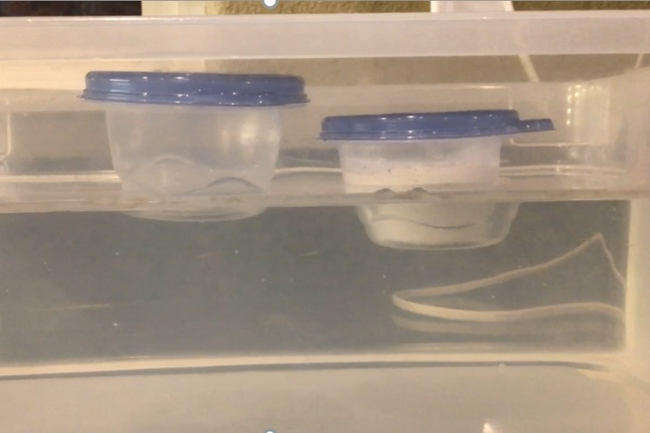
Did you catch that?
Each plastic container has the same average density.
Container on the right has higher average density than container on the left.
Notes:
TEACHER NOTES: These slides contain a short demo to show that objects with different densities will float at different heights. You can do the demo in class yourself or use these slides.
Image courtesy of MBER team

Slide 78
Find lab question 6.
oceanic crust density > continental crust density
Side view:
In this question, oceanic crust is converging with continental crust. This is the starting situation.
Continental Crust
Oceanic Crust
MAGMA
Notes:
TEACHER NOTES: In this situation make sure to recall that the plates are moving. The idea that students will hopefully come up with is that at a converging plate boundary, the more dense oceanic crust would be pushed beneath the less dense continental crust. You may want to take the opportunity to introduce the word SUBDUCTION here

Slide 79
So what do we think is happening?
Continental Crust
Oceanic Crust
MAGMA
Starting condition
what happens
[insert the drawing your class has agreed on here]
Notes:
TEACHER NOTES: Here we want to formalize the main idea that comes out of the lab and the demo. What happens with two plates that have different average densities (and therefore sit higher or lower on the magma substrate) collide with each other? This is the idea of SUBDUCTION and you will probably want to introduce that word here.

Slide 80
Let’s add this as a model statement on our Doodle
[Place the wording for this model statement that your students developed here]
Notes:
TEACHER NOTES:
Suggested wording…use what your kids come up with
[On average, oceanic crust is more dense than continental crust so when they converge the more dense plate (oceanic) subducts, or slides beneath, the less dense plate ]

Slide 81
LS04 Summary
We find that the types of rock that make up oceanic plates are more dense than the ones that make up continental plates and infer that on average continental crust is less dense than oceanic crust. We explore what might happen when those two types of plates collide and figure out that one must slide under the other one. We add this as a new model idea.

Slide 82
Learning Segment 05 Overview
Question to Model
You will need:
Doodle sheet
20 minutes
We return to the crust age maps again and use what we have figured out so far to explain the age distribution on oceanic plates. We also explore what happens to the matter in the plate when it subducts. Specifically, we wonder why the Earth does not run out of magma and whether the Earth is getting bigger because of all the new crust.

Slide 83
Taking stock of progress on our driving question
[place your class driving question here]
We saw that than on average, oceanic crust is more dense than continental crust.
You predicted and sketched what would happen when oceanic crust converges with continental crust.
How does this help us understand the pattern of crust age of oceanic plates? Where does new oceanic crust come from and
where does it go?
Notes:
TEACHER NOTES: Let’s return to the Driving Question which should be something like: ”What explains the patterns of crust age across the earth and what does that have to do with continent formation?"
Have the students consider what they have and have not figured out about the age of the crust and continents so far.
Once students have had a chance to think about this question, we may want to pause and ask students: what information do we need to help us answer this question? This question is relevant because the next several slides dig into some of the additional information we would need to make a good prediction.

Slide 84
Let’s go back to the diverging boundary.
Remember that at diverging plate boundaries, magma rises to the surface, forming new crust. Let’s combine this idea with the one we just figured out about converging oceanic and continental plates.
Transition here?
Diverging Plate Boundary
In Doodle Box I consider:
Why isn’t Earth expanding in size (diameter) as more oceanic crust forms at diverging boundaries?
And why doesn’t the mantle run out of magma?
Take turns and share your answer with your group. Listen and learn from each other.
Notes:
Animation removed
Teacher notes only/do not share this info with students (their ideas are what matter at this point; everything will be unpacked over the next several slides):
While we are gaining new crust at diverging boundaries, we are losing crust at converging boundaries. These processes balance each other out, so the Earth is not growing in diameter through these processes.
Another way to say this is: while the new oceanic crust is forming along diverging plate boundaries, along converging plate boundaries oceanic crust is subducting. Since the processes are in balance, there is no net accumulation of new crust.
[Although there IS an accumulation of continental crust over time, more on that LATER!]
NOTE: There is also a “conservation of mass” issue embedded here which could also be used to help answer the question.
Please note that there are legitimate ways a student might answer this question that do not involve plate tectonics in the way described above. For example, a student might say: The Earth is not expanding in size (diameter) from new crust forming at diverging boundaries because the planet is not actually gaining any new matter that it didn’t already have. The matter that is forming the new crust was previously in the mantle, and as it flows upward to form new crust, the existing crust would sink or collapse to fill any “voids” of magma that flowed upward. The existing solid crust that collapsed downward would be deeper in the planet and would be subject to higher temperatures; temperatures high enough to turn solid rock into magma. Therefore the collapsed crust would re-melt into magma, so the mantle will not run out of magma, and the Earth would not increase in diameter.
This student statement shows good logical scientific thinking, and should be commended. However, you would want to nudge the student toward thinking about the crust recycling process that develops from old oceanic crust sinking/subducting at converging plate boundaries to help the student understand a nuance of plate tectonics.

Slide 85
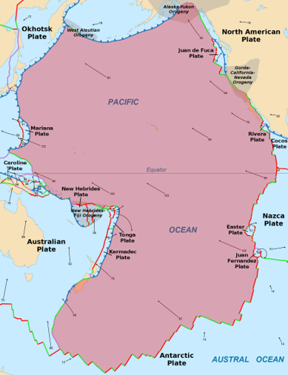
To help understand how crust is gained and lost at different plate boundaries, let’s zoom in on the small Juan de Fuca Plate on the northeastern edge of the Pacific Plate. (The area in pink on this map is the Pacific Plate.)
Notes:
The goal of the next few slides is to provide a nearby/local example of how the processes we have been describing can play out for one plate. Juan de Fuca was selected because it is a small plate off Northern CA (and extends northward toward Canada) which illustrates all three plate boundary types. If you are not in CA consider finding a similar plate boundary near you.
SOURCES:
Image: Pacific Plate
URL: https://upload.wikimedia.org/wikipedia/commons/1/19/PacificPlate.png
Attribution: Alataristarion, CC BY-SA 4.0 <https://creativecommons.org/licenses/by-sa/4.0>, via Wikimedia Commons
Animation removed

Slide 86
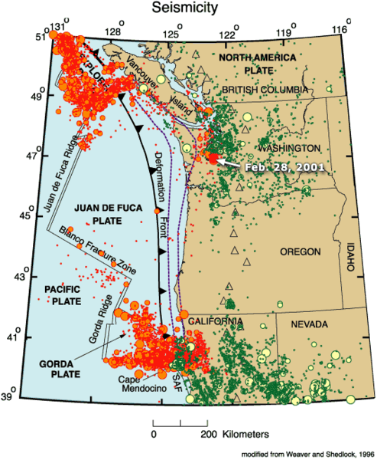
The Juan de Fuca Plate stretches from Northern California to Canada.
Seattle, Washington
Portland, Oregon
Sacramento, California
Notes:
The red and green dots on this map indicate locations of earthquakes that have occurred (mostly small earthquakes).
The main point of this slide, however, is to show that Juan de Fuca is near northern California, Oregon, and Washington.
SOURCES:
Image: Juan de Fuca Plate
URL: https://commons.wikimedia.org/wiki/File:Juan_de_fuca_plate.png

Slide 87
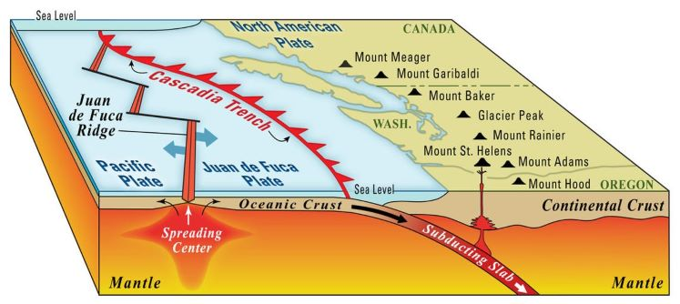
Side View of the Juan de Fuca Plate
In our lab we figured out that on average the continental crust is less dense than the oceanic crust so when those two types of plates converge the oceanic crust slips underneath the continental crust. But what happens to that plate that is sliding underneath? Take a look at this diagram to help you think about that.
Notes:
TEACHER NOTES: This could be a moment to use “turn and talk to your neighbor”.
Hopefully students will say that the sinking oceanic crust will melt back into the magma layer and help replenish the magma in the mantle.
SOURCES:
Image: The subduction zone creating the Cascade Range volcanoes.
URL: https://www.usgs.gov/science-support/osqi/yes/national-parks/mount-rainier-geology
Attribution: Public Domain
Animation removed

Slide 88
Side View of the Juan de Fuca Plate
After it forms (at a divergent boundary) oceanic crust is eventually melted back into the mantle (at a convergent boundary).
How does this idea help us with our question about why Earth doesn’t run out of magma? Revise your thinking in Doodle Box I
Notes:
TEACHER NOTES: Hopefully students will say that the sinking oceanic crust will help replenish the magma in the mantle (without having the crust collapse or something!).
SOURCES:
Image: The subduction zone creating the Cascade Range volcanoes.
URL: https://www.usgs.gov/science-support/osqi/yes/national-parks/mount-rainier-geology
Attribution: Public Domain
Animation removed

Slide 89
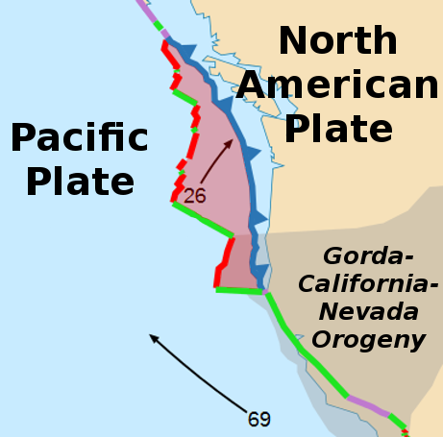
The Juan de Fuca Plate
The plate is moving 2.6 cm/year to the northeast.
New oceanic crust is forming along the diverging boundary (red).
Oceanic crust is subducting along the converging boundary (blue).
We are gaining oceanic crust on one side of the plate, but what is happening on the other side?
How might this observation help us think about the question we had about the Earth getting bigger? Record your answer in Doodle Box I.
Red = divergent boundary
Blue = convergent boundary
Green = transform boundary
Rates on map in mm per year
Notes:
TEACHER NOTES: The Juan de Fuca Plate is pink on the map (be sure to clarify that it is not the same as the pink plate on the earlier slide…that was the pacific plate). It is wedged in between the Pacific and North America Plates. The Juan de Fuca Plate is moving away from the Pacific Plate, and toward the North American Plate.
Note that the numbers on the map are in mm/year (for example, 26 mm/year = 2.6 cm/year).
SOURCES:
Image: Juan de Fuca Plate
URL: https://upload.wikimedia.org/wikipedia/commons/4/49/JuanDeFucaPlate.png
Attribution: Alataristarion, CC BY-SA 4.0 <https://creativecommons.org/licenses/by-sa/4.0>, via Wikimedia Commons
Animation removed

Slide 90
Side View of the Juan de Fuca Plate
Over geologic time, the recycling of oceanic crust helps keep Earth’s systems stable by removing some elements (through subduction) and reintroducing others (through volcanic eruptions).
Notes:
SOURCES:
Image: The subduction zone creating the Cascade Range volcanoes.
URL: https://www.usgs.gov/science-support/osqi/yes/national-parks/mount-rainier-geology
Attribution: Public Domain
Animation removed

Slide 91
Return to Ocean Crust Age
Given what we have just figured out, how would you explain the age pattern of oceanic crust?
Return to Doodle Box B and write a brief note to explain why we see the pattern.

Slide 92
What is a general statement we can say related to what we just discussed in Box I (why Earth isn’t expanding in diameter or running out of magma)?
Let’s come up a new model statement:
[Place the wording for the model statement that your students developed here]
Record these on the model tracker on your doodle sheet
Notes:
Something like this is the model statement we are looking for:
Over Earth’s surface, the amount of new crust forming must be in balance with the amount of old crust being subducted back into the mantle.
Some of the things students have said in the past:
Higher density plates are closer to earth’s core while lower density plates are higher.
The plate that is more dense is the plate that gets subducted at a convergent boundary.
When two plates converge, the denser plate will go underneath (subduct) the less dense plate and then it will start melting into magma.
As plates diverge they converge with other plates and balance the amount of crust gained with the amount of crust lost.

Slide 93
LS05 Summary
By examining what is happening at a specific plate boundary off the coast of North America, we figure out that the subducting plate melts and gets recycled so that replenishes the magma and keeps the Earth in balance.

Slide 94
Learning Segment 06 Overview
Question to Model
You will need:
Doodle sheet
Maps
25 minutes
We realize that we still don’t know how continents are formed and why the land there is so much older than in the ocean. We consider what is happening deep in the crust when an oceanic plate subducts under a continental plate. We also consider what happens when two oceanic plates converge. Next we go back to our crust age map to look for patterns and finalize our ideas about how continents form.

Slide 95
So we figured out what is happening when oceanic and continental plates converge based on their densities. Now, we want to figure out how that plate to plate interaction relates to the formation of new continental crust.
Recall the pattern of crust age we saw when looking at both the maps and the plate boundaries. (see doodle box H to refresh your memory)
Notes:
TEACHER NOTES: transition slide. In the last learning segment we figured out how to explain the age pattern of oceanic crust. Now we start wondering about the pattern of new crust along the converging oceanic and continental crust.

Slide 96
Taking stock of what we have and have not figured out:
We figured out:
New ocean crust forms along diverging plate boundaries (and we know why…)
What happens to old oceanic crust and why isn’t it as old as continental crust.
That crust formation is in balance with crust subduction, so Earth isn’t growing in size (diameter).
What we haven’t figured out:
HOW DOES CONTINENTAL CRUST FORM?
Notes:
TEACHER NOTES: This is a more detailed transition slide. You may only want to show one of these or combine them in some way depending on how well you think your students are following the progression of model ideas.

Slide 97
But you have some clues. Take a look at your map.
What do you find right next to almost every converging boundary?
Red dots indicate very recent volcanoes.
Are they are always on a particular side of the plate boundary?
Notes:
TEACHER NOTES: Have them go back to their maps and see what is happening at converging plate boundaries and what other features seem to be present in those locations. They should note that volcanoes are only on one side of the plate boundary (with the exception of volcanoes that form in the middle of plates…we are not going to address these)
SOURCES:
Image: Map of Plate Boundary Types
URL: https://core2.gsfc.nasa.gov/research/lowman/lowman.html
Attribution: Illustration prepared by Paul D. Lowman Jr., NASA Goddard Space Flight Center. Van der Grinten projection, April 1997.
Animation removed

Slide 98
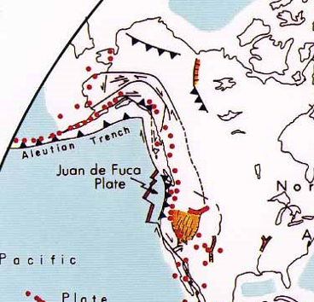
Let’s focus on the coast of Alaska:
Red on our crust age map indicates that this area has new continental crust
You can see some of those volcanoes are on the mainland of Alaska, while others are volcanic islands (the Aleutian Island Chain).
Notes:
TEACHER NOTES: Just focusing in on one part of the map for the next few slides.
SOURCES
Image: Map of Plate Boundary Types
URL: https://core2.gsfc.nasa.gov/research/lowman/lowman.html
Attribution: Illustration prepared by Paul D. Lowman Jr., NASA Goddard Space Flight Center. Van der Grinten projection, April 1997.
Image: Age of Oceanic Lithosphere
URL: https://www.ngdc.noaa.gov/mgg/ocean_age/data/2008/ngdc-generated_images/whole_world/2008_age_of_oceans_plates.pdf
Attribution: Mr. Elliot Lim, CIRES & NOAA/NCEI

Slide 99
What happens above the subducting plate when ocean crust converges with continental crust?
Why would those red blobs of magma rise up to the surface?
What might the fact that it rises tell us about the density of that part of the magma compared to the areas around it?
Notes:
TEACHER NOTES: Hopefully students will say something like: The rising magma must be significantly less dense than the oceanic crust around it.
SOURCES
Image: The subduction zone creating the Cascade Range volcanoes.
URL: https://www.usgs.gov/science-support/osqi/yes/national-parks/mount-rainier-geology
Attribution: Public Domain
Animation removed

Slide 100
What about ocean to ocean convergence?
Continental Crust
This was the starting condition (side view) for oceanic to continental convergence based on the plate densities.
This is the starting condition for oceanic to oceanic convergence.
What do you predict would happen?
Oceanic Crust
MAGMA
Oceanic Crust
Oceanic Crust
MAGMA
Notes:
TEACHER NOTES:
Animation removed.
This slide is intended to prompt students to begin thinking about density in relation to the colliding two plates of oceanic crust. Density helped students understand the oceanic to continental crust convergence, so maybe it will help here.
From the bottom image, it would appear that the two blocks of crust are floating at the same height, implying they have the same average density. In this case, if we were to squeeze these blocks together, it seems like 2 things could potentially occur: Both plates start to rise along the boundary, OR both plates start to sink along the boundary. In nature, while that could start to occur, soon, one plate or the other will “slip” beneath the other plate (subduct). Again, ask students: is there a way we can predict which plate would subduct? This leads us into the next slide.
Science note for the teacher regarding the TOP image:
Oceanic crust is made of rocks that are (on average) more dense than the rocks that make up the continental crust. So if both are “floating” above gooey crust & mantle material (“magma” in images above), continental crust will float higher than ocean crust. A similar phenomenon: place a wood block and a Styrofoam block of the same size in water. They will both float. However, the wood block will float lower in the water than the Styrofoam because the Styrofoam is much less dense than the wood block. The force from Earth’s gravitational attraction pulls more strongly on materials with more mass per volume. Be careful about using water to represent magma without being very clear that you are using it an an analog to magma as it is not uncommon for kids to come away with the idea that the plates are floating on water.

Slide 101
At oceanic to oceanic convergent boundaries, one of the plates will subduct (go beneath).
What would cause the plate on the left to subduct, instead of the plate on the right?
Notes:
TEACHER NOTES: This is really a quick question—don’t dwell on this slide. Instead move to the next slide to make progress on figuring this out.
SOURCES:
Image: Oceanic Plates
URL: https://pubs.usgs.gov/gip/dynamic/understanding.html
Attribution: U.S. Geological Survey
Animation removed

Slide 102
Another factor to consider:
Over time, sediment from the ocean builds up on the ocean floor. The sediment fills pores (small holes or voids) in the basalt & gabbro and other rocks.
How would sediment filling the pores in rocks impact the density of a plate of oceanic crust?
So, the oceanic crust age can help us predict which is denser and will subduct.
Notes:
TEACHER NOTES: Consider adding animation to this slide to delay showing the last note. Natural debris in ocean water will slowly settle to the bottom (again, based on the density of the debris versus the density of ocean water). The material can be solid particles of weathered rock, shells built by marine organisms, and/or the remains of plankton and other dead organisms. The rate of this settling of sediment is on average relatively consistent throughout the oceans. Once ocean crust forms at a mid-ocean ridge spreading center, the sediment begins to accumulate on top of the new ocean crust. At a microscopic level, rocks are somewhat porous. Over time, the sediment fills more and more of the pores in the rocks. Since empty space is being replaced by matter, the density of the oceanic crust increases with more sediment. Since there is more sediment accumulated over time, older oceanic crust will be more dense than younger oceanic crust.
SOURCES:
Image: Oceanic Plates
URL: https://pubs.usgs.gov/gip/dynamic/understanding.html
Attribution: U.S. Geological Survey
Animation removed

Slide 103
Given the information about sediment on the last slide, it seems not all oceanic crust has the same density.
Does this help us answer the question regarding which plate will likely subduct?
Notes:
TEACHER NOTES: Consider using this question for a “turn and talk to your neighbor” moment.
Regarding the question:
Oceanic crust, on average, is more dense than continental crust.
However, there are significant variations in density within and between any given chunk of crust.
Why?
Crust is made of rocks of different types, in different amounts.
Therefore, one block of oceanic crust will have slightly different rock types in different proportions and will therefore have a different density than a different block of oceanic crust.
SOURCES:
Image: Oceanic Plates
URL: https://pubs.usgs.gov/gip/dynamic/understanding.html
Attribution: U.S. Geological Survey
Animation removed

Slide 104
Here is a side view of two oceanic plates converging:
It is very similar to the ocean/continent boundary, but instead, of mountain ranges of volcanoes, we get arcs of islands.
Notes:
SOURCES:
Image: Oceanic Plates
URL: https://pubs.usgs.gov/gip/dynamic/understanding.html
Attribution: U.S. Geological Survey
Animation removed

Slide 105
To go back to the part of Alaska we were looking at, notice that there are 41 active volcanoes in this region.
Notes:
SOURCES:
Image: Alaska’s historically active volcanoes
URL: https://pubs.usgs.gov/fs/2004/3084/
Attribution: U.S. Geological Survey, 2004, revised 2009

Slide 106
Here is a side view of two oceanic plates converging:
Why is molten rock forming above the subducting plate in the first place?
Notes:
TEACHER NOTES: This gets a little didactic feeling through here so try and make use of the questions sprinkled throughout to make this more interactive. We made this choice because of time pressures we know teachers are facing and because we have stepped through a lot of earlier information. Make sure students are really making sense of these ideas.
SOURCES:
Image: Oceanic Plates
URL: https://pubs.usgs.gov/gip/dynamic/understanding.html
Attribution: U.S. Geological Survey
Animation removed

Slide 107
Here is a side view of two oceanic plates converging:
1. Temperature in the crust increases with depth.
2. Water significantly lowers the melting point of rock.
Water in the subducting plate causes some of the plate to melt into magma at relatively low temperatures—well before the plate is deep enough to fully melt. Where will that magma go?
Notes:
TEACHER NOTES: This gets a little didactic feeling through here so try and make use of the questions sprinkled throughout to make this more interactive. We made this choice because of time pressures we know teachers are facing and because we have stepped through a lot of earlier information. Make sure students are really making sense of these ideas.
SOURCES:
Image: Oceanic Plates
URL: https://pubs.usgs.gov/gip/dynamic/understanding.html
Attribution: U.S. Geological Survey
Animation removed

Slide 108
Crust is a mixture of different materials that don’t all melt at the same temperature.
The materials that melt first form a magma less dense (more like granite & rhyolite) than the original oceanic crust rock (basalt & gabbro) that is subducting.
The rest of the oceanic plate keeps subducting, where it eventually re-melts into basalt/gabbro magma (oceanic crust magma!) in the mantle.
Notes:
TEACHER NOTES: This gets a little didactic feeling through here so try and make use of the questions sprinkled throughout to make this more interactive. We made this choice because of time pressures we know teachers are facing and because we have stepped through a lot of earlier information. Make sure students are really making sense of these ideas.
SOURCES:
Image: Oceanic Plates
URL: https://pubs.usgs.gov/gip/dynamic/understanding.html
Attribution: U.S. Geological Survey
Animation removed

Slide 109
Some of the low-density magma accumulates just below the surface and never erupts.
It slowly cools in huge magma chambers, forming continental crust rocks (such as granite).
These cooling magma chambers thicken the continental crust from below with more low-density rock.
Notes:
TEACHER NOTES: This is a specific example of non-volcanic crust accumulation. The Sierra Nevada mountains of California (mostly consisting of granite) were originally formed in huge underground magma chambers. The slow cooling of these magma chambers over millions of years allowed the crystals in granite to grow to their relatively large sizes, visible without a microscope. Eventually the magma chambers were pushed upward through plate tectonics (specifically through subduction long ago), exposing them, and the softer materials around the granite has been washed away through weathering and erosion, exposing the granite mountains.
SOURCES:
Image: Oceanic Plates
URL: https://pubs.usgs.gov/gip/dynamic/understanding.html
Attribution: U.S. Geological Survey
Animation removed

Slide 110
This is kind of opposite of what you might think:
LOSING oceanic crust through subduction at converging plate boundaries PRODUCES continental crust!
The volcanic island arcs, mountain ranges, and slow-cooling granite magma chambers consist of low-density continental crust.
Note: not all islands & volcanoes form this way. Some form above “hot spots” in the mantle, and usually produce islands of mostly basalt (such as the Galapagos, Hawaii and Iceland).
Notes:
TEACHER NOTES: This is the big payoff of the previous few slides. You might want to see if you can get kids to consider how this idea squares up with the notion that subducting plates are recycled. Overall this is a small amount of the matter that ends up accumulating but when we are talking about the VAST amounts of time that this has been happening, we see an overall build up of continental crust.
PLEASE NOTE: We elected to not spend time on hot spot volcanoes. You may want to quickly let kids know that there are volcanoes (and other themal features) that are not at plate boundaries.
For more information:
https://www.nationalgeographic.org/encyclopedia/hot-spots/
https://oceanexplorer.noaa.gov/facts/volcanic-hotspot.html
SOURCES
Image: Oceanic Plates
URL: https://pubs.usgs.gov/gip/dynamic/understanding.html
Attribution: U.S. Geological Survey
Image: The subduction zone creating the Cascade Range volcanoes.
URL: https://www.usgs.gov/science-support/osqi/yes/national-parks/mount-rainier-geology
Attribution: Public Domain
Animation removed

Slide 111
This helps explain why continental crust is so much thicker than oceanic crust:
Notes:
TEACHER NOTES: Again, this is about the accumulation that has occurred over very long periods of time. Continental crust can be up to 70 km thick. Oceanic crust is only 7-10 km thick.
So based on that, continental crust can be up to 10 times the thickness of oceanic crust.
SOURCES
Image: Continental and Oceanic Crust
URL: https://commons.wikimedia.org/wiki/File:Continental_and_oceanic_crust.png
Attribution: USGS and me. I made a better labeling., CC0, via Wikimedia Commons

Slide 112
We need a model statement about this:
[write your class version here]
Notes:
TEACHER NOTES: The model statement could be something like: [New continental crust forms along converging boundaries where one plate subducts under another one. The action of subduction produces some low-density magma which can rise to the surface and form new continental crust: volcanic islands, mountain ranges, and granite formations.]
Animation removed

Slide 113
Taking stock of what we have and have not figured out:
We figured out:
We have figured out how oceanic crust forms and can explain its age pattern on the ocean floor, and why we don’t have really old oceanic crust (it subducts back into the mantle).
We have also figured out how low-density continental crust forms.
What we haven’t figured out:
Why continental crust can be so much older than oceanic crust.
Why the oldest continental crust is mostly located toward the middle of continents, with less old crust surrounding it.
ALSO, what happens to old continental crust—does it subduct back into the mantle like oceanic crust?
Notes:
TEACHER NOTES: We have included a lot of these checkpoints in this unit because there is a lot to keep track of on our way to fully explaining continent formation. Use as you see fit and feel free to modify based on how your students at tracking the ideas.

Slide 114
Let’s Return to the Continental Crust Age Map
(review what you noticed in Doodle Box C)
Notes:
TEACHER NOTES: Now we return to the full pattern of continental crust age. Give your students a chance to review and revise what they noticed before.
SOURCES:
URL: http://www.lithosphere.info/TC1-age-and-temperature.html
By Irina M. Artemieva
Also documented in this research article:
Artemieva, I.M. (2006). Global 1°×1° thermal model TC1 for the continental lithosphere: Implications for lithosphere secular evolution. Technophysics, 416, 245-277.

Slide 115
Now let’s examine this same map in a time sequence.
The first image shows only the oldest crust (purple), the next one adds in the 2nd oldest crust (dark blue), etc. so you can see a time sequence of the continental crust.
Note: The land masses would NOT have been in these same locations.
The plates are constantly moving positions!
Notes:
TEACHER NOTES: This is just setting up the next slide which shows the full time sequence.
SOURCES:
Images courtesy of MBER team based on
URL: http://www.lithosphere.info/TC1-age-and-temperature.html
By Irina M. Artemieva
Also documented in this research article:
Artemieva, I.M. (2006). Global 1°×1° thermal model TC1 for the continental lithosphere: Implications for lithosphere secular evolution. Technophysics, 416, 245-277.
We made these different layered slides from the original.
Animation removed

Slide 116
While you examine the age sequence of continental crust, describe what you notice in Doodle Box K
Notes:
TEACHER NOTES: you could simply display this slide or you could make handout of it. You might consider animating this. The sequence goes from left to right by rows.
SOURCES:
Images courtesy of MBER team based on
URL: http://www.lithosphere.info/TC1-age-and-temperature.html
By Irina M. Artemieva
Also documented in this research article:
Artemieva, I.M. (2006). Global 1°×1° thermal model TC1 for the continental lithosphere: Implications for lithosphere secular evolution. Technophysics, 416, 245-277.
We made these different layered slides from the original.

Slide 117
While you examine the age sequence of slides, describe what you notice in Doodle Box K.
Be prepared to share your answers.
Notes:
TEACHER NOTES: directions for what to do with observations.
Animation removed

Slide 118
Share out. I will try to capture some things. Add new things to your list.
Notes:
TEACHER NOTES: This is a chance for you to hear from groups about what they are noticing.
SOURCES:
Images courtesy of MBER team based on
URL: http://www.lithosphere.info/TC1-age-and-temperature.html
By Irina M. Artemieva
Also documented in this research article:
Artemieva, I.M. (2006). Global 1°×1° thermal model TC1 for the continental lithosphere: Implications for lithosphere secular evolution. Technophysics, 416, 245-277.
We made these different layered slides from the original.

Slide 119
What happens when two continental plates collide? Remember the plates are THICK and the same average density.
Notes:
TEACHER NOTES:
Very briefly we need to establish that when two CONTINENTAL plates converge there is NO subduction the land just buckles and folds causing mountains to form. We just give them this info here because they have all they need in their model to understand why this happens. The crust is thick and the same average density since the sedimentation process that makes older oceanic cruse more dense is not happening in the same way on land.
SOURCE:
https://upload.wikimedia.org/wikipedia/commons/a/ab/Collision_of_two_plates_in_Pakistan.jpg

Slide 120
Based on what you noticed, you are going to focus on answering three questions.
Write these questions in Doodle Box L.
Discuss with your group and decide on answers based on your observations and our model so far.
Why is continental crust so much older than oceanic crust?
Why is there more continental crust over time?
Based the answers to those questions, how did the continents form?
Consider how you would convert these ideas to model statements to complete our model.
Notes:
TEACHER NOTES: This is a chance for the students to use all the info they have just found out about continental crust to put the final pieces of the puzzle together. Make sure to give them time to really discuss these questions.
Animation removed

Slide 121
Let’s add new model statement(s):
[write your class version here]
Notes:
TEACHER NOTES: Our suggestions:
Once low-density rock (continental crust) forms on Earth’s surface, it can’t sink again. It is stuck on the surface because of its density.
The total amount of continental crust on Earth slowly increases over time.
This final statement was teacher generated at the end of the sequence: Converging plates can cause continental crust (such as islands) to accumulate into larger and larger land masses (continents and supercontinents). New diverging boundaries can cause existing land masses to break apart.

Slide 122
LS06 Summary
We see that as oceanic crust subducts it causes some low density rock to rise and collect or erupt. The resulting crust often rises above sea level and becomes new land (either a volcanic mountain range or island). We also realize that this explains why the continental crust is so much thicker than the oceanic crust and that over time the movement of the plates causes the land to accumulate into larger and larger masses. This accounts for why the oldest rock is found in the interior of continents and the youngest at the edge near oceanic plates. We add the final model ideas.

Slide 123
Learning Segment 07 Overview
MODEL to PHENOMENON
30 minutes
We use our model to answer our driving question.

Slide 124
Taking stock one more time
Can we answer some of the questions we had along the way?
Why is new crust (almost) always along a plate boundary? BUT, why ISN’T there new crust along all of these boundaries?
Why is the youngest crust in the middle of the oceans, with the crust getting older toward the continents?
Why is continental crust so much older than oceanic crust?
Notes:
TEACHER NOTES: This is a chance to circle back to some questions we had at the beginning that might help to scaffold the answer to the big driving question. Use at your discretion.

Slide 125
So…How DID the Earth’s continents form?
We now have a model to answer this question!
Notes:
SOURCES
Image: Earth
URL: https://www.pexels.com/photo/earth-wallpaper-41953/
Attribution: None required. [https://www.pexels.com/photo-license/]

Slide 126
Let’s use our model to answer the driving question.
[place you class driving question here]
Notes:
TEACHER NOTES: return to your driving question. Choose your own adventure for assessment but note that there is a quiz included in the downloadable materials.

Slide 127
LS07 Summary
We fit all the pieces together to explain where continental crust comes from and how it accumulates over time to make the large land masses we see today.

